Slide 1
Syllabus
Electronic Devices & Circuits – I
Course Pre –requisite
Basic Electrical Engineering
Applied Physics

Slide 2
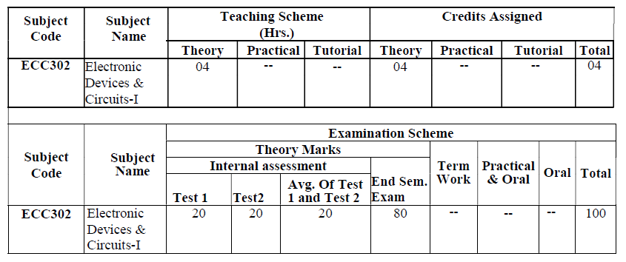

Slide 3
Course Outcomes
1. Understand operation & applications of diodes, regulators, transistors in order to design basic circuits
2. Analyze & design various biasing circuits for BJT & FET.
3. Design & demonstrate small signal model of BJT & FET amplifier.
4. Design, construct and characterize electronic circuits according to specification

Slide 4
1. Diode and material science (06 )
1.1 Study of various types of resistor, capacitor and inductors.
1.2 Basic fabrication steps of passive elements.
1.3 PN junction Diode characteristics, small signal model

Slide 5
2 . Rectifier, Filters and Regulator (08)
2.1 Analysis and design of rectifier circuit with Filters (L, LC, C,CLC,CRC)
2.2 Concept of load and line regulation in power supply circuits.
2.3 Analysis and design of zener voltage regulator

Slide 6
3. Transistor biasing and design (08)
3.1 Operation of BJT, FET (N-CHANNEL, P -CHANNEL) with characteristics and equation.
3.2 Bipolar Junction Transistor: BJT characteristics, DC/AC load line, DC analysis and design of fixed bias, collector to base bias and voltage divider bias, stability factor analysis
3.3 Junction Field Effect Transistor: Analysis and design of self bias and voltage divider bias, zero temp drift biasing.

Slide 7
4 . Transistor modeling and Small signal analysis of amplifier ( 12 )
4.1 Hybrid and hybrid-pi model of BJT with graphical representation.
4.2 Small signal model of FET with graphical representation.
4.3 Small signal analysis (Zi, Zo, Av and Ai) of CE, CB, and CC configurations using hybrid-pi model of BJT
4.4 small signal (mid-frequency) analysis of CS, CD and CG amplifiers using FET

Slide 8
5.High frequency response of BJT and FET amplifiers (08)
5.1 High frequency hybrid-pi equivalent Circuits of BJT and FET, Miller effect and Miller capacitance, gain bandwidth product
5.2 Effects of capacitors on frequency response of single stage amplifier using BJT and FET
5.3 Analysis of single stage amplifiers at HF and gain bandwidth product

Slide 9
6. Design of small signal amplifiers (06)
6.1 Design of single stage RC Coupled CE amplifier.
6.2 Design of single stage RC Coupled CS amplifier. (USE of parameters from data sheet compulsory)

Slide 10
Textbooks :
1. D. A. Neamen, “Electronic Circuit Analysis and Design,” Tata McGraw Hill, 2ndEdition.
2. A. S. Sedra, K. C. Smith, and A. N. Chandorkar, “Microelectronic Circuits Theory and Applications,” International Version, OXFORD International Students, 6thEdition
3. R. S. Dudhe and M. Farhan, “Electronic Devices and Circuits,” Synergy Knowledgeware,
1st Edition, 2013.

Slide 11
Reference Books:
Boylestad and Nashelesky, “Electronic Devices and Circuits Theory,” Pearson Education, 11th Edition.
2. A. K. Maini , “Electronic Devices and Circuits,” Wiley.
3. S Salivahanan, N Suresh Kumar, “Electronic Devices & Circuits”, Fourth Edition, McGrawHill Education.
4. A. Rockett, “Material Science of Semiconductors,”, Springer, 1stEdition, 2009
5. A. Mottershead, “Electronic Devices and Circuits; An Introduction

Slide 12
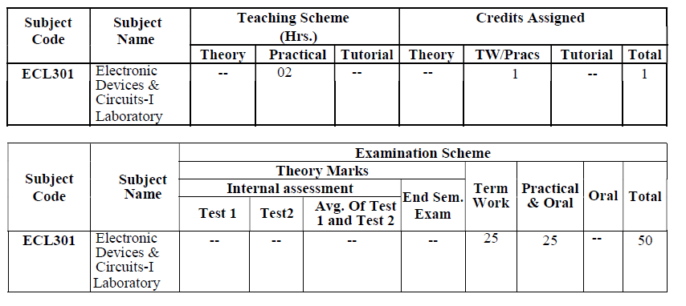
Laboratory Plan

Slide 13
Laboratory plan
Maximum of 8 practicals including minimum 2 simulations should be conducted based on
following topics
Study of different measuring instruments such as CRO, Function Generator, Multimeter, and Power Supply. (Compulsory)
Filter circuits
Biasing of BJT and FET
Frequency response
Zener regulator
Single stage amplifiers

Slide 14
Mini Project
Minimum One project based on:
Design of single stage CE and CS amplifier
Design of filter and regulator circuits
Design of power supply
Any other relevant topic based on syllabus
Note : Small project should be considered as a part of term-work.

Slide 15
Term Work:
At least 08 Experiments including 02 simulations covering entire syllabus must be given during the “Laboratory session batch wise”. Computation/simulation based experiments are also encouraged.
Application oriented one mini-project can be conducted for maximum batch of four students.

