Slide 1
telemetry and Data Acquisition System

Slide 2
Introduction
Telemetry is presentation of measured values at location remote from site of measurement. Greek words ‘Tele’: remote, ‘meter’: measuring. e.g., doctor analyzing data of patient from remote location
Telemetry involves three steps:
a. converting measured quantity to signal
b. Transmission of that signal over proper channel
c. Its reconversion to actual data for recording, displaying(CRT) for graphical analysis and further computation

Slide 3
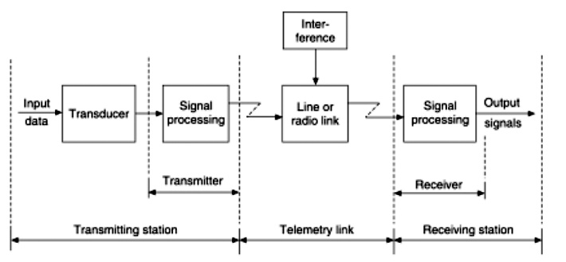
Block diagram of telemetry system

Slide 4
Characteristics Of Telemetry
Simple System Setup and Configuration
Strong environmental rating
Storage and streaming
Radio transmission
Data Security

Slide 5
Factors influencing Telemetry system design
Primary criteria for choice and design is accuracy.
System is decided whether transmitted data is in Analog or Digital domain.
For digital data to be transmitted, error detection, recognition and correction capability make system accurate.
Selection of apt. bandwidth for data channel and data link to avoid crosstalk.
Power levels must be low to reduce noise generation.
S/N ratio of the system must be high.

Slide 6
The Concept of Multiplexing
Multiplexing to refer to the combination of information streams from multiple sources for transmission over a shared medium
  Multiplexer is a mechanism that implements the concept
Demultiplexing to refer to the separation of a combination back into separate information streams
  Demultiplexer to refer to a mechanism that implements the concept

Slide 7
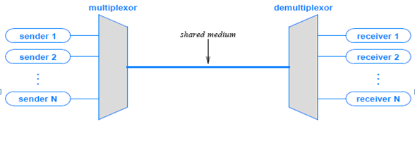
The Concept of Multiplexing
Figure 1 illustrates the concept
each sender communicates with a single receiver
all pairs share a single transmission medium
multiplexer combines information from the senders for transmission in such a way that the demultiplexer can separate the information for receivers

Slide 8
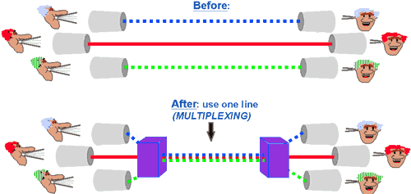
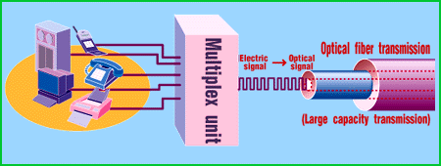
Multiplexing in networks
Main purpose is ?
Sharing the medium

Slide 9
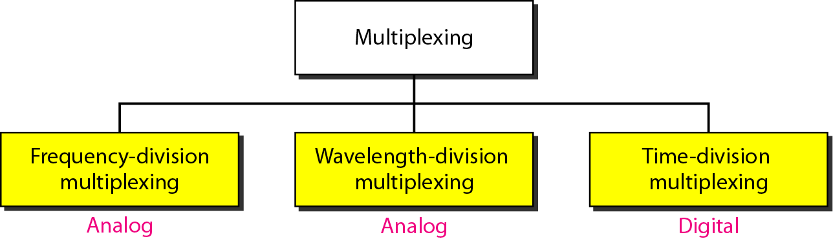
The Basic Types of Multiplexing
TDM and FDM are widely used
WDM is a form of FDM used for optical fiber

Slide 10
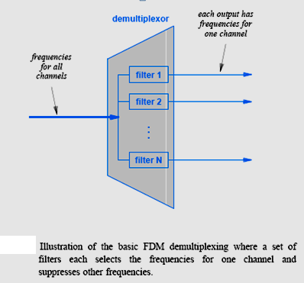
Frequency Division Multiplexing

Slide 11
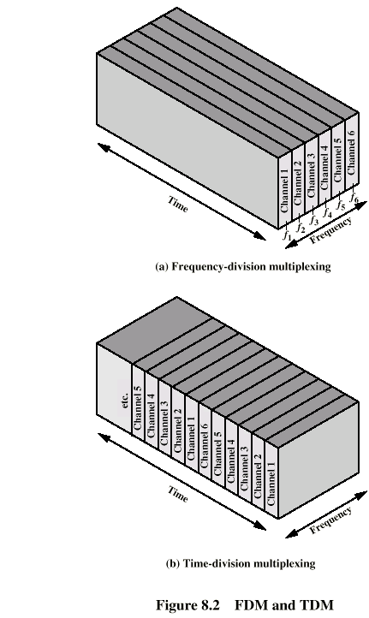
Frequency Division Multiplexing

Slide 12
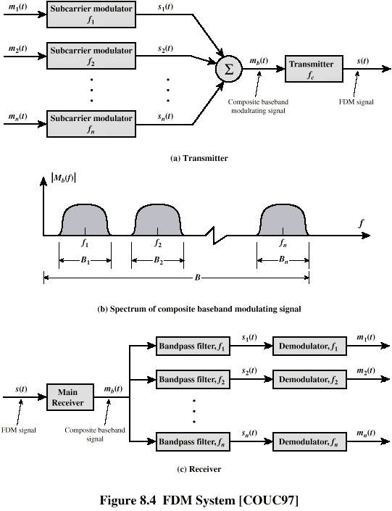
Frequency Division Multiplexingq

Slide 13
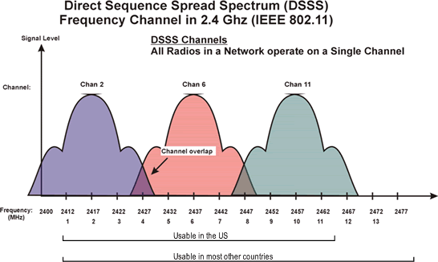
Example usage of Multiplexing in DSSS (used in cell phone technology)

Slide 14
Frequency Division Multiplexing
  ADVANTAGES
  A large number of signals can be transmitted simultaneously
  FDM does not need synchronization between its transmitter and receiver for proper operation
  Demodulation of FDM is easy
  DISADVANTAGES
  Large bandwidth
  Intermodulation Distortion
  Requirement of large number of modulators and filters
  Problem of crosstalk

Slide 15
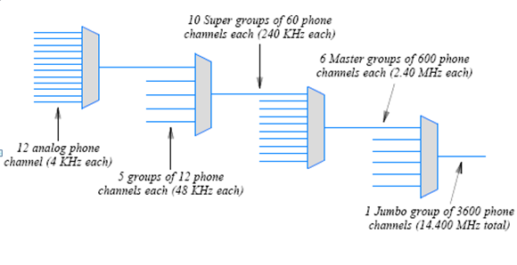
Hierarchical FDM

Slide 16
Time Division Multiplexing
  TDM is a technique used for transmitting several message signals over a single communication channel by dividing the time frame into slots, one slot for each message signal

Slide 17
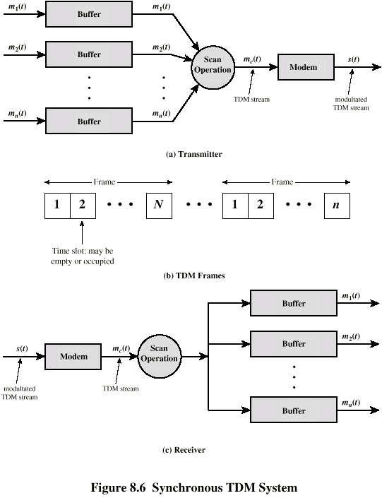
TDM System

Slide 18
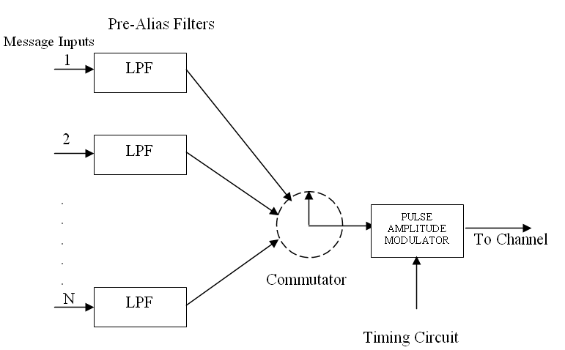
TDM-PAM: Transmitter

Slide 19
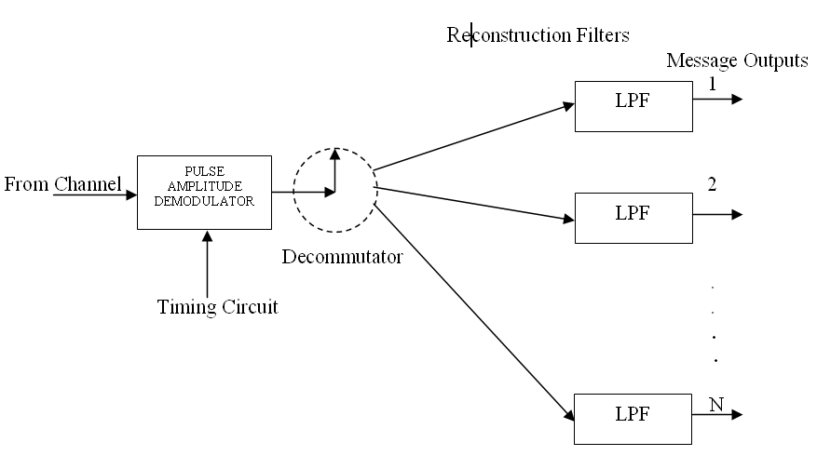
TDM-PAM : Receiver

Slide 20
Samples of Signal -1

Slide 21
Samples of signal - 2
Ts
Ts

Slide 22
Multiplexing of TWO signals
0
Ts
2Ts

Slide 23
Time Division Multiplexing
  ADVANTAGES
  Full available channel bandwidth can be utilized for each channel
  Intermodulation distortion is absent
  TDM circuitry is not very complex
  The problem of crosstalk is not very severe
  DISADVANTAGES
  Synchronisation is essential for proper operation
  Due to slow narrowband fading, all the TDM channels may get wiped out

Slide 24
Types of telemetry systems
Landline Telemetry System: Power Lines, Telephone Lines and Electrical Wires. Distance ranges from 50m to 1 km e.g., labs, industries.
Types: Current, Voltage & position.
Radio-Frequency System: Radio links from1 km to 50 km at 4MHz. For distance >50 Km Microwave links are used 890 MHz to 30GHz. Repeaters are installed after every 30 to 60 km for long distance transmission.

Slide 25
LANDLINE TELEMETRY SYSTEM

Slide 26
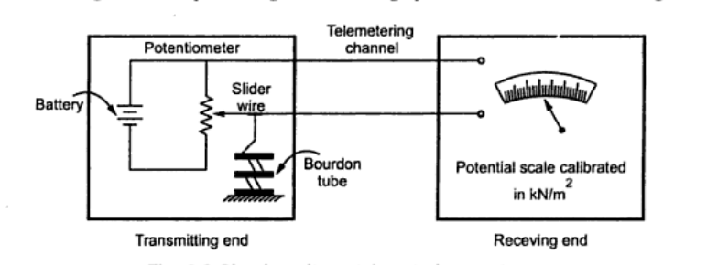
Voltage telemetry system
Measured Variable is transmitted in form of voltage
At transmitting end, Slide wire is connected in series with battery.
Slide wire is further connected to Bourdon tube for pressure measurement.
When pressure changes, slider actuates the slider of potentiometer
change in Voltage is transmitted at the receiver end.
Circuit of Voltage Telemetry System

Slide 27
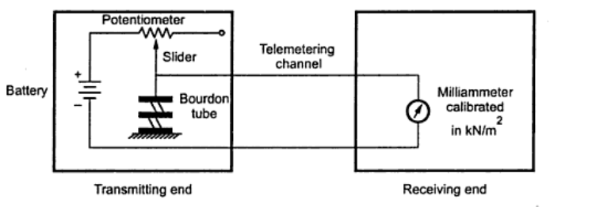
Current telemetry system
Working is almost same as of Voltage telemetry system
When pressure changes Borden tube moves sliding contact thereby value of current changes
This current passes through pair of wires and measured by milliammeter.
Circuit of Current Telemetry System

Slide 28
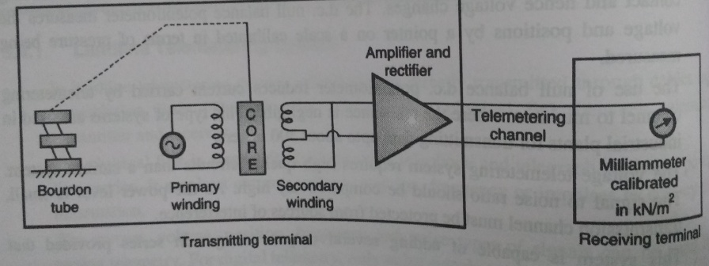
Current telemetry system
In a Motion Balance System the slidewire is replaced by a position detector like an LVDT.

Slide 29
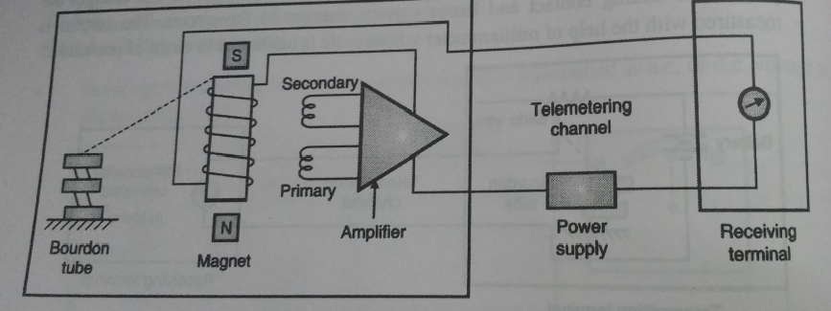
Current telemetry system
In Force Balance system , bourdon tube connected to force coil. Pressure changes, bourdon tube displaces and rotates the force. Results in change in flux. A part of the current output is fedback to force coil which produces force opposing the bourdon tube input

Slide 30
Demerits and merits
Merits:
Effective for short distance measurement
V and I can be easily transmitted
Circuitry required is simple
Wide variety of primary sensing elements are available to measure reqd. variable.
Demerits:
Demands high S/N ratio that is difficult to calibrate.
Need to be protected from EMI, noises and distortions in the channel.
Multiplexing is difficult
Limited frequency response

Slide 31
R.F. TELEMETRY SYSTEM

Slide 32
R.F. TELEMETRY SYSTEM
No physical link between telemeter transmitter and receiver.
Link is established through radio links.
Examples : in spacecrafts, rockets and missiles corrective actions can be taken from stations with help of R.F. Links
In instrumentation the o/p of transducer is
considered as modulating signal.

Slide 33
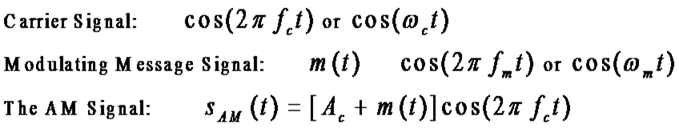
R.F. TELEMETRY SYSTEM
Modulation schemes:
When signal is in continuous form:
Amplitude Modulation
Angle Modulation
When signal is in form of pulses:
Pulse modulation
AM : amp. of high-carrier signal is varied acc. to
instantaneous value of modulating message signal m(t)
A_{c}

Slide 34
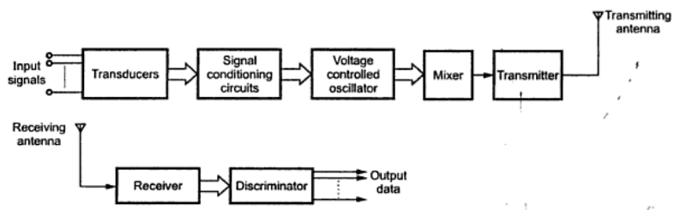
Frequency telemetry system block diagram:
The disadvantage of fm telemetry system is capacity of channels offered is less

Slide 35
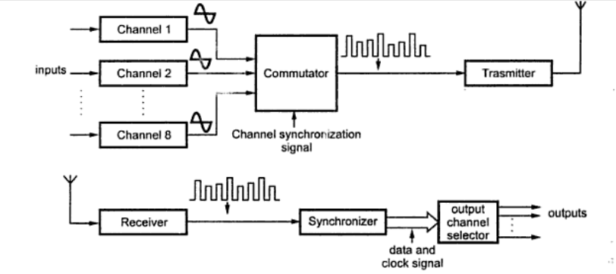
Pulse telemetry system
Pam telemetry system: Employs TDM technique

Slide 36
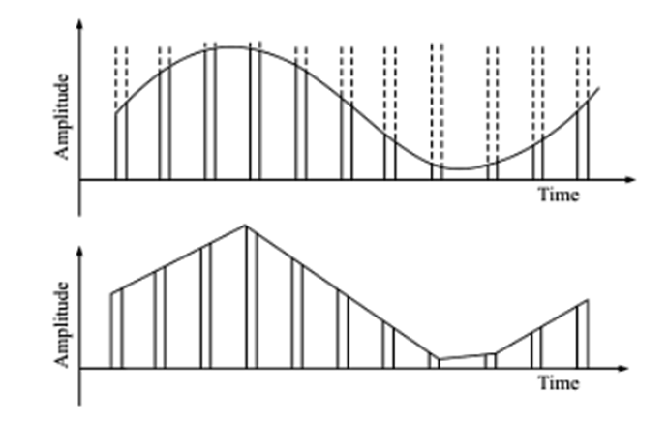
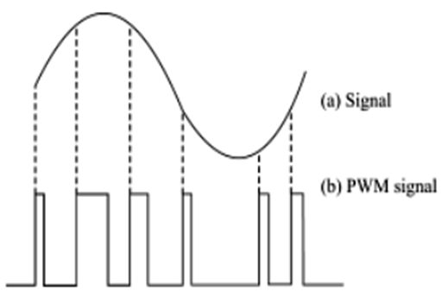
TYPES OF PULSE MODULATION
PWM: Monostable multivibrator
PAM

Slide 37
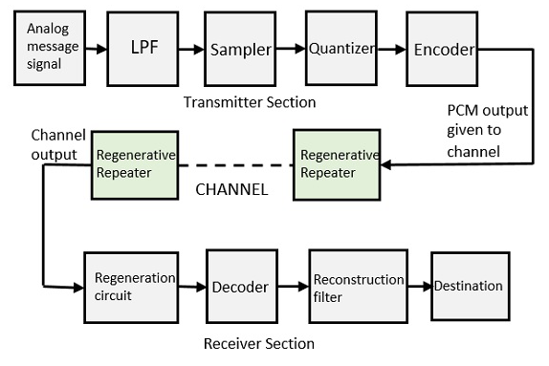
PULSE CODE MODULATION

Slide 38
Digital Data Acquisition System & control

Slide 39
Introduction
● A data acquisition system consists of many components that are integrated to:
● Sense physical variables (use of transducers).
● Condition the electrical signal to make it readable by an A/D board.
● Convert the signal into a digital format acceptable by a computer.
● Process, analyze, store, and display the acquired data with the help of software .
Notes:
A data acquisition system consists of many components that are integrated to sense physical variables by using transducers to convert the physical variable to an electrical signal, then condition that electrical signal to make it readable by an analog-to-digital converter.

Slide 40
Need of DAS
● Data acquisition systems interface between the real world of physical parameters, which are analog, and the artificial world of digital computation and control.
● DAQ are used widely because they are low cost, accurate, and relatively simple to implement.
● Data acquisition systems are capable of measuring hundreds of variables simultaneously.
● They are now used by most engineers and scientists for laboratory research, industrial control, test, and measurement of input and output data to and from a computer.
● Industries that presently employ such automatic systems include steel making, food processing, paper production, oil refining, chemical manufacturing, textile production, cement

Slide 41
Objective of Data Acquisition System
● The data acquisition system must acquire the necessary data at correct speed & at the correct time.
● It must use all the data efficiently to inform the operator about the state of the plant.
● It must monitor the operation of complete plant .
● It must provide effective human communication system which helps in identifying the problem areas.
● It must be able to collect & store data properly for diagnosis.

Slide 42
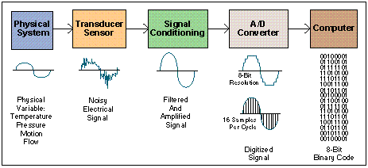
Data Acquisition System
Block Diagram
Notes:
This is a block diagram of the steps needed to take a physical variable and make it usable by a computer. The stages of this system will be used in various labs throughout the quarter. Next, we will explain each of these stages in more detail.

Slide 43
Flow Of Information DAS
1. The input transducers measure some property of the environment.
2. The output from the transducers is conditioned (amplified, filtered..)
3. The conditioned analog signal is digitized using an analog-to-digital converter (ADC).
4. The digital information is acquired, processed and recorded by the computer.
5. The computer may then modify the environment by outputting control signals. The digital control signals are converted to analog signals using a digital-to-analog converter (DAC).
6. The analog signals are conditioned (e.g. amplified and filtered) appropriately for an output transducer.
7. The output transducer interacts with the environment.

Slide 44
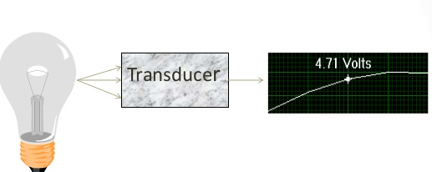
Transducers
●Transducer is used to convert the physical quantity into an electrical signal.
Examples:
● Strain gauge
● Thermocouple
● Piezoelectric device
● The transducer generate a voltage proportional to physical quantity being measured.
● This voltage is applied to data acquisition system as a input.
Notes:
Transducers are used to sense physical phenomena and translate it into electric signals. Examples of things that can be measured with transducers are temperature, pressure, light, force, displacement, level, electrical signals, and switches.

Slide 45
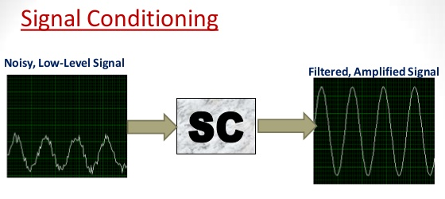
Signal Conditioning
● The output of transducer is a representation of physical signal, which we have to measure.
● This signal has to be modified before it becomes usable & satisfactory to drive the signal presentation stage.
●The proper representation of analog or digital signal obtained from the signal conditioning stage.
● The conditioning equipment required for process like
  ● Amplification
  ● Attenuation
  ● Integration
  ● Differentiation
  ● Subtraction
Notes:
In the signal conditioning stage, electrical signals are conditioned so they can be used by an analog input board. The signal may be conditioned by amplification, where the power of the signal is increased to make it easier to read in more detail. Isolation may also occur, so that the input and output electronics do not interfere with each other. The signal may also be filtered, to remove noise or unwanted frequencies from the signal. Linearization happens to help make the output proportional to the input.

Slide 46
Multiplexers
● It allows a single channel to share it with more than one input quantity. It accept multiple analog input.
● With the help of multiplexer we can transmit more than one quantity using same channel.
● The multiplexers are mostly used when many quantities are to be transmitted.
● Also when the distance between the source & distance is more multiplexers are used.
● Multiplexers reduce the cost of installation, maintenance & periodic replacement of channels if those are used for separate i/p signal.

Slide 47
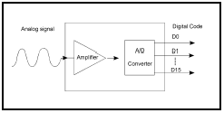
ANALOG DIGITAL(A/D) CONVERTER
Analog to digital (A/D) conversion changes analog voltage or current levels into digital information. The conversion is necessary to enable the computer to process or store the signals.

Slide 48
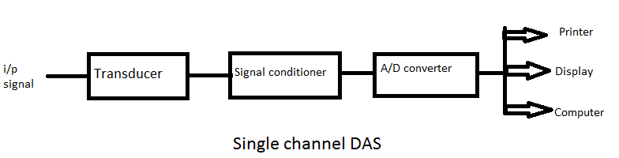
Single channel DAS
● It’s basically working as the common analog DAS. Same components are used for it.

Slide 49
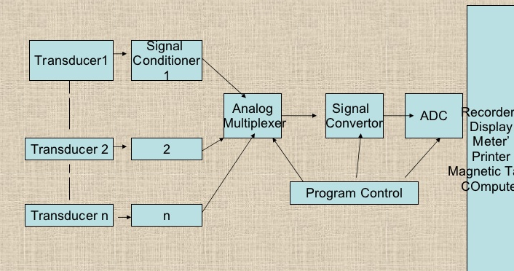
Multichannel DAS
● The individual analog signal are applied to signal conditioning circuit. These signal are then multiplexed. Sample & Hold is used to store the previous data. This signal is then digitized. When conversion is complete the status line form converter cause the S/H to return to sample mode & acquires the signal of the next channel.

Slide 50
Sample & Hold circuit
● Sample and hold circuits are used in linear systems. In some kinds of analog-to-digital converters, the input is compared to a voltage generated internally from a digital-to-analog converter (DAC).
● The circuit tries a series of values and stops converting once the voltages are equal, within some defined error margin. If the input value was permitted to change during this comparison process, the resulting conversion would be inaccurate and possibly unrelated to the true input value.
● Such successive approximation converters will often incorporate internal sample and hold circuitry. In addition, sample and hold circuits are often used when multiple samples need to be measured at the same time. Each value is sampled and held, using a common sample clock.

Slide 51
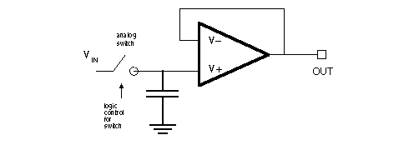
Implementation of Sample & Hold circuit
● The simplest implementation of a S&H circuit is shown below. The voltage V’ would ideally stay constant in the hold mode by having a value equal to Vin at the instance of clock going low. But there are two error sources due to switch:
The channel charge go to both junctions to causes negative glitches. If source impedance of Vin is small, then the glitch is small and last a short duration.
2. The channel charge go to V’ causes a negative voltage that is long lasting

Slide 52
Implementation of Sample & Hold circuit
● In above fig. When switch s is closed then ,
Vout(t) = Vin(t)
● When switch is opened the capacitor C holds the i/p voltage to the last t(sampled) value, because negligible current is drawn by the follower. Therefore,
Vout (t – t sampled) = Vin * (t sampled)
●The type of capacitor used for this application is important. A low leakage capacitor such as a polystyrene or polypropylene type would be a good choice.

Slide 53
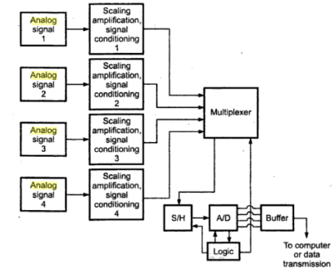
Multichannel Analog Multiplexed System

Slide 54
Multichannel Analog Multiplexed System
●In this system, there is a single analog to digital converted preceded by a multiplexer. The individual analog signal are applied directly. They are amplified & signal conditioned to the multiplexer. Then analog to digital converter convert these analog signals to digital signals.
● For the utilization of time , the multiplexer gets or selects new channel to be converted while the previous data stored in the sample & hold circuit is converted into digital form
● when this conversion completes the status line from the converter makes the sample & hold circuit to go back to sample mode.
●This process is comparatively slower but has obvious advantage of low cost due to sharing of more than one channel

Slide 55
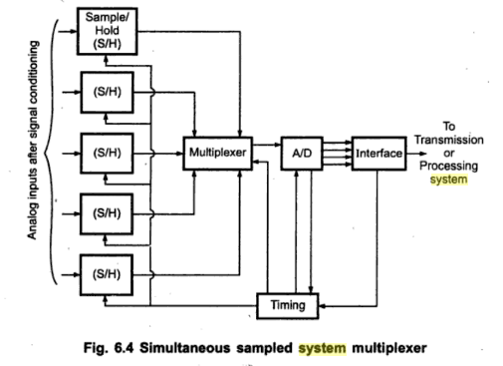
Multiplexed output of sample/hold circuit

Slide 56
Multiplexed output of sample/hold circuit
● When more no of channels are to be monitored at the same time, the multiplexing of the o/p of sample & hold circuit is done.
●In this case, each sample & hold circuit is attached to each channel. They are synchronously updated by timing circuit.
● The sample & hold circuit are first multiplexed & then they are connected to analog to digital converter.
●The advantage of this multiplexing techniques is that this is moderately faster than earlier.

Slide 57
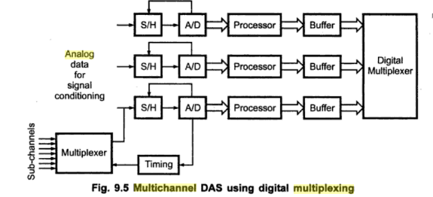
Multiplexed After A/D CONVERSION

Slide 58
Multiplexed After A/D CONVERSION
● In this techniques each sample& hold circuit & the AtoD converter is assigned to the individual channel.
● The conversion speed is as per the requirement. The technique is exhibiting parallel conversion. In industrial system, the number of strain gauge , thermocouples, LVDTs are distributed over large area.
●As the analog signal is digitized at the center , the data transmission provides great immunity against line frequency & other interferences. The data in digital form performs logical operations.
●Based on relative speed at which changes occur in the data , the scanning rate can be increased or decreased.

Slide 59
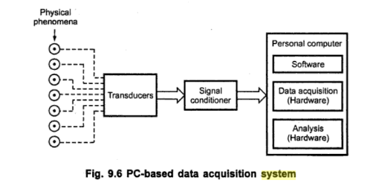
Computer based DAS

Slide 60
Computer based DAS
● The field of data acquisition encompasses a very wide range of activities. At its simplest level, it involves reading electrical signals into a computer from some form of sensor.
● These signals may represent the state of a physical process, such as the position and orientation of machine tools, the temperature of a furnace or the size and shape of a manufactured component.
● The acquired data may have to be stored, printed or displayed. Often the data have to be analyzed or processed in some way in order to generate further signals for controlling external equipment or for interfacing to other computers.
● This may involve manipulating only static readings, but it is also frequently necessary to deal with time-varying signals as well. Some systems may involve data to be gathered slowly, over time spans of many days or weeks.

Slide 61


