Slide 1
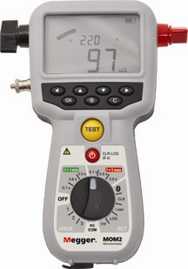
1
PRESENTATION
ON
MEGGER

Slide 2
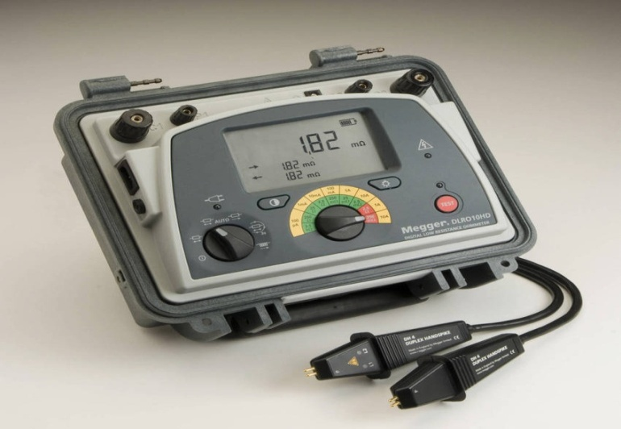
3
INTRODUCTION
MEGGER
The megger , or megohmmeter , is a high range ohmmeter.
Used to measure insulation resistance and other high resistance values.
This principle forms the basis of insulation testing instrument known as MEGGER.
Also used for ground, continuity, and short circuit testing of electrical power systems.
Designed to cover a wide range(more than 1000megohms) of resistances.

Slide 3
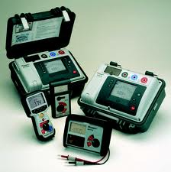
PRINCIPLE :
The instrument works on the principle of ratio-meter/ohmmeter . The required deflection torque is produce by both voltage and current(in the cross-coil) . Due to the interaction between the magnetic field produce by voltage and current , the deflecting torque is produce . The required coil are so positioned that the deflecting torque is proportional to the ratio V/I.

Slide 4
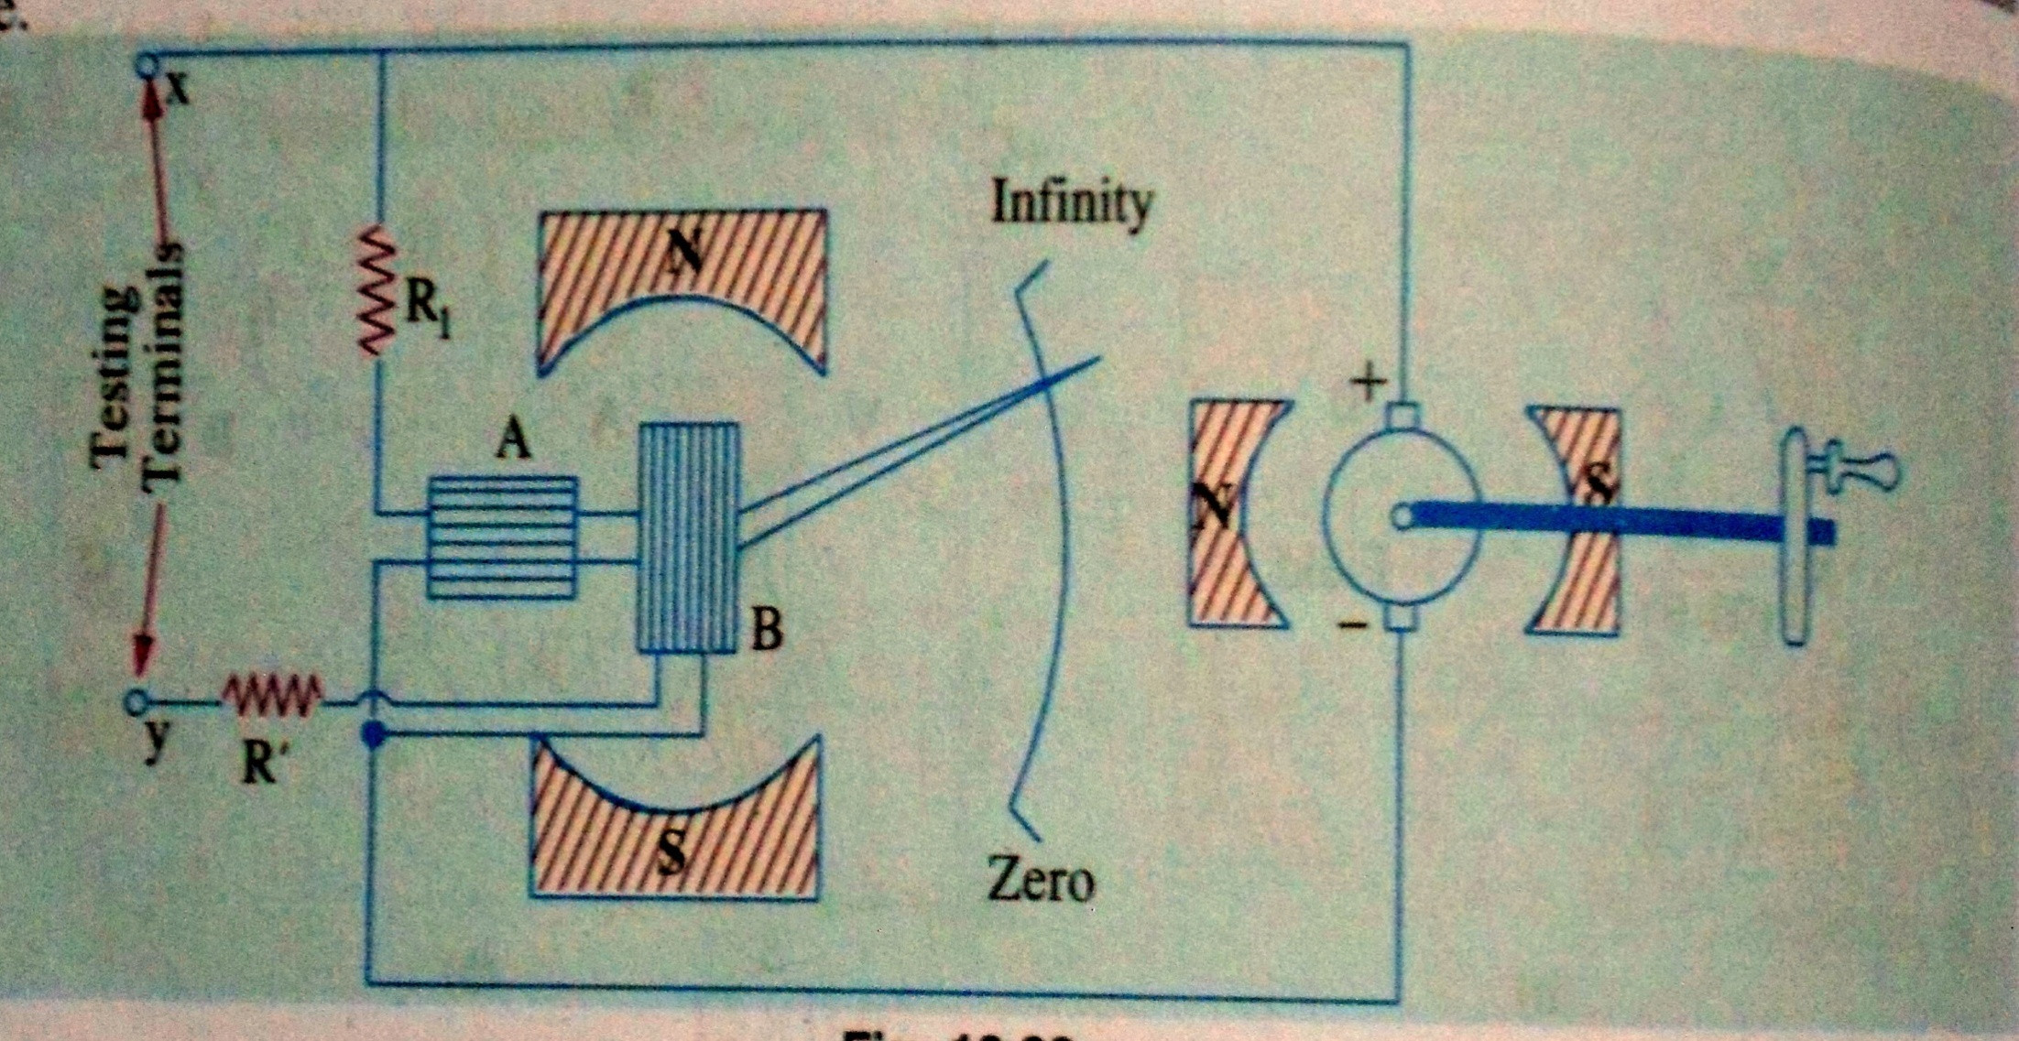
Construction of Megger

Slide 5
Advantages of Megger
Permanent magnet DC generator
Measures resistance between zero to infinity

Slide 6
Permanent magnet DC generator: The megger has a small permanent magnet DC generator. The generator is capable of generating either 250V or 500V at full speed. This generator generates a constant voltage and thus avoids the effect of capacitive currents.
Measures resistance between zero to infinity: A megger can measure all resistance lying between zero and infinity essentially it is a high resistance measuring device.

Slide 7
APPLICATIONS OF MEGGER
1.Measurement of high value resistances.
2.Used to measure the electrical resistance of insulators.
3.Testing of electrical components, machinery.
4.Installations for winding

Slide 8


Slide 9
THANK YOU

