Slide 1
Electronic Instruments and Controls

Slide 2
UNIT-I:Principles of Measurement
Measurement
Basic requirements
Significance of measurement
Methods of measurement
Instrument and measurement systems

Slide 3
UNIT-I:Principles of Measurement
Evolution of instruments
Classification of Instruments
Types of Instrumentation system
Elements of generalized measurement system
Detailed generalized measurement system

Slide 4
1. Measurement:
Measurement of a given quantity is essentially an act or result of comparison between the quantity (whose magnitude is unknown) and predetermined or predefined standards.
Two quantities are compared the result is expressed in numerical values.

Slide 5
2. Basic requirements for a meaningful measurement:
The standard used for comparison purposes must be accurately defined and should be commonly accepted.
The apparatus used and the method adopted must be provable (verifiable).

Slide 6
3. Significance of Measurement
”I often say that when you can measure what you are speaking about and can express it in numbers, you know something about it; when you cannot express in it numbers your knowledge is of meager and unsatisfactory kind”
Notes:
Importance of Measurement is simply and eloquently expressed in the following statement of famous physicist Lord Kelvin:

Slide 7
4. Methods of Measurement
Direct Methods
Indirect Methods
Notes:
DIRECT METHODS: In these methods, the unknown quantity (called the measurand ) is directly compared against a standard.
INDIRECT METHOD: Measurements by direct methods are not always possible, feasible and practicable. In engineering applications measurement systems are used which require need of indirect method for measurement purposes.

Slide 8
5. Instruments and Measurement Systems
Measurement involves the use of instruments as a physical means of determining quantities or variables.
Because of modular nature of the elements within it, it is common to refer the measuring instrument as a MEASUREMENT SYSTEM.

Slide 9
6. Evolution of Instruments
Mechanical
Electrical
Electronic Instruments.
Notes:
MECHANICAL: These instruments are very reliable for static and stable conditions. But their disadvantage is that they are unable to respond rapidly to measurements of dynamic and transient conditions.
ELECTRICAL: It is faster than mechanical, indicating the output are rapid than mechanical methods. But it depends on the mechanical movement of the meters. The response is 0.5 to 24 seconds. ELECTRONIC: It is more reliable than other system. It uses semiconductor devices and weak signal can also be detected
ELECTRONIC: It is more reliable than other system. It uses semiconductor devices and weak signal can also be detected

Slide 10
7. Classification of Instruments
Absolute Instruments
Secondary Instruments
Application of measurement systems are:
i) Monitoring of process and operation.
ii) Control of processes and operation.
iii) Experimental engineering analysis.
Notes:
ABSOLUTE: These instruments give the magnitude if the quantity under measurement terms of physical constants of the instrument.
SECONDARY: These instruments are calibrated by the comparison with absolute instruments which have already been calibrated.
Further it is classified as
Deflection Type Instruments
Null Type Instruments

Slide 11
8. Types of Instrumentation System
Intelligent Instrumentation (data has been refined for the purpose of presentation )
Dumb Instrumentation (data must be processed by the observer)

Slide 12
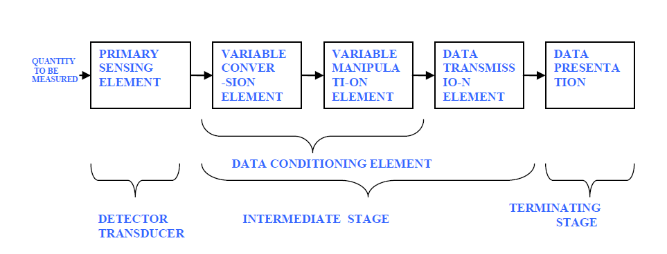
9. Elements of Generalized Measurement System
Notes:
PRIMARY SENSING ELEMENT: The quantity under measurement makes its first contact with the primary sensing element of a measurement system.
VARIABLE CONVERSION ELEMENT: It converts the output of the primary sensing element into suitable form to preserve the information content of the original signal.
DATA PRESENTATION ELEMENT: The information about the quantity under measurement has to be conveyed to the personnel handling the instrument or the system for monitoring, control or analysis purpose.

Slide 13
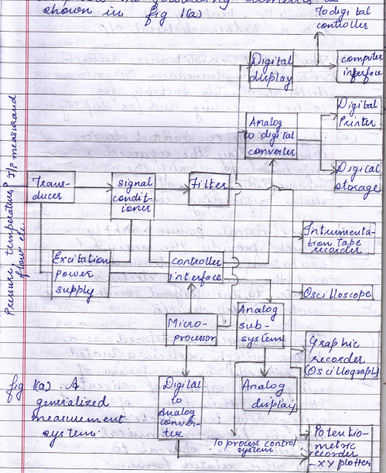
9. Detailed Generalized Measurement System

Slide 14
THANK YOU !!

