Slide 1
Introduction to VHDL

Slide 2
What and Why is HDL?
In software everything is sequential
In hardware events are concurrent
Advantages –
  Documentation 
  Simulation of the behavior of the circuit 
  Synthesis – automatic generation of net lists
  Portability
Examples – ABEL, VHDL, Verilog
Notes:
ABEL (Advanced Boolean Equation Language)

Slide 3
VHDL
VHDL is an industry standard language used to describe hardware from the abstract to concrete level.
V – VHSIC - Very High Speed Integrated Circuit
HDL - Hardware Description Language

Slide 4
BASIC FEATURES OF VHDL
Concurrency.
Supports sequential statements.
Supports for test & simulation.
Strongly typed language.
Supports hierarchies.
Supports for vendor defined libraries.
Supports multivalued logic.

Slide 5
CONCURRENT AND SEQUENTIAL STATEMENTS
Concurrent - statements are executed at the same time in parallel, as in Hardware
Sequential - it executes one statement at a time in sequence only

Slide 6
4 Classes of VHDL statements
• LIBRARY - a file which includes predefined hardware component declarations,
• PACKAGE - a file which includes shared data type definitions in one file
• ENTITY - specifies a logic block with its exact I/O ports
• ARCHITECTURE – describes the internal architecture of the entity
a. Structural Description - the design is represented as an arrangement of interconnected components.
b. Dataflow Description - represents the behavior but implies some structure. It is similar to an RTL description.
c. Behavior Description - describes the behavior of the circuit without any structural information. The description is done using a sequence of programming language statements.

Slide 7
IEEE Libraries and Packages
The library “ieee” contains several packages of definitions standardized by IEEE, which can be used in all IEEE-certified VHDL environments
Library Package Contents
ieee std_logic_1164 standard data types (bit, byte..)
ieee std_logic_arith signed and unsigned numbers, converters
ieee std_logic_signed signed numbers only
ieee std_logic_unsigned unsigned numbers only

Slide 8
Entity Declaration
Specifies the interface with the external environment.
Format
  entity NAME_OF_ENTITY is
  port (signal_names: mode type;
  signal_names: mode type;
  :
  signal_names: mode type);
  end [NAME_OF_ENTITY] ;
Entity may have several ARCHITECTURE statements

Slide 9
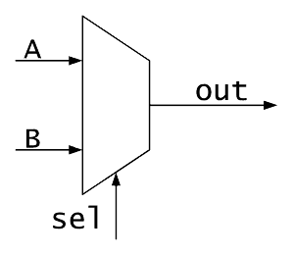
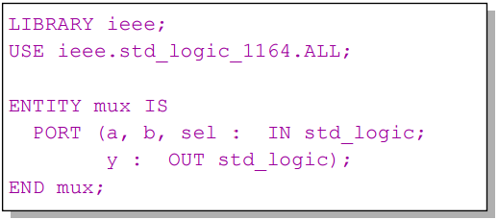
Example

Slide 10
ARCHITECTURE
An architecture specifies the behavior, function, interconnections and the relationship between the inputs and the outputs of an entity.
An entity can have more than one architecture .
There can be no architecture without an entity .
Each architecture is bound to an entity using the configuration statement .

Slide 11
VHDL architectures can be classified as
Behavioral – Defines a sequentially described functioning of the design.
Structural – Defines interconnections between previously defined components.
Dataflow – Defines a concurrently described functioning of the design.
Mixed - A combination of structural and behavioral architectures .

Slide 12
Syntax
architecture architecture_name of entity_name is
[declarations]
begin
[statements]
end [ architecture_name ];

Slide 13
Process Statement
It is a concurrent statement , which delineates a part of an architecture where sequential statements are executed.
Syntax
label: process[(sensitivity list )]
declarations
begin
sequential statements
end process;

Slide 14
VHDL IDENTIFIERS
Identifiers are used to name items in a VHDL model.
A basic identifier may contain only capital ‘A’ - ’Z’ , ‘a’ - ’z’, ‘0’ - ’9’, underscore character ‘_’
Must start with a alphabet.
May not end with a underscore character.
Must not include two successive underscore characters.
Reserved word cannot be used as identifiers.
VHDL is not case sensitive.

Slide 15
OBJECTS
There are three basic object types in VHDL
• Signal : represents interconnections that connect components and ports.
• Variable : used for local storage within a process.
• Constant : a fixed value.
The object type could be a scalar or an array

Slide 16
Data Types
Predefine
  Package standard of library std: BIT , BOOLEAN, INTEGER, REAL
  Package std_logic_1164 of library ieee: STD_LOGIC, STD_ULOGIC
  Package std_logic_arith of library ieee: SIGNED, UNSIGNED
User defined

Slide 17
Bit literal
Used to represent value of a digital system
Values allowed are 0 and 1
Bit vector literal is expressed as a string of bit literals enclosed in double quotes
e.g. 1 , 0, 1011 , X 7CEF ( hex ), O 5673 ( octal )
e.g. signal valid : bit

Slide 18
Std_logic type
std_logic type is a data_type defined in the std_logic_1164 package of IEEE library
It defines a number of states for a digital signal which helps in simulation and debugging
It is an enumerated type and is defined as
type std_logic is (U,X,0,1,Z,W,L,H,-);
where
U -Uninitialized
X -Forcing Unknown
0 -Forcing 0
1 -Forcing 1
Z-High Impedance
W -Weak Unknown
L -Weak 0
H -Weak 1
- -Don't Care

Slide 19
Boolean literal
represents true or false value
values allowed are
  true(TRUE,True)
  false(FALSE,False)
e.g.: signal busactive : boolean;
...
busactive <= true;
...
if (busactive and valid = “1”) then
data_out <= din;
valid_out <= “1”;
end if;

Slide 20
Character literals
The package STANDARD predefines a set of character literals
Character literals are enclosed in single quotes
e.g. : “a” , “A”, “1” , “!”
An array of character literals is enclosed in double quotes
e.g. “Warning : timing violation”
Not synthesizable

Slide 21
Integer literal
defines a value with integers
They can be either positive or negative
exponents have to be integers
e.g. 3, -1, 47E23 , -4E-2, 345
16#3ed2# , 16#23#E+2 (base16)
2#10111# , 2#10101#E12 (base2)
e.g. Signal count integer range 0 to 255;
Synthesizable

Slide 22
Real literal
defines a value with real numbers
They can be either positive or negative
exponents have to be integers
e.g. 3.23, -1.78946, 4.78E23 , -4.23E-2, 0.345
16#1.23ed2# , 16#23.0#E+2 (base16)
2#1.0111# , 2#1.0101#E-12 (base2)
Not synthesizable

Slide 23
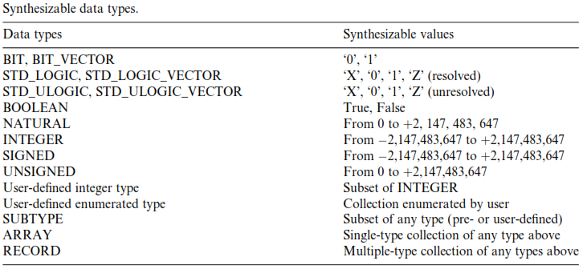
Synthesizable Data Type

Slide 24
Physical literal
Physical literal is a number with units.
type current is range -2147484638 to 2147484637
units
nA; --Base Unit nano ampere
uA = 1000 nA; --micro ampere
mA = 1000 uA; --milli ampere
A = 1000 mA; --ampere
end units;
Not synthesizable

Slide 25
Subtype
Subtype is a type with a range constraint
Subtypes are compatible with their base type
subtype Count16 is integer range 0 to 16;
subtype digit is integer range 0 to 9;
subtype nanosec is time range 0 ns to 1 us;

Slide 26
OPERATORS
Precedence Operator Class Operators
Logical operator and or nand nor xor xnor
Relational operator = /= < <= > >=
Shift Operator sll srl sla sra rol ror
Adding Operator + - &
Sign + -
Multiplying Operator * / mod rem
Miscellaneous ** abs not

Slide 27
Composite Data Type –Array
There are two composite types
  arrays : contain many elements of the same type
  records : contain elements of different types
Arrays can be either uni or multi dimensional.
Array Declaration Syntax
type array_name is array (index range) of element_type;
examples:
type byte is array (7 downto 0) of std_logic;

Slide 28
Array
Declaration examples
signal A : std_logic_vector(3 downto 0) := “1011”;
signal B : std_logic_vector(0 to 3) := “1011”;
signal C : std_logic_vector(6 downto 0);
A(3) A(2) A(1) A(0)
1 0 1 1
B(0) B(1) B(2) B(3)

Slide 29
Array assignment examples
A <= („1‟, „0‟, others => „0‟); --aggregation
A <= “1011”;
A <= “10” & ”11”; --concatenation
A <= ( „1‟, „0‟, „1‟, „1‟);
A <= “101” & „1‟;
A <= „1‟ & ‟0‟ & ‟1‟ & ‟1‟;
C <= A & B;
A <= C( 5 downto 2 ); --slicing
A(2 downto 1) <= C(6 downto 5);
A <= (others => „0‟);
A <= (1 => „0‟, others => „1‟ );
A <= (2 | 0 => „1‟ , others => „0‟);
A <= (0 to 3 => „0‟);

Slide 30
Multi dimensional Array
type array_name is array (index_range, index_range) of element_type;
e.g.:
type memory is array(3 downto 0, 7 downto 0) of bit;
--4 X 8 memory

Slide 31
VHDL Object types : Signal
●
Syntax
Signal signal_name : signal_type [ range constraint ] [:=initial value]
It connects design entities together and communicate changes in values within a design .
Signals can be declared in an entity (can be seen by all the architectures of the entity) , in an architecture (local to the architecture), in a package (globally available to the user of the package) or as a parameter of a subprogram(i.e.. a function or a procedure)
Signals declared in a port statement of an entity describe the components input/output connectors.
Signals have three properties attached to it
–type and type attributes
–value
–time ( i.e. it has a history )

Slide 32
Signal contd.
signal assignment is done using the „<=„ symbol . e.g. : c <= “1” ;
signals updates can have a delay specified in their assignment statements. E.g..
clk <= not clk after 10 ns;
signal assignment is concurrent outside a process and sequential within a process

Slide 33
Signal contd.
Concurrent
a <= b;
a <= c; --multiple drivers
Sequential (inside process)
a <= c;
if ip = “1” then a <= b;
end if;
Sequential (inside process)
count <= count + 1;
count <= count + 1;
count <= count + 1;
--count increments only once

Slide 34
Variable
Syntax
variable variable_name : variable_type [ range ] [:= initial value ];
e.g. : variableindex : integer range 0 to 15;
variablecount : std_logic_vector( 3 downto0 ) := “0000”;

Slide 35
Variables contd..
Variables are assigned values using the := symbol
Variables are identifiers within a process or a subprogram. Their visibility is limited only to its process or sub program.
Variables have only type and value attached to it. They don‟t have a past history unlike a signal. Require less memory and result in fast simulation.
Variable assignment occurs immediately.

Slide 36
Sequential (inside process)
count :=count + 1;
count :=count + 1;
count :=count + 1;
--count increments 3 times

Slide 37
Constant
A constant is an identifier with a fixed value
Syntax
Constant constant_name : constant_type [:=value ] ;
e.g. : constantpi : real := 3.147592;
constantdatawidth : natural := 32;
It is used in place of the value to make the code more readable
A constant has just the type and value associated with it .
Value can be assigned to a deferred constant later in a package if changes are foreseen. This minimizes recompilation.
Constants are used to define data parameters (buswidth, time delay, etc) and lookup tables (ROM , etc);

