Slide 1
Semiconductor Memories

Slide 2
Memory
Device that provides the storage facility.
Two types of memories used in digital systems
  Random Access Memory (RAM)
  Read Only Memory (ROM)
RAM – read-write memory
ROM - read memory

Slide 3
Memory Unit
An array of cells arranged in a rectangular form
Has circuits to enable transferring the binary information into or out.
Binary information stored is called words (group of bits).
Word length is specified in terms of bytes
Capacity of memory = no. of words * no. of bits per word

Slide 4
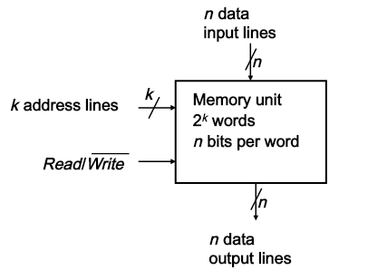
Block diagram of Memory Unit

Slide 5
Characteristics of Memories
Access Mode - defines the way the memory locations can be accessed.
  Random Access
  Sequential Access
Random – time taken to access any two memory locations is same. Eg. RAM
Sequential – time taken to access any two memory locations is different. Eg. Magnetic tape/disk.

Slide 6
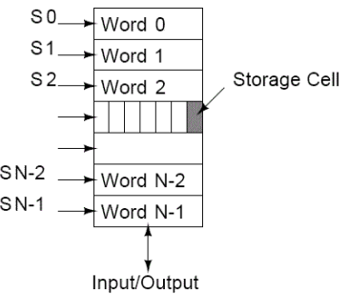
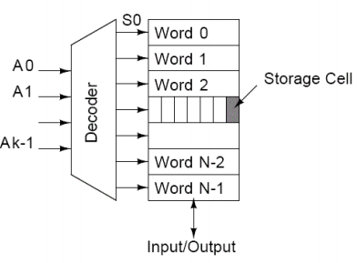
Sequential Access Random Access

Slide 7
Operating Mode – For RAM devices
SRAM – retains stored information as long as power is there.
  Uses latches or flip-flops as storage cells
  Faster in read/write operation
  used in cache memories
  Less packaging density, less memory
  High cost
  Consumes more power
DRAM – retains stored information with periodic refreshing along with power supply.
  Uses capacitance of MOS transistors as storage element
  Slower compared to SRAM
  used as main memory
  More memory
  Less cost (but cost increases with refreshing)
  Consumes less power

Slide 8
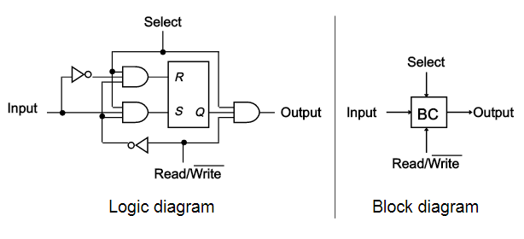
Single Memory Cell of SRAM

Slide 9
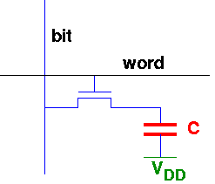
Single Memory Cell of DRAM

Slide 10
Volatile or Non-volatile – power dependent
Volatile – retain the stored information as long as power is switched on. Eg. RAM
Non-volatile – retain the stored information even after power is switched off. Eg. Hard disks

Slide 11
Erasable or Non-erasable –
Erasable – erasing the stored contents and writing the new contents is possible. Eg. Hard disk.
Non-erasable – contents can not be erased, they are permanent. Eg. ROM

Slide 12
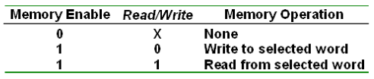

Slide 13
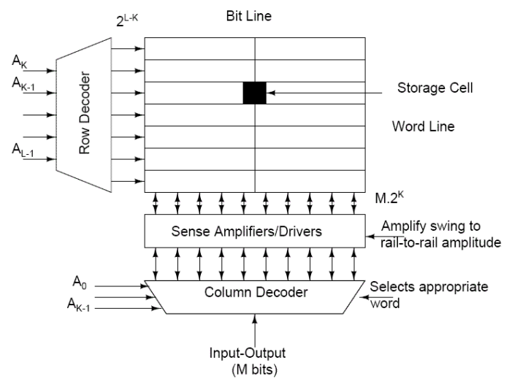
Memory with row and column decoder

Slide 14
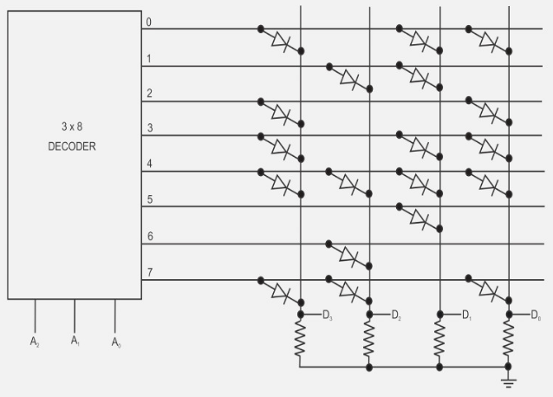
ROM Array

Slide 15
Types of ROM
Mask ROM
  Data written during chip fabrication
PROM
  Fuse ROM: Non-rewritable
  EPROM: Erase data by UV rays
  EEPROM: Erase and write through electrical means
    Speed 2-3 times slower than RAM
    Upper limit on write operations
    Flash Memory – High density, Low Cost

Slide 16
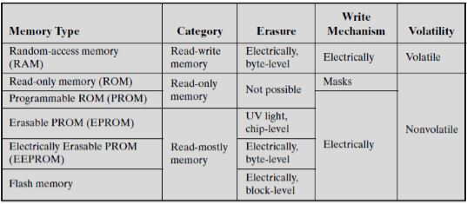
Comparison

Slide 17
Programmable Logic Devices
Connections are not hardwired
Switches are used which can be connected or disconnected as per the requirement.
Intersection of row and column wire represents programmable connection.

