Slide 1
Logic Families

Slide 2
Logic Family
A collection of different IC’s that have similar circuit characteristics
The set of digital ICs belonging to the same logic family are electrically compatible with each other.

Slide 3
Classification - 1
Based on complexity
  SSI < 12 gates/chip
  MSI < 100 gates/chip
  LSI …1K gates/chip
  VLSI …10K gates/chip
  ULSI …100K gates/chip
  GSI …1Meg gates/chip

Slide 4
Classification - 2
Based on specific circuit technology
  RTL resistor-transistor logic (obsolete)
  DTL diode-transistor logic (obsolete)
  TTL transistor-transistor logic (widespread, standard)
  ECL emiter-coupled logic (high speed)
  MOS (PMOS, NMOS) metal-oxide semiconductor (high component density)
  CMOS complementary metal-oxide semiconductor (low power consumption)

Slide 5
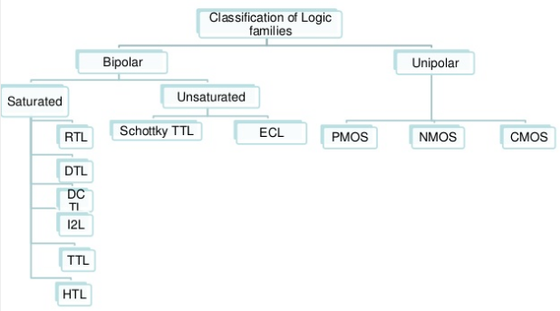
Logic Family Tree

Slide 6
Electrical Parameters / Characteristics of Digital ICs
Voltages and Currents
Noise Margin
Power Dissipation
Propagation Delay
Speed-Power Product
Fan-In, Fan-Out

Slide 7
Electrical Parameter
Voltages and Currents
For a High-state gate driving a second gate, we define:
  V_{OH} (min), high-level output voltage, the minimum voltage level that a logic gate will produce as a logic 1 output.
  V_{IH} (min), high-level input voltage, the minimum voltage level that a logic gate will recognize as a logic 1 input. Voltage below this level will not be accepted as high.
  I_{OH}, high-level output current, current that flows from an output in the logic 1 state under specified load conditions.
  I_{IH}, high-level input current, current that flows into an input when a logic 1 voltage is applied to that input.

Slide 8
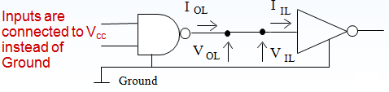
Electrical Parameter
Voltages and Currents
For a Low-state gate driving a second gate, we define:
  V_{OL} (max), low-level output voltage, the maximum voltage level that a logic gate will produce as a logic 0 output.
  V_{IL} (max), low-level input voltage, the maximum voltage level that a logic gate will recognize as a logic 0 input. Voltage above this value will not be accepted as low.
  I_{OL} , low-level output current, current that flows from an output in the logic 0 state under specified load conditions.
  I_{IL} , low-level input current, current that flows into an input when a logic 0 voltage is applied to that input.

Slide 9
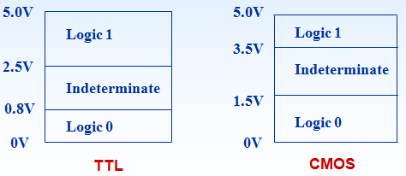
Electrical Parameter
Voltages and Currents
Typical acceptable voltage ranges for positive logic 1 and logic 0 are shown below.
A logic gate with an input at a voltage level within the ‘indeterminate’ range will produce an unpredictable output level.

Slide 10
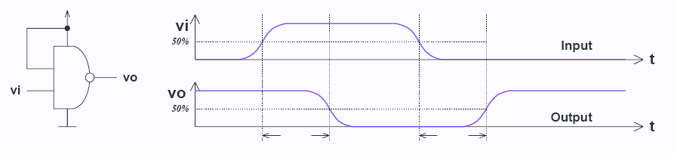
Electrical Parameter
Propagation Delay
The propagation delay (t_{pd}) is the time taken for a change at the input to appear at the output
T_{PD,HL} – input-to-output propagation delay from HI to LO output
T_{PD,LH} – input-to-output propagation delay from LO to HI output
Shorter propagation delay – high operating frequency
T_{PD,HL}
T_{PD,LH}

Slide 11
Electrical Parameter
Power Dissipation
The power dissipation parameter for a logic family is specified in terms of power consumption per gate
It is the product of supply voltage V_{CC} and supply current I_{CC.}
Less power dissipation – better IC
Typical range – 10 to 25 mV

Slide 12
Electrical Parameter
Noise margin
This is a quantitative measure of noise immunity offered by the logic family.
Noise Immunity – circuit’s ability to tolerate the noise without causing spurious changes in the output voltage.
Higher the noise margin better the circuit.

Slide 13
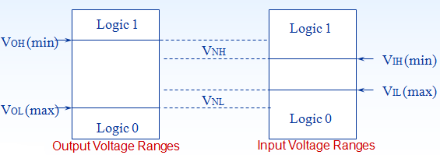
Electrical Parameter
Noise margin
HI state noise margin: LO state noise margin:
V_{NH} = V_{OH}(min) – V_{IH}(min) V_{NL} = V_{IL}(max) – V_{OL}(max)
Noise margin: V_{N} = min(V_{NH},V_{NL})

Slide 14
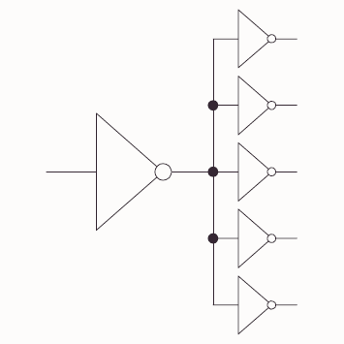

Electrical Parameter
Fan-in / Fan-out
Fan in the no. of inputs of a logic gates. More the fan-in larger the propagation delay.
Fan-out the maximum number of logic inputs (of the same logic family) that an output can drive reliably (maintaining its output levels within the specified limits).

Slide 15
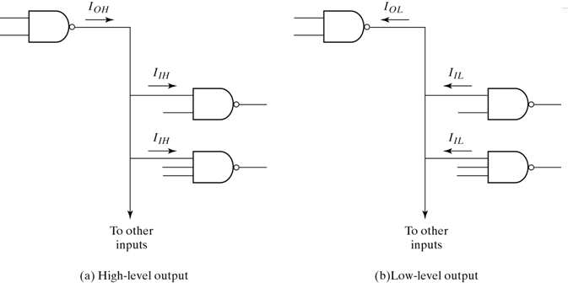
Electrical Parameter
Fan-out Calculation

Slide 16
Electrical Parameter
Speed-Power Product
A simple means for measuring and comparing the overall performance of an IC family is the speed-power product.
It is the product of propagation delay and average power dissipation of IC at a specified frequency
The smaller the speed-power product, the better.
The speed of a logic circuit can be increased, that is, the propagation delay can be reduced, at the expense of power dissipation.

Slide 17
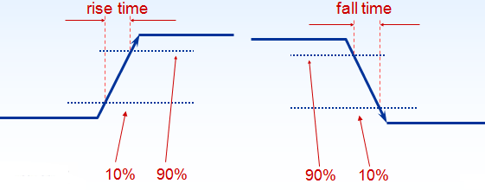
Rise Time / Fall Time
Rise Time - time that elapses between 10 and 90 % of the final signal level when the signal is making a transition from logic LOW to logic HIGH.
Fall Time - time that elapses between 90 and 10 % of the signal level when it is making HIGH to LOW transition.

Slide 18
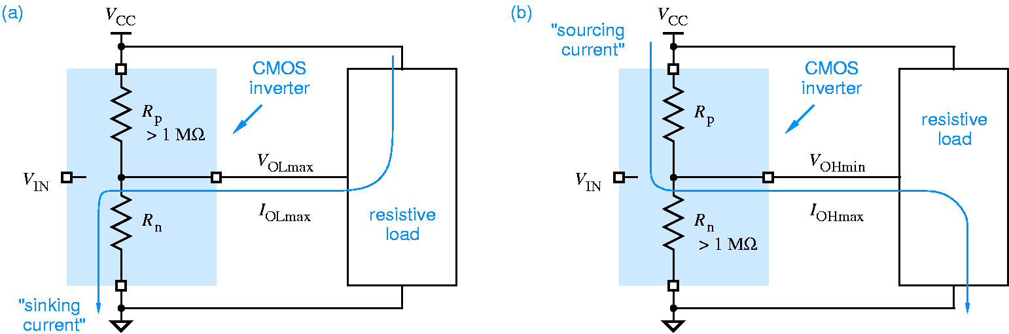
Current Sinking / Current Sourcing
Current Sinking – current flows through supply – load – device – ground
An output must sink current from a load when the output is in the LOW state.
Current Sourcing – current flows through supply – device – load – ground
An output must source current to a load when the output is in the HIGH state.

Slide 19
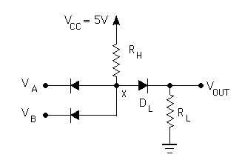
Diode Logic (DL)
simplest; does not scale
NOT not possible (need an active element)

Slide 20
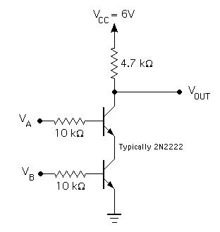
Resistor-Transistor Logic (RTL)
replace diode switch with a transistor switch
can be cascaded
large power draw

Slide 21
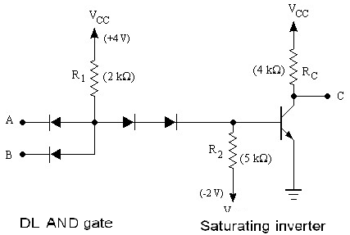
Diode-Transistor Logic (DTL)
essentially diode logic with transistor amplification
reduced power consumption
faster than RTL

Slide 22
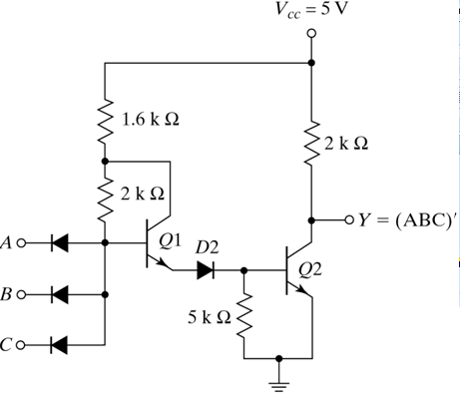
Modified DTL

Slide 23
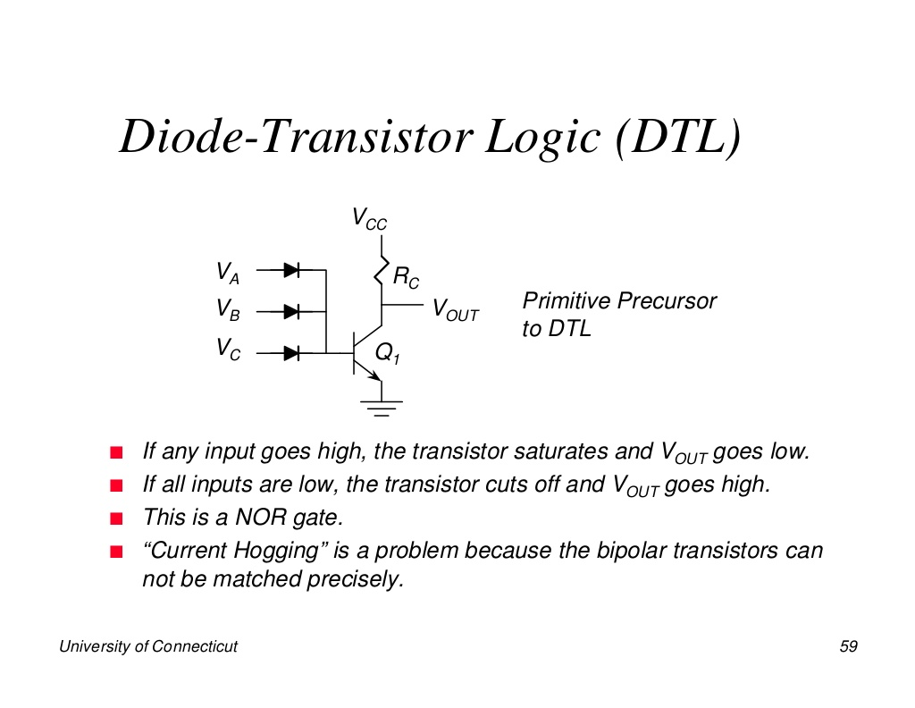

Slide 24
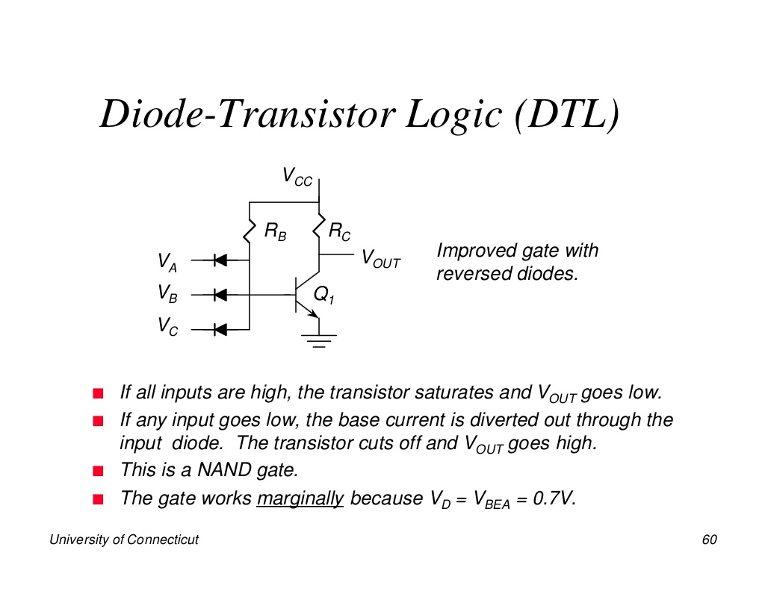

Slide 25
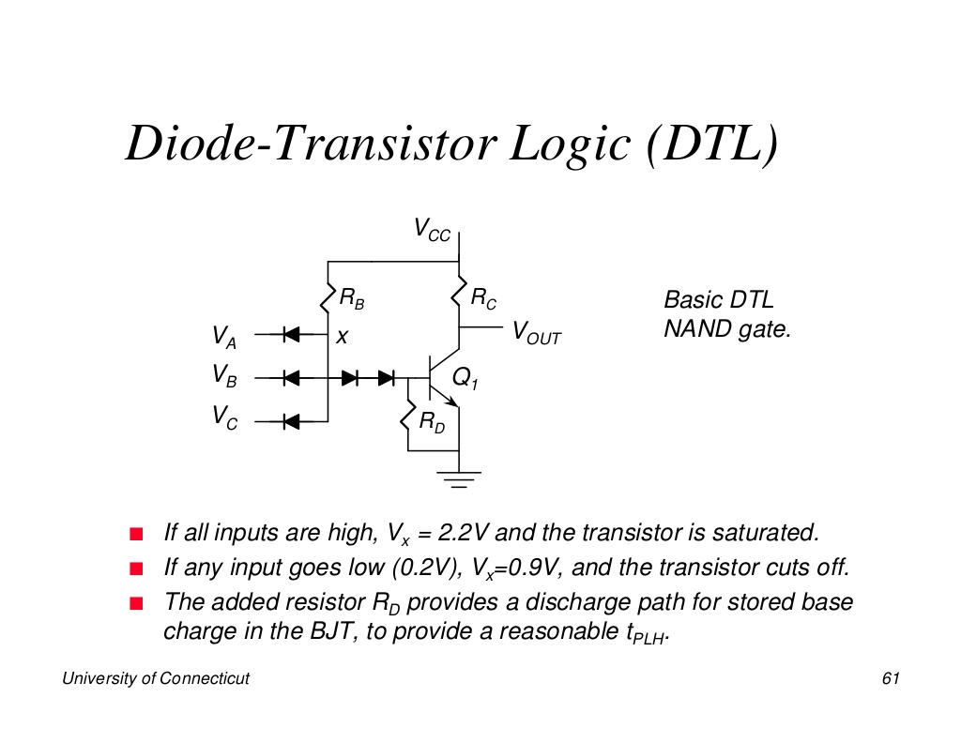

Slide 26
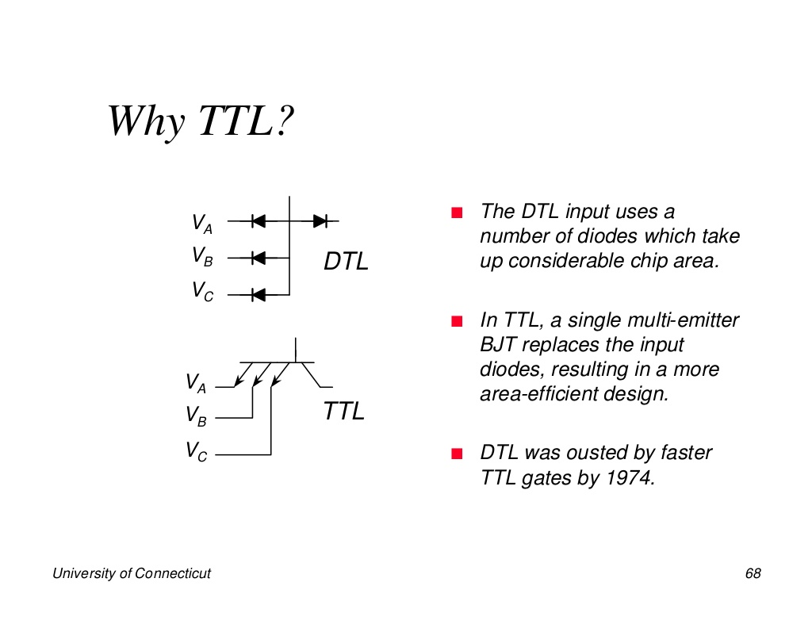

Slide 27
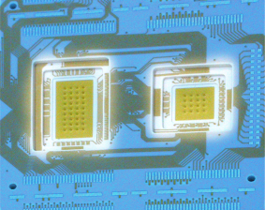
Integration Levels
Gate/transistor ratio is roughly 1/10
  SSI < 12 gates/chip
  MSI < 100 gates/chip
  LSI …1K gates/chip
  VLSI …10K gates/chip
  ULSI …100K gates/chip
  GSI …1Meg gates/chip

Slide 28
Transistor-Transistor Logic (TTL)
First introduced by in 1964 (Texas Instruments)
Based on bipolar transistors
One of the most widely used families for small- and medium-scale devices – rarely used for VLSI
Typically operated from 5V supply
Typical noise immunity about 1 –
Many forms, some optimised for speed, power, etc.
High speed versions comparable to CMOS (~ 1.5 ns)
Low-power versions down to about 1 mW/gate
Three different types of output configurations:
  1. open-collector output
  2. Totem-pole output
  3. Three-state (or tristate) output

Slide 29
Various series of the TTL Logic family

Slide 30
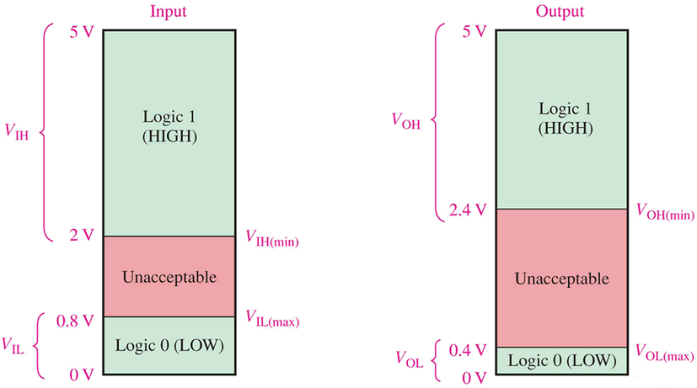
TTL Logic Levels

Slide 31
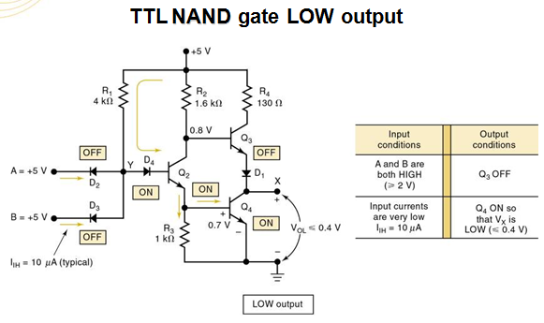

Slide 32
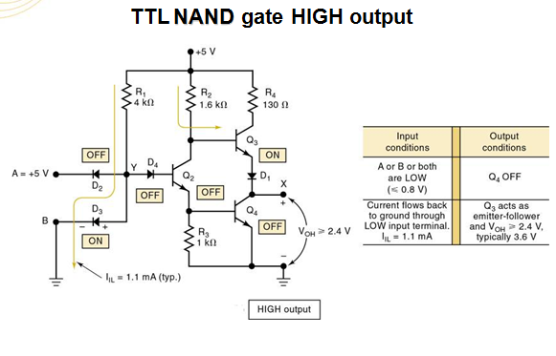

Slide 33
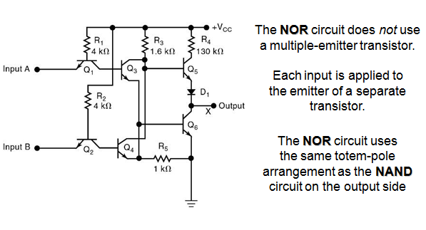
TTL NOR Gate

Slide 34
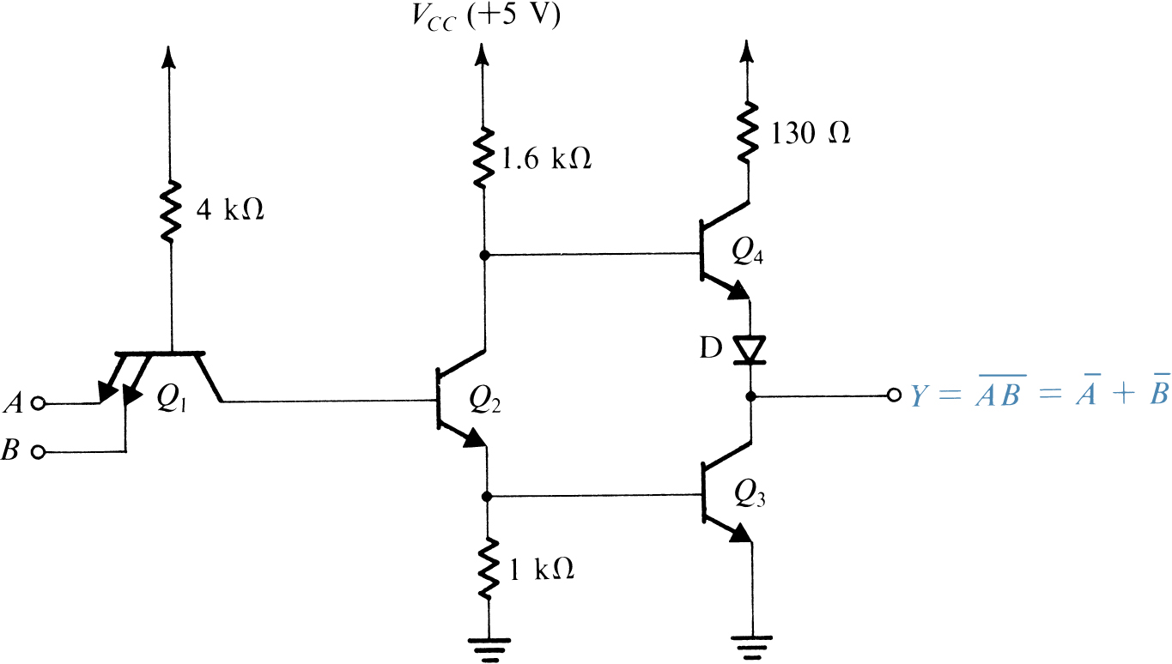
TTL NAND with Totem-pole output

Slide 35
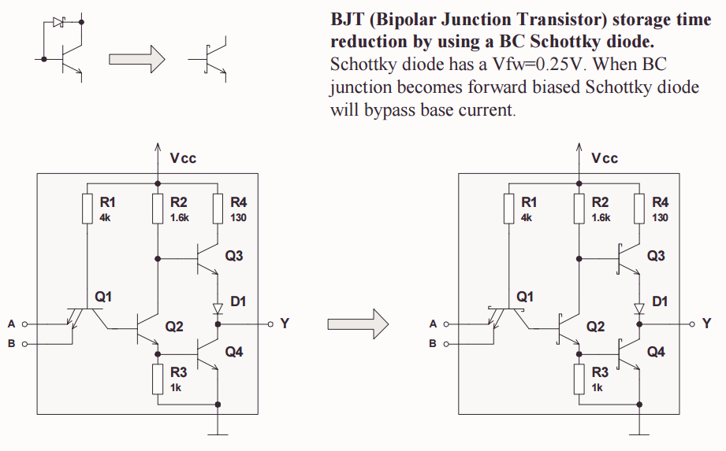
TTL Evolution

Slide 36
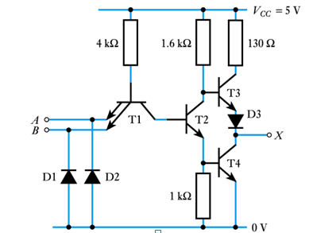
A standard TTL NAND gate

Slide 37
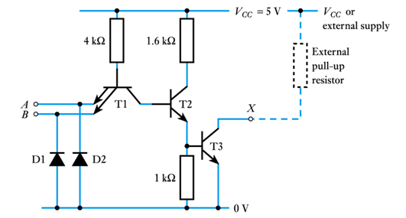
A TTL NAND gate with open collector output

Slide 38
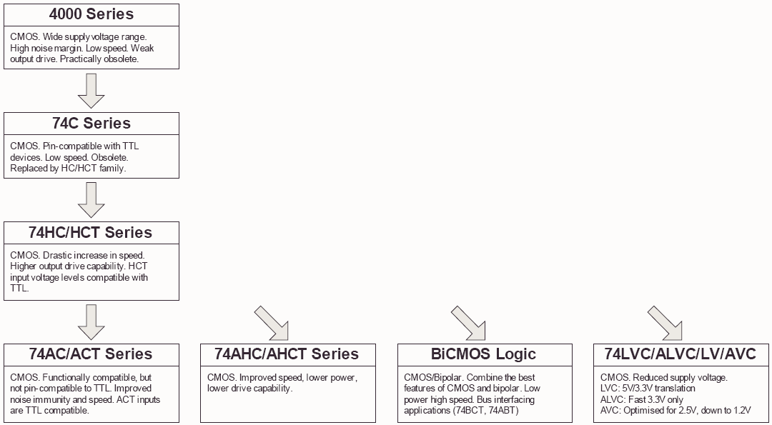
CMOS family evolution

Slide 39
Various series of the CMOS Logic family

Slide 40
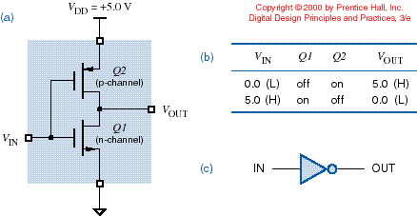
CMOS Inverter
Lect #4
Rissacher EE365

Slide 41
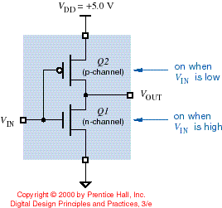
Alternate transistor symbols
Lect #4
Rissacher EE365

Slide 42
CMOS Gate Characteristics
No DC current flow into MOS gate terminal
  However gate has capacitance ==> current required for switching (CV²f power)
No current in output structure,
except during switching
  Both transistors partially on
  Power consumption related
  to frequency
  Slow input-signal rise times
  ==> more power
Symmetric output structure
==> equally strong drive in
LOW and HIGH states
Lect #4
Rissacher EE365

Slide 43
CMOS Gate Operation
Java applet showing CMOS gates
  visit:
  tech-www.informatik.uni-hamburg.de/applets/cmos/
  illustrates gate operation, including power drain during switching
  Link is on class website
Lect #4
Rissacher EE365

Slide 44
Pull-up / Pull-down Model
Typical CMOS gate can be viewed as consisting of two parts
  pull-up network and pull-down network
V_{DD}
A
B
Pull-up
C
output
A
Pull-down
B
C
GND
Lect #4
Rissacher EE365

Slide 45
Pull-up / Pull-down Model
High level inputs to the PDN cause switches to close
If there is a closed switch path thru PDN, then output is low
Low level inputs to the PUN cause switches to close
If there is a closed switch path thru PUN, then output is high
Lect #4
Rissacher EE365

Slide 46
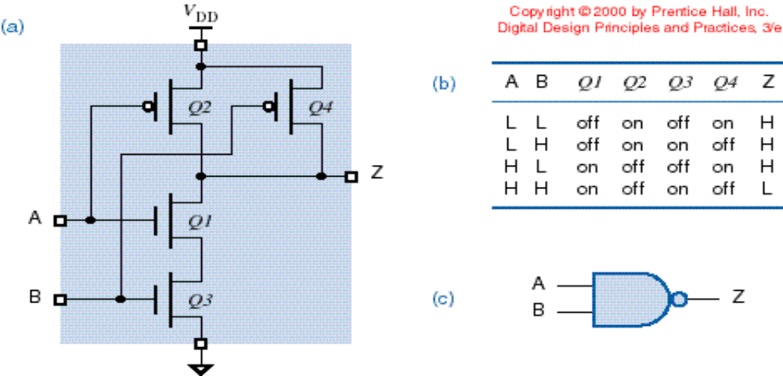
CMOS NAND Gates
Use 2n transistors for n-input gate
Lect #4
Rissacher EE365

Slide 47
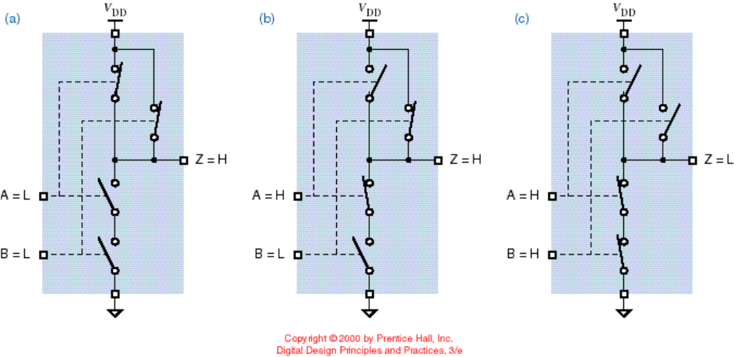
CMOS NAND -- switch model
Lect #4
Rissacher EE365

Slide 48
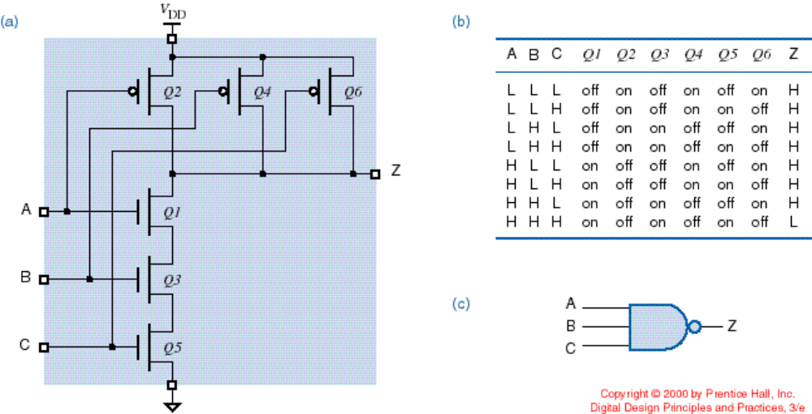
CMOS NAND -- more inputs (3)
Lect #4
Rissacher EE365

Slide 49
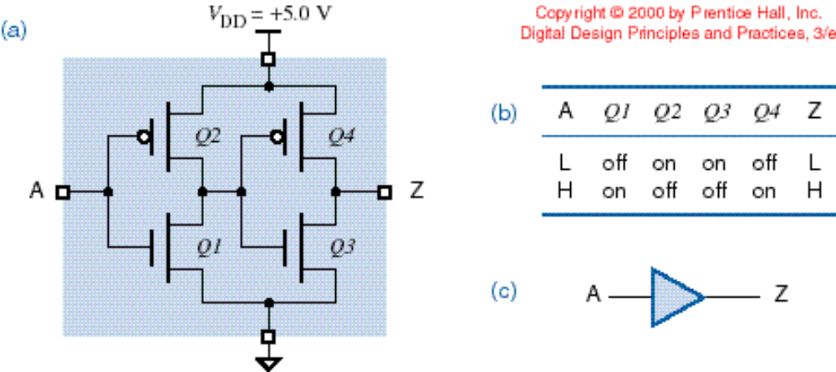
CMOS – non-inverting buffer
Lect #4
Rissacher EE365

Slide 50
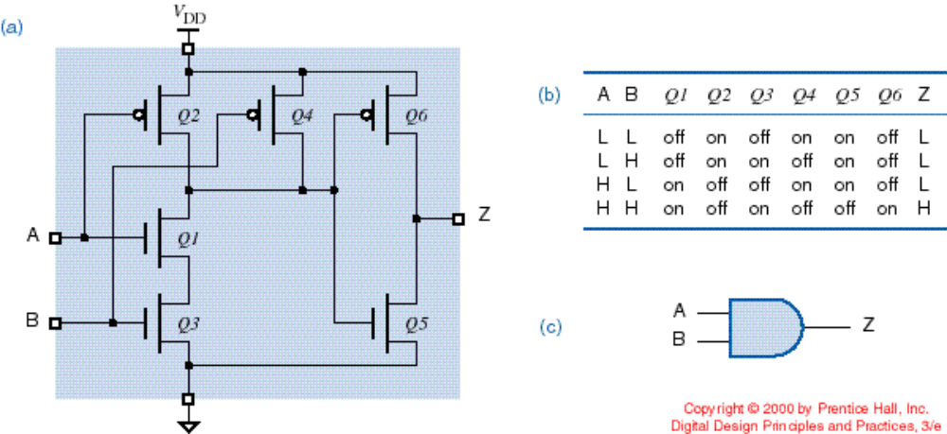
CMOS – 2-input AND gate
Note the number of transistors compared to NAND (6 vs. 4)
Lect #4
Rissacher EE365

Slide 51
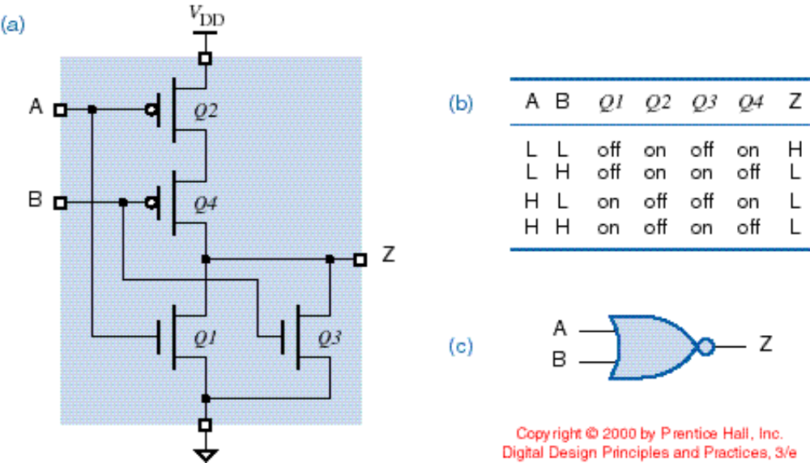
CMOS NOR Gates
Like NAND -- 2n transistors for n-input gate
Lect #4
Rissacher EE365

Slide 52
NAND vs. NOR
NMOS has lower “on” resistance than PMOS (important when multiple transistors are in series)
NAND
NOR
Result: NAND gates are preferred in CMOS due to speed
Lect #4
Rissacher EE365

Slide 53
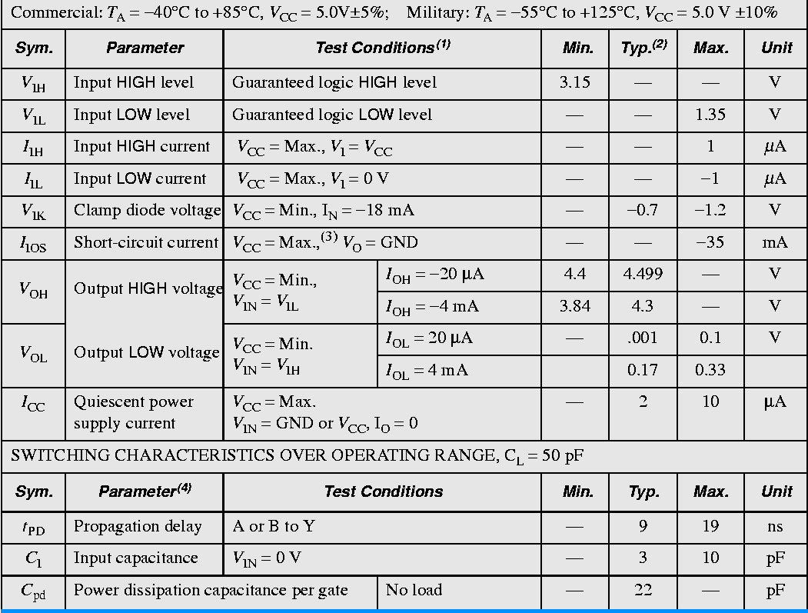
Data sheet for 74HC00 CMOS NAND gates

Slide 54
TTL differences from CMOS
Asymmetric input and output characteristics.
Inputs source significant current in the LOW state, leakage current in the HIGH state.
Output can handle much more current in the LOW state (saturated transistor).
Output can source only limited current in the HIGH state (resistor plus partially-on transistor).
TTL has difficulty driving “pure” CMOS inputs because V_{OH} = 2.4 V (except “T” CMOS).

Slide 55
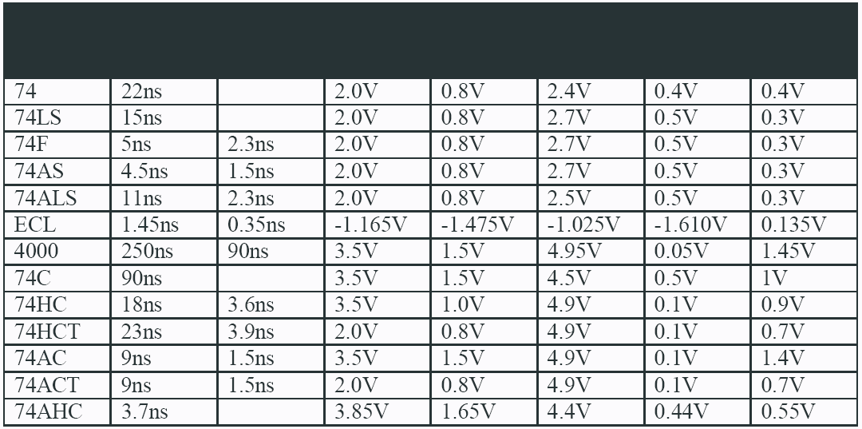
Overview
TTL
Logic
Family
T_{PD} T_{rise/fall} V_{IH,min} V_{IL,max} V_{OH,min} V_{OL,max}
Noise
Margin
Values typical for V_{cc}/V_{dd} = 5V
When interfacing different families, pay attention to their input/output voltage, current (fanout) specs.
CMOS
Notes:
These also have lower power requirements than the standard TTL

Slide 56
Emitter-coupled logic (ECL)
  based on bipolar transistors, but removes problems of storage time by preventing the transistors from saturating
  very fast operation - propagation delays of 1ns or less
  high power consumption, perhaps 60 mW/gate
  low noise immunity of about 0.2-0.25 V
  used in some high speed specialist applications, but now largely replaced by high speed CMOS

Slide 57
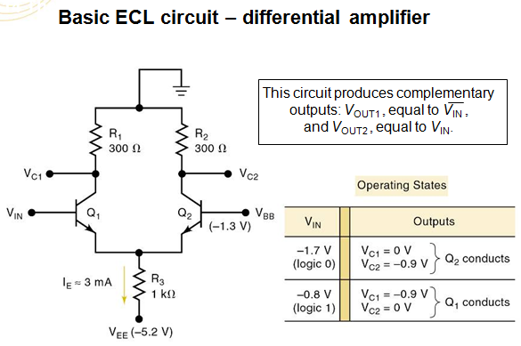

Slide 58
A Comparison of Logic Families
Parameter | CMOS | TTL | ECL
Basic gate | NAND/NOR | NAND | OR/NOR
Fan-out | >50 | 10 | 25
Power per gate (mW) | 1 @ 1 MHz | 1 - 22 | 4 - 55
Noise immunity | Excellent | Very good | Good
t_{PD} (ns) | 1 - 200 | 1.5 – 33 | 1 - 4

Slide 59
