Slide 1
Principles of Communication
SE-IT
Lecture-1
Date – 21/7/2020
Session : 3:00 pm – 4:00 pm
Instructor:
Fr. Dr. John Rose S.J

Slide 2
Module1:
Introduction
Topics:
1. Basics of Analog and Digital Communications
2. Electromagnetic Spectrum and Applications
3. Types of Communication Channel

Slide 3
Communications
Communications:
Transfer of information from one place to another. Should be efficient, reliable and secured.
“A communication system is a process of conveying information from a source to a destination”
Communication system:
Components/subsystems act together to accomplish information transfer/exchange
“An electronic communication system is transferring information using an electrical field as a mean of signal”

Slide 4
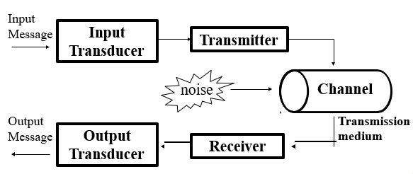
Elements of Communication system

Slide 5
Elements of Communication system
Input Transducer
To convert the message to a form suitable for the particular type of communication system.
Eg: Speech waves are converted to voltage variation by a microphone.
Transmitter
Processes the input signal to produce a transmitted signal that suited the characteristic of transmission channel.
Eg: modulation, coding

Slide 6
Elements of Communication system
Channel (Transmission medium)
A medium that bridges the distance from source to destination.
Eg: Atmosphere (free space), coaxial cable, fiber optic, waveguide
Signal undergoes degradation from noise, interference and distortion.

Slide 7
Elements of Communication system
The two main categories of channel commonly used are:
Line (conducted media)
  The channel is made up metallic cable (such as coaxial cable, twisted pair, parallel wires, and others) or fibre optic cable.
Free space or radiated media
  This is the medium where the transmission of signal is carried out by the propagation of electromagnet wave.
  The main applications are in radio broadcasting, microwaves and satellites transmission systems.

Slide 8
Elements of Communication system
Loses in medium of transmission
  However, each medium introduces losses termed as attenuation, distortion and adds noise to some degree to the transmitted signal. The amount of attenuation, distortion and noise depends on the type of transmission medium used.
  There is normally no signal processing in the transmission medium, it is just the medium where the transmitter is connected to the receiver.

Slide 9
Elements of Communication system
Receiver
To extract the desired signal from the output channel and to convert it to a form suitable for the output transducer.
Eg: Demodulation, decoding
Other functions performed:
Amplification, filtering.
Output Transducer
Converts the electrical signal at its input into a form desired by the system used.
Eg: Loudspeaker, PC and tape-recorders.

Slide 10
Losses in Communication System
Various unwanted undesirable effect crop up in transmissions
Attenuation
  Reduces signal strength at the receiver
Distortion
  Waveform perturbation caused by imperfect response of the system to the desired signal itself
  Equalizer can be used to reduced the effect
Interference
  Contamination by extraneous signals from human sources

Slide 11
Losses in Communication System
Noise
  Random and unpredictable electrical signals from internal or external to the system
  The term SNR (signal to noise ratio) is used to measure performance (noise) relative to an information analog signal
  The term BER (Bit Error Rate) is used in digital system to measure the deterioration of the signal

Slide 12
ELECTRONIC COMMUNICATION SYSTEM
It is Classified into Three Categories
Unidirectional / Bi-directional (Modes of Channel Operation)
Analog / Digital
Baseband / Modulation

Slide 13


Unidirectional/Bidirectional
Simplex:
Simplex is one direction of Communication, It requires only one line of communication.
Simplex Channels are not often used in communication system because it is not possible to send back error or control signals to the transmit end.
Example: Tv or Radio

Slide 14
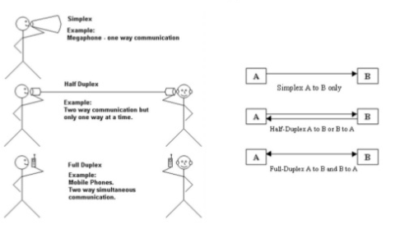
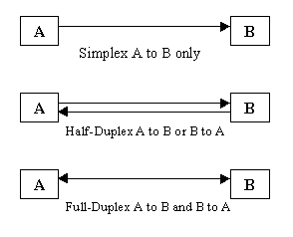
Unidirectional/Bidirectional
Half- Duplex:
Two directions of Communication (can send and receive) but only one direction is allowed through at a time.
Only one end Transmits at a time, the other end receives.
Advantage:
It has single lane and it is cheaper than Double lane (less connectors)
Example: CB Radio, Walky - Talky

Slide 15
Unidirectional/Bidirectional
Duplex:
Two ways of communication with data can travel in both direction simultaneously. This is the most common channel operation in communication system and networking.
Example Mobile phone lines.

Slide 16
Analog vs. Digital
The signal can be analog or digital message:
Analog
  Continuous Variation
    Assumes the total range of frequencies/time
  All information is transmitted.
Digital
  Takes samples
    non-continuous stream of on/off pulses
  Translates to 1s and 0s

Slide 17
BASEBAND / MODULATED Signal
Baseband Signal
  Base band signal is the modulating signal/original information signal either in a digital or analog form (intelligent/message) in communication system
Example: voice signal (300Hz – 3400Hz)
  Transmission of original information whether analog or digital, directly into transmission medium is called baseband transmission.
Modulated Signal
  Modulated signal is baseband signal which its original frequency is shifted to higher frequency to facilitate transmission purposes

Slide 18
Baseband Transmission
The need of baseband transmission:
  The concepts and parameter of baseband transmission are used in modulated transmission
  Performance of baseband transmission is used as the standard for comparing modulation techniques
Baseband signal is not suitable for long distance communication because:
  Hardware limitation (Eg: requires very long antenna)
  Interference with other waves
The need of baseband transmission:
  The concepts and parameter of baseband transmission are used in modulated transmission
  Performance of baseband transmission is used as the standard for comparing modulation techniques
Baseband signal is not suitable for long distance communication because:
  Hardware limitation (Eg: requires very long antenna)
  Interference with other waves

Slide 19
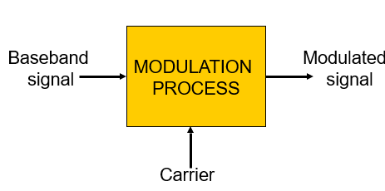
Block Diagram of Modulation Process

Slide 20
What is modulation?
Modulation:
Process of changing baseband signals to facilitate the transmission medium.
Modulation is the process of changing the parameters of the carrier signal in accordance with the instantaneous of message signal.
Process of modulation
  Frequency translation such as AM, FM, PM etc
  Sampling and coding such as PAM, PCM etc
  Keying such as ASK, FSK etc

Slide 21
Modulation
Types of modulation :
  Analogue modulations are frequency translation method caused by changing the appropriate quantity in a carrier signal
  Digital modulation is the result of changing analogue signal into binary ones by sampling and coding
  Keying modulations are digital signals subsequently modulated by the frequency modulation by using one or other analogue method

Slide 22
Thank You

