Slide 1
Principles of communication
SEM – III
DEPARTMENT OF INFORMATION TECHNOLOGY

Slide 2
Introduction to the course
Contents:
Module1 – Basics of Communication
Module2 – Fourier Transform and Noise
Module3 – Analog Communication
Module4 – Pulse Analog Communication
Module5 – Digital Communication
Module6 – Radio and Propagation of waves

Slide 3
Moodle server details
Moodle Server----> 14.142.126.126//moodle
Information Technology – SE ODD SEM – Principles of Communication – PCOM_2019 - 2020

Slide 4
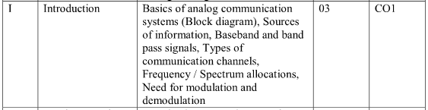
Syllabus : Module- 1

Slide 5
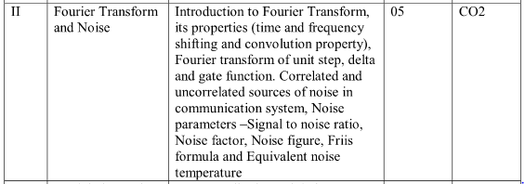
Module - 2

Slide 6
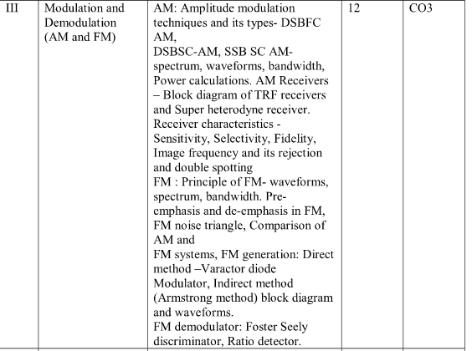
MODULE -3

Slide 7

MODULE - 4

Slide 8
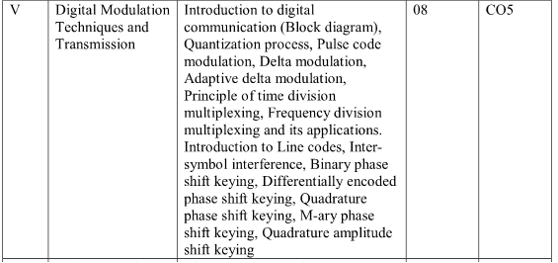
MODULE - 5

Slide 9

Module - 6

Slide 10
Study Materials
Text Books:
Simon Haykin, Michael Moher, Introduction to Analog & Digital Communications, Wiley India Pvt. Ltd., 2nd Ed.
V Chandrasekar, Communication Systems, Oxford University Press, Ist Ed.
Reference Books
George Kennedy, Bernard Davis, SRM Prasanna, Electronic Communication Systems, Tata McGraw Hill, 5th Ed.
Wayne Tomasi, Electronic Communications Systems, Pearson Publication, 5th Ed.
BP Lathi,Zhi Ding, Modern Digital and Analog Communication Systems, Oxford University.
Analog and Digital Communications by TL Signal

Slide 11
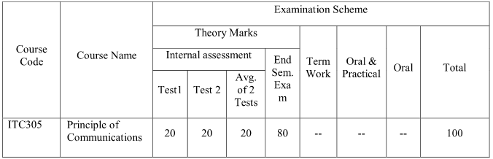
Term Test – 20 Marks
Term Work – (Assignments, Tutorial Submission, MCQ’s and Mock Viva)

Slide 12
Tutorial & Assignment Evaluation
Rubrics Evaluation is based on (Total – 10marks)
Knowledge 2 Marks
Presentation 2 Marks
Understanding/ Problem Solving Skill/ Completeness 4 Marks
Punctuality & Submission on Time 2 Marks
Assignment Evaluation is based on, (Total – 5marks)
Knowledge 2 Marks
Content 2 Marks
Neatness and Timeline 1 Marks

Slide 13
Course OUTCOMES:
On successful completion of the course, students should be able to,
CO1- Apply Fourier analysis to identify different types of noise occurred in analog and digital communication systems.
CO2- Discuss different Analog Modulation and Demodulation Methods.
CO3- Apply Sampling Theorem to design Pulse Modulation and Demodulation Methods and to understand different multiplexing techniques.
CO4- Discuss Digital Modulation and Demodulation methods and also describe the effect of Electromagnetic Radiation and propagation of waves.

