Slide 1
Noise in Communication
System

Slide 2
NOISE
Electrical noise is defined as any undesirable electrical energy that falls within the passband of the signal.
The unwanted signals arise from a variety of sources which may be considered in one of two main categories:-
Interference, usually from a human source (man made)
Naturally occurring random noise
Interference
Interference arises for example, from other communication systems (cross talk), 50 Hz supplies (hum) and harmonics, switched mode power supplies, thyristor circuits, ignition (car spark plugs) motors … etc.

Slide 3
Types of Noise
Noise
Correlated
Harmonic distortion
Inter modulation distortion
Uncorrelated
Internal Noise
External Noise
Shot noise
Transit time noise
Thermal Noise
Flicker Noise
Partition Noise
Atmospheric Noise
Extra Terrestrial Noise
Man-made noise
Solar noise
Cosmic noise

Slide 4
Correlated noise:
“ If there is no signal then there is no noise”.
It is produced by non-linear Amplification which includes,
1. Harmonic Distortion
Intermodulation Distortion
Non-linear distortion that creates unwanted frequencies that interfere with the signal and degrade the performance.

Slide 5
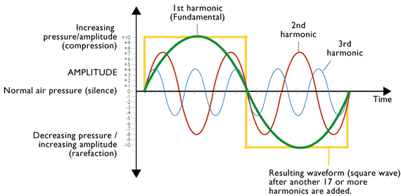
Harmonic Distortion:
Harmonics are integral multiple of the original signal.
It is also called amplitude distortion.

Slide 6
Intermodulation Distortion:
Intermodulation takes place when the frequency components in the original signal mix in a non-linear device to produce sum and difference frequency components.
For example , mixer and radio detector
Sum frequency
Difference frequency
freq
fb-fa
fa
fb
fb+fa

Slide 7
External Noise
Atmospheric Noise : Atmospheric Noise is also known as static noise which is the natural source of disturbance caused by lightning, discharge in thunderstorm and the natural disturbances occurring in the nature.
Industrial Noise : Sources of Industrial noise are auto-mobiles, aircraft, ignition of electric motors and switching gear.
The main cause of Industrial noise is High voltage wires. These noises is generally produced by the discharge present in the operations. It is also called as MAN-MADE NOISE.

Slide 8
Extraterrestrial Noise : Extraterrestrial Noise exist on the basis of their originating source.
They are subdivided into
i) Solar Noise
ii) Cosmic Noise
Solar Noise: Solar noise is generated by the sun. As Sun is a large body with extremely high temperature thus it emits or releases high electrical energy in noise form over a broad frequency range.
However, the intensity of the produced noise signal changes timely. This is so because the temperature change of the sun.

Slide 9
Cosmic Noise: This noise originates from the stars present in the outer space. As distant stars are also very high-temperature bodies and are also termed as the sun. The noise generated from the star is similar to that generated from the sun. Cosmic noise is also known as black body noise.

Slide 10
Internal Noise
Internal Noise are the type of Noise which are generated internally or within the Communication System or in the receiver. They may be treated qualitatively and can also be reduced or minimized by the proper designing of the system.

Slide 11
Shot Noise : These Noise are generally arises in the active devices due to the random behaviour of Charge particles. In case of electron tube, shot Noise is produces due to the random emission of electron form cathodes.
Partition Noise : When a circuit is to divide in between two or more paths then the noise generated is known as Partition noise. The reason for the generation is random fluctuation in the division.
Low- Frequency Noise : They are also known as FLICKER NOISE. These type of noise are generally observed at a frequency range below few kHz. Power spectral density of these noise increases with the decrease in frequency. That why the name is given Low- Frequency Noise.

Slide 12
High- Frequency Noise : These noises are also known TRANSIT- TIME Noise. They are observed in the semi-conductor devices when the transit time of a charge carrier while crossing a junction is compared with the time period of that signal.
Thermal Noise : Thermal Noise are random and often referred as White Noise or Johnson Noise. Thermal noise are generally observed in the resistor or the sensitive resistive components of a complex impedance due to the random and rapid movement of molecules or atoms or electrons

Slide 13
Thank You !!!

