Slide 1
Multithread Programming

Slide 2
Process
The executable program loaded in memory is called process.
It has its own address space.
Each process may execute a different program.
Each process communicates via operating system, files and network.
Process may contain multiple threads.

Slide 3
Thread
A thread is a light-weight smallest part of a process that can run concurrently with the other parts(other threads) of the same process.
Threads are independent because they all have separate path of execution, that’s the reason if an exception occurs in one thread, it doesn’t affect the execution of other threads.
All threads of a process share the common memory.
The process of executing multiple threads simultaneously is known as multithreading.

Slide 4
Advantages of Java Multithreading
It doesn't block the user because threads are independent and you can perform multiple operations at same time.
You can perform many operations together so it saves time.
Threads are independent so it doesn't affect other threads if exception occur in a single thread.
Notes:
In a multithreaded application, different parts of the application are executed by different threads.
The entire application does not halt even if any of the threads is blocked during the execution of the application.
Different threads are allocated to different processors and each thread is executed in different processors in parallel.
Reduces the computation time.

Slide 5
Note
The main purpose of multithreading is to provide simultaneous execution of two or more parts of a program to maximum utilize the CPU time.
A multithreaded program contains two or more parts that can run concurrently.
Each such part of a program called thread.
Threads are lightweight sub-processes, they share the common memory space.
In Multithreaded environment, programs that are benefited from multithreading, utilize the maximum CPU time so that the idle time can be kept to minimum.

Slide 6
Terms
Multitasking: Ability to execute more than one task at the same time is known as multitasking. One CPU is involved in multitasking.
Multithreading: It is a process of executing multiple threads simultaneously. Multithreading is also known as Thread-based Multitasking.
Multiprocessing: It is same as multitasking, however in multiprocessing more than one CPUs are involved.
Parallel Processing: It refers to the utilization of multiple CPUs in a single computer system.

Slide 7
Process-based Multitasking (Multiprocessing) | Thread-based Multitasking (Multithreading)
Each process have its own address in memory i.e. each process allocates separate memory area. | Threads share the same address space.
Process is heavyweight. | Thread is lightweight.
Cost of communication between the process is high. | Cost of communication between the thread is low.
Switching from one process to another require some time for saving and loading registers, memory maps, updating lists etc. | At least one process is required for each thread.

Slide 8
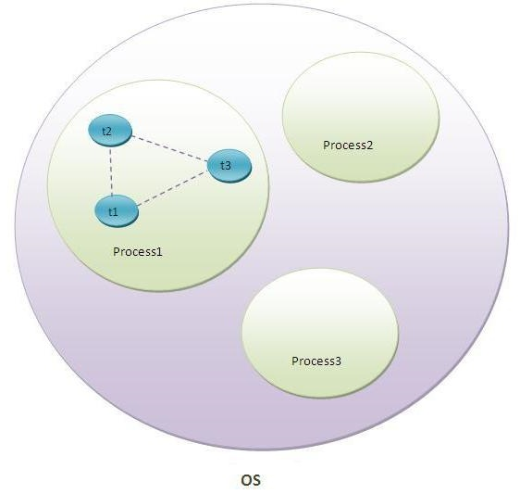
Thread in Java

Slide 9
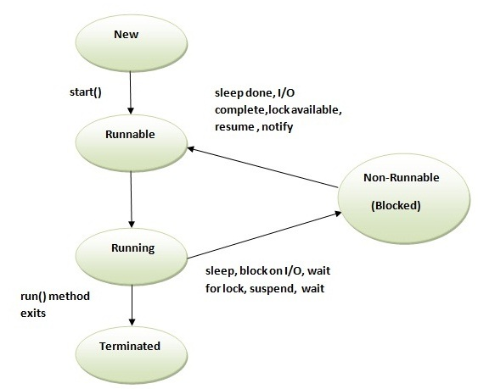
Life cycle of thread

Slide 10
New/ NewBorn State:
  A new thread begins its life cycle in the new state.
  It remains in this state until the program starts the thread.
  It is also referred to as a born thread.
Runnable:
  After a newly born thread is started, the thread becomes runnable
  A thread in this state is considered to be ready for execution and is waiting for the availability of the processor .

Slide 11
Running
The thread is in running state if the thread scheduler has selected it.
Non-Runnable (Blocked)
This is the state when the thread is still alive, but is currently not eligible to run.

Slide 12
Terminated
A thread is in terminated or dead state when its run() method exits.
A runnable thread enters the terminated state when it completes its task or otherwise terminates.
Notes:
Timed waiting:
A runnable thread can enter the timed waiting state for a specified interval of time.
A thread in this state transitions back to the runnable state when that time interval expires or when the event it is waiting for occurs.

Slide 13
Benefits of Multithreading
In a multithreaded application, different parts of the application are executed by different threads.
The entire application does not halt even if any of the threads is blocked during the execution of the application.
Different threads are allocated to different processors and each thread is executed in different processors in parallel.
Reduces the computation time.

Slide 14
Benefits …
Improves the performance of an application
Threads share the same address space and hence saves memory .
Cost of communication between threads is relatively low.
Utilizes hardware resources in a better way.
Better availability

Slide 15
Drawbacks of Multithread
Increased complexity
Synchronization of shared resources.
Debugging is difficult, at times result is unpredictable
Potential deadlock.
Programming complications may occur.

Slide 16
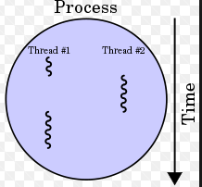
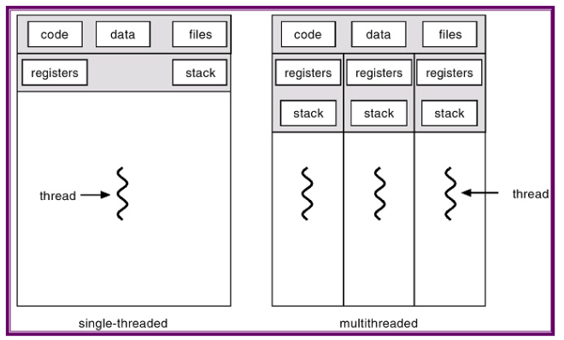

Slide 17
Creating a thread in Java
There are two ways to create user defined thread in Java:
1) By extending Thread class.
2) By implementing Runnable interface.

Slide 18
Runnable interface
Runnable is predefined interface declared in java.lang package.
It is implemented by a class that is intended to be executed by a thread and it must define a method of no arguments called run.
A thread has been started and not being stopped.
Thread methods are overridden except the run().
By inheriting from runnable interface, programmers construct user define threads.
One predeclared method
public void run()

Slide 19
Thread class
Thread is predefined class declared in java.lang package.
JVM allows an application to have multiple threads of execution running concurrently.
Threads have their own priority.
Highest priority threads are executed in preference to lower priority threads.

Slide 20
Thread class
Thread class provide constructors and methods to create and perform operations on a thread.
Thread class extends Object class and implements Runnable interface.
Commonly used Constructors of Thread class:
Thread()
Thread(String name)
Thread(Runnable r)
Thread(Runnable r,String name)

Slide 21
Commonly used methods of Thread class
public void run(): is used to perform action for a thread.
public void start(): starts the execution of the thread.JVM calls the run() method on the thread.
public void sleep(long miliseconds): Causes the currently executing thread to sleep (temporarily cease execution) for the specified number of milliseconds.
public void join(): waits for a thread to die.
public void join(long miliseconds): waits for a thread to die for the specified miliseconds.

Slide 22
public int getPriority(): returns the priority of the thread.
public int setPriority(int priority): changes the priority of the thread.
public String getName(): returns the name of the thread.
public void setName(String name): changes the name of the thread.
public Thread currentThread(): returns the reference of currently executing thread.
public int getId(): returns the id of the thread.
public Thread.State getState(): returns the state of the thread.

Slide 23
public boolean isAlive(): tests if the thread is alive.
public void yield(): causes the currently executing thread object to temporarily pause and allow other threads to execute.
public void suspend(): is used to suspend the thread(depricated).
public void resume(): is used to resume the suspended thread(depricated).
public void stop(): is used to stop the thread(depricated).
public boolean isDaemon(): tests if the thread is a daemon thread.
public void setDaemon(boolean b): marks the thread as daemon or user thread.
public void interrupt(): interrupts the thread.

Slide 24
Priority of a Thread (Thread Priority)
Each thread have a priority.
Priorities are represented by a number between 1 and 10.
In most cases, thread schedular schedules the threads according to their priority (known as preemptive scheduling).
But it is not guaranteed because it depends on JVM specification that which scheduling it chooses.

Slide 25
3 constants defined in Thread class
public static int MIN_PRIORITY
public static int NORM_PRIORITY
public static int MAX_PRIORITY
Default priority of a thread is 5 (NORM_PRIORITY).
The value of MIN_PRIORITY is 1 and
value of MAX_PRIORITY is 10.

Slide 26
Example of priority of a Thread
class TestMultiPriority1 extends Thread{
public void run(){
System.out.println("running thread name is:"+Thread.currentThread().getName());
System.out.println("running thread priority is:"+Thread.currentThread().getPriority());
} }

Slide 27
public static void main(String args[]){
TestMultiPriority1 m1=new TestMultiPriority1();
TestMultiPriority1 m2=new TestMultiPriority1();
m1.setPriority(Thread.MIN_PRIORITY);
m2.setPriority(Thread.MAX_PRIORITY);
m1.start();
m2.start();
}
Output:
running thread name is:Thread-0 running thread priority is:10 running thread name is:Thread-1 running thread priority is:1

Slide 28
Daemon Thread in Java
Daemon thread in java is a service provider thread that provides services to the user thread.
Its life depend on the mercy of user threads i.e. when all the user threads dies, JVM terminates this thread automatically.
There are many java daemon threads running automatically e.g. gc, finalizer etc.
Typing the jconsole in the command prompt will show all the details.
The jconsole tool provides information about the loaded classes, memory usage, running threads etc.

Slide 29
Note !!
It provides services to user threads for background supporting tasks. It has no role in life than to serve user threads.
Its life depends on user threads.
It is a low priority thread.

Slide 30
Termination of Daemon thread
The sole purpose of the daemon thread is that it provides services to user thread for background supporting task.
If there is no user thread, why should JVM keep running this thread.
That is why JVM terminates the daemon thread if there is no user thread.

Slide 31
Methods for Java Daemon thread by Thread class
The java.lang.Thread class provides two methods for java daemon thread.
No. | Method | Description
1) | public void setDaemon(boolean status) | is used to mark the current thread as daemon thread or user thread.
2) | public boolean isDaemon() | is used to check that current is daemon

Slide 32
Simple example of Daemon thread in java
public class TestDaemonThread1 extends Thread{
public void run(){
if(Thread.currentThread().isDaemon()){
//checking for daemon thread
System.out.println("daemon thread work");
}
else{
System.out.println("user thread work");
}
}

Slide 33
public static void main(String[] args){
TestDaemonThread1 t1=new TestDaemonThread1();
//creating thread
TestDaemonThread1 t2=new TestDaemonThread1();
TestDaemonThread1 t3=new TestDaemonThread1();
t1.setDaemon(true); //now t1 is daemon thread
t1.start(); //starting threads
t2.start();
t3.start();
}
}
Output
daemon thread work
user thread work
user thread work

Slide 34
Thread Synchronization
Two or more threads within a program, there may be a situation when multiple threads try to access the same resource and finally they can produce unforeseen result due to concurrency issues.
For example,
If multiple threads try to write within a same file then they may corrupt the data because one of the threads can override data
While one thread is opening the same file at the same time another thread might be closing the same file.

Slide 35
So there is a need to synchronize the action of multiple threads and make sure that only one thread can access the resource at a given point in time.
This is implemented using a concept called monitors.
Each object in Java is associated with a monitor, which a thread can lock or unlock.
Only one thread at a time may hold a lock on a monitor.
Java programming language provides a very handy way of creating threads and synchronizing their task by using synchronized blocks. You keep shared resources within this block.

Slide 36
Why use Synchronization
The synchronization is mainly used to
To prevent thread interference.
To prevent consistency problem.

Slide 37
Types of Synchronization
There are two types of synchronization
Process Synchronization
Thread Synchronization

Slide 38
Thread Synchronization
There are two types of thread synchronization mutual exclusive and
inter-thread communication.
Mutual Exclusive
  Synchronized method.
  Synchronized block.
Cooperation (Inter-thread communication in java)

Slide 39
Concept of Lock in Java
Synchronization is built around an internal entity known as the lock or monitor.
Every object has an lock associated with it.
By convention, a thread that needs consistent access to an object's fields has to acquire the object's lock before accessing them, and then release the lock when it's done with them.

Slide 40
Synchronized method
If you declare any method as synchronized, it is known as synchronized method.
Synchronized method is used to lock an object for any shared resource.
When a thread invokes a synchronized method, it automatically acquires the lock for that object and releases it when the thread completes its task.

Slide 41
class Table{
synchronized void printTable(int n){ //synchronized method
for(int i=1;i<=5;i++){
System.out.println(n*i);
try{
Thread.sleep(400);
}catch(Exception e){System.out.println(e);}
}}}
class MyThread1 extends Thread{
Table t;
MyThread1(Table t){
this.t=t;
}
public void run(){
t.printTable(5);
}
}

Slide 42
class MyThread2 extends Thread{
Table t;
MyThread2(Table t){
this.t=t;
}
public void run(){
t.printTable(100);
} }
public class TestSynchronization2{
public static void main(String args[]){
Table obj = new Table(); //only one object
MyThread1 t1=new MyThread1(obj);
MyThread2 t2=new MyThread2(obj);
t1.start();
t2.start();
} }

Slide 43
Synchronized block in java
Synchronized block can be used to perform synchronization on any specific resource of the method.
Suppose you have 50 lines of code in your method, but you want to synchronize only 5 lines, you can use synchronized block.
If you put all the codes of the method in the synchronized block, it will work same as the synchronized method.
Points to remember for Synchronized block
Synchronized block is used to lock an object for any shared resource.
Scope of synchronized block is smaller than the method.

Slide 44
Example
class MyThread1 extends Thread{
Table t;
MyThread1(Table t){
this.t=t;
}
public void run(){
t.printTable(5);
} }
class Table{
void printTable(int n){
synchronized(this){//synchronized block
for(int i=1;i<=5;i++){
System.out.println(n*i);
try{
Thread.sleep(400);
}catch(Exception e){System.out.println(e);} } }
} //end of the method
}

Slide 45
class MyThread2 extends Thread{
Table t;
MyThread2(Table t){
this.t=t;
}
public void run(){
t.printTable(100);
}
}
public class TestSynchronizedBlock1{
public static void main(String args[]){
Table obj = new Table(); //only one object
MyThread1 t1=new MyThread1(obj);
MyThread2 t2=new MyThread2(obj);
t1.start();
t2.start();
}
}

Slide 46
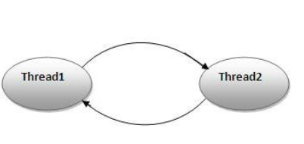
Deadlock in java
Deadlock in java is a part of multithreading.
Deadlock can occur in a situation when a thread is waiting for an object lock, that is acquired by another thread and second thread is waiting for an object lock that is acquired by first thread.
Since, both threads are waiting for each other to release the lock, the condition is called deadlock.

Slide 47
Inter-thread communication in Java
Inter-thread communication or Co-operation is all about allowing synchronized threads to communicate with each other.
Cooperation (Inter-thread communication) is a mechanism in which a thread is paused running in its critical section and another thread is allowed to enter (or lock) in the same critical section to be executed.
It is implemented by following methods of Object class:
wait()
notify()
notifyAll()

Slide 48
wait() method
Causes current thread to release the lock and wait until either another thread invokes the notify() method or the notifyAll() method for this object, or a specified amount of time has elapsed.
The current thread must own this object's monitor, so it must be called from the synchronized method only otherwise it will throw exception.

Slide 49
notify() method
Wakes up a single thread that is waiting on this object's monitor.
If any threads are waiting on this object, one of them is chosen to be awakened.
The choice is arbitrary and occurs at the discretion of the implementation.
Syntax:
public final void notify()

Slide 50
notifyAll() method
Wakes up all threads that are waiting on this object's monitor.
Syntax:
public final void notifyAll()

Slide 51
Wait() v/s Sleep()
wait() | sleep()
wait() method releases the lock | sleep() method doesn't release the lock.
method of Object class | method of Thread class
non-static method | static method
should be notified by notify() or notifyAll() methods | after the specified amount of time, sleep is completed.

Slide 52
Quiz
What is the name of the method used to start a thread execution?
A.init();
B.start();
C.run();
D.resume();
Answer: Option B

Slide 53
Which two are valid constructors for Thread?
1.Thread(Runnable r, String name)
2.Thread()
3.Thread(int priority)
4.Thread(Runnable r, ThreadGroup g)
5.Thread(Runnable r, int priority)
A.1 and 3
B.2 and 4
C.1 and 2
D.2 and 5
Answer: Option C

Slide 54
class X implements Runnable
{ public static void main(String args[]) {
/* Missing code? */
}
public void run() {} }
Which of the following line of code is suitable to start a thread ?
A.Thread t = new Thread(X);
B.Thread t = new Thread(X); t.start();
C.X run = new X(); Thread t = new Thread(run); t.start();
D.Thread t = new Thread(); x.run();
Answer: Option C

Slide 55
Which cannot directly cause a thread to stop executing?
A.Calling the SetPriority() method on a Thread object.
B.Calling the wait() method on an object.
C.Calling notify() method on an object.
D.Calling read() method on an InputStream object.
Answer: Option C

