Slide 1
Method Overriding in java

Slide 2
Method Overriding
Declaring a method in subclass which is already present in parent class is known as method overriding
Example:
One of the simplest example- Boy class extends Human class.
Both the classes have a common method void eat().
Boy class is giving its own implementation to the eat() method or in other words it is overriding the method eat().

Slide 3
class Human{
public void eat()
{
System.out.println("Human is eating");
}
}
class Boy extends Human{
public void eat(){
System.out.println("Boy is eating");
}
public static void main( String args[]) {
Boy obj = new Boy();
obj.eat();
}
}
Output:
Boy is eating

Slide 4
Rules of method overriding in Java
Argument list:
The argument list of overriding method must be same as that of the method in parent class.
The data types of the arguments and their sequence should be maintained as it is in the overriding method.

Slide 5
Rules of method overriding in Java
Access Modifier:
The Access Modifier of the overriding method (method of subclass) cannot be more restrictive than the overridden method of parent class.
For e.g. if the Access Modifier of base class method is public then the overriding method (child class method ) cannot have private, protected and default Access modifier as all of the three are more restrictive than public.

Slide 6
class MyBaseClass{
public void disp()
{
System.out.println("Parent class method");
}
}
class MyChildClass extends MyBaseClass{
protected void disp(){
System.out.println("Child class method");
}
public static void main( String args[]) {
MyChildClass obj = new MyChildClass();
obj.disp();
}
}

Slide 7
Error !!!!
Output:
Exception in thread "main" java.lang.Error: Unresolved compilation problem: Cannot reduce the visibility of the inherited method from MyBaseClass
This is not allowed as child class disp method is more restrictive(protected) than base class(public)

Slide 8
However this is perfectly valid scenario as public is less restrictive than protected. Same access modifier is also a valid one.
class MyBaseClass{
protected void disp() {
System.out.println("Parent class method");
}
}
class MyChildClass extends MyBaseClass{
public void disp(){
System.out.println("Child class method");
}
public static void main( String args[]) {
MyChildClass obj = new MyChildClass();
obj.disp();
}}
Output:
Child class method

Slide 9
Note
Private, static and final methods cannot be overridden as they are local to the class.
However static methods can be re-declared in the sub class, in this case the sub-class method would act differently and will have nothing to do with the same static method of parent class.
Overriding method (method of child class) can throw any unchecked exceptions, regardless of whether the overridden method(method of parent class) throws any exception or not.

Slide 10
However the overriding method should not throw checked exceptions that are new or broader than the ones declared by the overridden method.
Binding of overridden methods happen at runtime which is known as dynamic binding.
If a class is extending an abstract class or implementing an interface then it has to override all the abstract methods unless the class itself is a abstract class.

Slide 11
Super keyword in Overriding
super keyword is used for calling the parent class method/constructor.
super.methodname() calling the specified method of base class while super() calls the constructor of base class.
Let’s see the use of super in Overriding.

Slide 12
class ABC{
public void mymethod()
{
System.out.println("Class ABC: mymethod()");
}
}
class Test extends ABC{
public void mymethod(){
super.mymethod(); //This will call the mymethod() of parent class
System.out.println("Class Test: mymethod()");
}
public static void main( String args[]) {
Test obj = new Test();
obj.mymethod();
}}
Output:
Class ABC: mymethod()
Class Test: mymethod()

Slide 13
Overloading vs overriding
Overloading | Overriding
Overloading happens at compile-time | Overriding happens at runtime
The binding of overloaded method call to its definition has happens at compile-time | Binding of overridden method call to its definition happens at runtime
Static methods can be overloaded which means a class can have more than one static method of same name | Static methods cannot be overridden, even if you declare a same static method in child class it has nothing to do with the same method of parent class.
Argument list should be different while doing method overloading | Argument list should be same in method Overriding.

Slide 14
Overloading | Overriding
Basic difference is that overloading is being done in the same class | For overriding base and child classes are required. Overriding is all about giving a specific implementation to the inherited method of parent class.
Static binding is being used for overloaded methods | Dynamic binding is being used for overridden/overriding methods.
Return type of method does not matter in case of method overloading, it can be same or different | The overriding method can have more specific return type

Slide 15
Real example of Java Method Overriding
Consider a scenario,
Bank is a class that provides functionality to get rate of interest.
But, rate of interest varies according to banks. For example, SBI, ICICI and AXIS banks could provide 8%, 7% and 9% rate of interest.

Slide 16
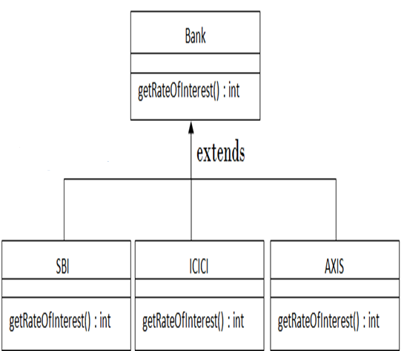

Slide 17
class Bank{
int getRateOfInterest(){return 0;}
}
class SBI extends Bank{
int getRateOfInterest(){return 8;}
}
class ICICI extends Bank{
int getRateOfInterest(){return 7;}
}
class AXIS extends Bank{
int getRateOfInterest(){return 9;}
}

Slide 18
class Test2{
public static void main(String args[]){
SBI s=new SBI();
ICICI i=new ICICI();
AXIS a=new AXIS();
System.out.println("SBI Rate of Interest: "+s.getRateOfInterest());
System.out.println("ICICI Rate of Interest: "+i.getRateOfInterest());
System.out.println("AXIS Rate of Interest: "+a.getRateOfInterest());
}
}
Output:
SBI Rate of Interest: 8
ICICI Rate of Interest: 7
AXIS Rate of Interest: 9

Slide 19
END

