Slide 1
Method Overloading in Java

Slide 2
Method Overloading / Static Polymorphism.
Method overloading is also known as Static Polymorphism.
Method Overloading is a feature that allows a class to have two or more methods having same name, if their argument lists are different.
Argument lists could differ in –
1. Number of parameters.
2. Data type of parameters.
3. Sequence of Data type of parameters.

Slide 3
Note
Static Polymorphism is also known as compile time binding or early binding.
Static binding happens at compile time.
Method overloading is an example of static binding where binding of method call to its definition happens at Compile time.

Slide 4
Example 1: Overloading – Different Number of parameters in argument list
When methods name are same but number of arguments are different.
class DisplayOverloading
{
public void disp(char c) // disp method -1 args
{
System.out.println(c);
}
public void disp(char c, int num) // disp method -2 args
{
System.out.println(c + " "+num);
}
}

Slide 5
class Sample
{ public static void main(String args[]) {
DisplayOverloading obj = new DisplayOverloading();
obj.disp('a');
obj.disp('a',10);
}}
Output:
a
a 10

Slide 6
Example 2: Overloading – Difference in data type of arguments
In this example, method disp() is overloaded based on the datatype of arguments.
we have two definition of method disp(),
one with char argument and
another with int argument.

Slide 7
class DisplayOverloading2
{
public void disp(char c)
{ System.out.println(c); }
public void disp(int c)
{ System.out.println(c ); }
}
class Sample2
{
public static void main(String args[]) {
DisplayOverloading2 obj = new DisplayOverloading2();
obj.disp('a');
obj.disp(5);
}}
Output:
a
5

Slide 8
Example3: Overloading – Sequence of data type of arguments
method disp() is overloaded based on sequence of data type of arguments
Both the methods have different sequence of data type in argument list.
First method is having argument list as (char, int) and second is having (int, char).
Since the sequence is different, the method can be overloaded without any issues.

Slide 9
class DisplayOverloading3
{
public void disp(char c, int num)
{
System.out.println("I’m the first definition of method disp");
}
public void disp(int num, char c)
{
System.out.println("I’m the second definition of method disp" );
}
}

Slide 10
class Sample3
{ public static void main(String args[]) {
DisplayOverloading3 obj = new DisplayOverloading3();
obj.disp('x', 51 );
obj.disp(52, 'y');
}
}
Output:
I’m the first definition of method disp
I’m the second definition of method disp

Slide 11
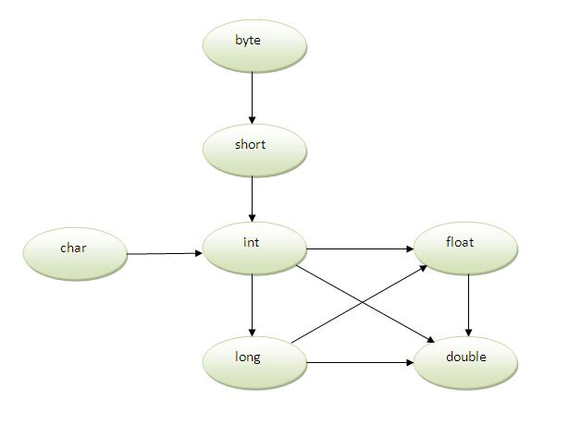
Method Overloading and Type Promotion
Notes:
One type is promoted to another implicitly if no matching datatype is found.
As displayed in the above diagram, byte can be promoted to short, int, long, float or double. The short datatype can be promoted to int,long,float or double. The char datatype can be promoted to int,long,float or double and so on.

Slide 12
One type is promoted to another implicitly if no matching datatype is found.
As displayed in the above diagram, byte can be promoted to short, int, long, float or double.
The short datatype can be promoted to int, long, float or double.
The char datatype can be promoted to int, long, float or double and so on.

Slide 13
Example of Method Overloading with TypePromotion
class OverloadingCalculation1
{
void sum(int a, long b)
{
System.out.println(a+b);
}
void sum(int a, int b, int c)
{
System.out.println(a+b+c);
}

Slide 14
public static void main(String args[]){
OverloadingCalculation1 obj=new OverloadingCalculation1();
obj.sum(20,20); //now int literal will be promoted to long
obj.sum(20,20,20);
}
}
Output: 40
60

Slide 15
Example of Method Overloading with Type Promotion in case of ambiguity
If there are no matching type arguments in the method, and each method promotes similar number of arguments, there will be ambiguity.
class OverloadingCalculation3
{
void sum(int a,long b)
{
System.out.println("a method invoked");
}
void sum(long a,int b)
{
System.out.println("b method invoked");
}

Slide 16
public static void main(String args[]){
OverloadingCalculation3 obj=new OverloadingCalculation3();
obj.sum(20,20); //now ambiguity
}
}
Output: Compile Time Error
One type is not de-promoted implicitly
for example
double cannot be depromoted to any type implicitly.

Slide 17
Few Valid/invalid cases of method overloading
Case 1:
int mymethod(int a, int b, float c)
int mymethod(int var1, int var2, float var3)
Result: Compile time error.
Argument lists are exactly same.
Both methods are having same number, data types and same sequence of data types in arguments.

Slide 18
Case 2:
int mymethod(int a, int b)
int mymethod(float var1, float var2)
Result: Perfectly fine.
Valid case for overloading.
Here data types of arguments are different.

Slide 19
Case 3:
int mymethod(int a, int b)
int mymethod(int num)
Result: Perfectly fine.
Valid case for overloading.
Here number of arguments are different.

Slide 20
Case 4:
float mymethod(int a, float b)
float mymethod(float var1, int var2)
Result: Perfectly fine.
Valid case for overloading.
Sequence of the data types are different, first method is having (int, float) and second is having (float, int).

Slide 21
Case 5:
int mymethod(int a, int b)
float mymethod(int var1, int var2)
Result: Compile time error.
Argument lists are exactly same.
Even though return type of methods are different, it is not a valid case.
Since return type of method doesn’t matter while overloading a method.

Slide 22
Note
In java, Method Overloading is not possible by changing the return type of the method.

Slide 23
????
class Demo
{
public int myMethod(int num1, int num2)
{ System.out.println("First myMethod of class Demo");
return num1+num2;
}
public int myMethod(int var1, int var2)
{ System.out.println("Second myMethod of class Demo");
return var1-var2;
}
}

Slide 24
class Sample4
{ public static void main(String args[]) {
Demo obj1= new Demo();
obj1.myMethod(10,10);
obj1.myMethod(20,12);
}
}
Answer:
It will throw a compilation error: More than one method with same name and argument list cannot be defined in a same class.

Slide 25
?????
class Demo2
{ public double myMethod(int num1, int num2)
{
System.out.println("First myMethod of class Demo");
return num1+num2;
}
public int myMethod(int var1, int var2)
{
System.out.println("Second myMethod of class Demo");
return var1-var2;
}
}

Slide 26
class Sample5
{ public static void main(String args[]) {
Demo2 obj2= new Demo2();
obj2.myMethod(10,10);
obj2.myMethod(20,12);
}
}
Answer:
It will throw a compilation error: More than one method with same name and argument list cannot be given in a class even though their return type is different. Method return type doesn’t matter in case of overloading.

Slide 27
Examples
First sum method performs addition of two numbers and second sum method performs addition of three numbers.
class Calculation
{
void sum(int a,int b)
{
System.out.println(a+b);
}
void sum(int a,int b,int c)
{
System.out.println(a+b+c);
}
Notes:
In this example, we have created two overloaded methods,

Slide 28
public static void main(String args[]){
Calculation obj=new Calculation();
obj.sum(10,10,10);
obj.sum(20,20);
}
}
Output: 30
40

Slide 29
Example 2
The first sum method receives two integer arguments and second sum method receives two double arguments.
class Calculation2
{
void sum(int a,int b)
{
System.out.println(a+b);
}
void sum(double a,double b)
{
System.out.println(a+b);
}
Notes:
In this example, we have created two overloaded methods that differs in data type.

Slide 30
public static void main(String args[]){
Calculation2 obj=new Calculation2();
obj.sum(10.5,10.5);
obj.sum(20,20);
}
}
Output:21.0
40

