Slide 1
Flow of Control

Slide 2
Objectives
learn about Java branching statements
learn about loops
learn about the type boolean

Slide 3
Flow of Control
Flow of control is the order in which a program performs actions.
  Up to this point, the order has been sequential.
A branching statement chooses between two or more possible actions.
A loop statement repeats an action until a stopping condition occurs.

Slide 4
Branching Statements
The if-else Statement
Introduction to Boolean Expressions
Nested Statements and Compound Statements
Multibranch if-else Statements
The switch Statament
(optional) The Conditional Operator

Slide 5
The if-else Statement
A branching statement that chooses between two possible actions.
syntax
  if (Boolean_Expression)
  Statement_1
  else
  Statement_2

Slide 6
The if-else Statement
example
  if (count < 3)
  total = 0;
  else
  total = total + count;

Slide 7
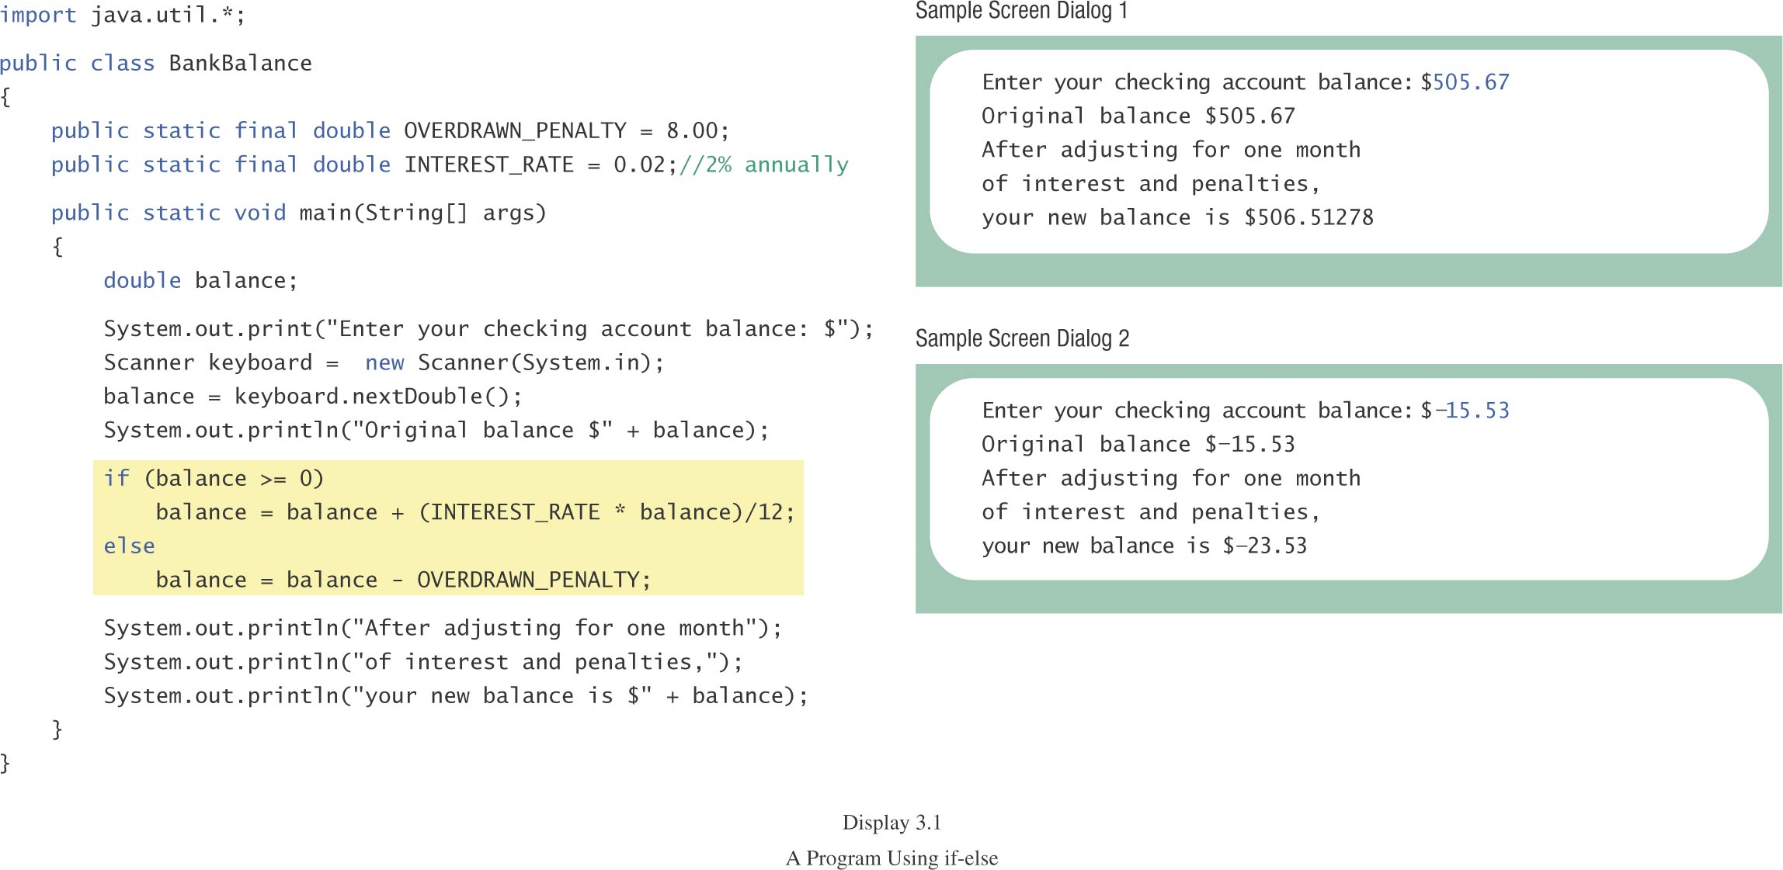
The if-else Statement
class BankBalance

Slide 8
Compound Statements
To include multiple statements in a branch, enclose the statements in braces.
  if (count < 3)
  {
  total = 0;
  count = 0;
  }

Slide 9
Omitting the else Part
If the else part is omitted and the expression after the if is false, no action occurs.
syntax
  if (Boolean_Expression)
  Statement
example
  if (weight > ideal)
  caloriesPerDay -= 500;

Slide 10
Introduction to Boolean Expressions
The value of a boolean expression is either true or false.
examples
  time < limit
  balance <= 0

Slide 11
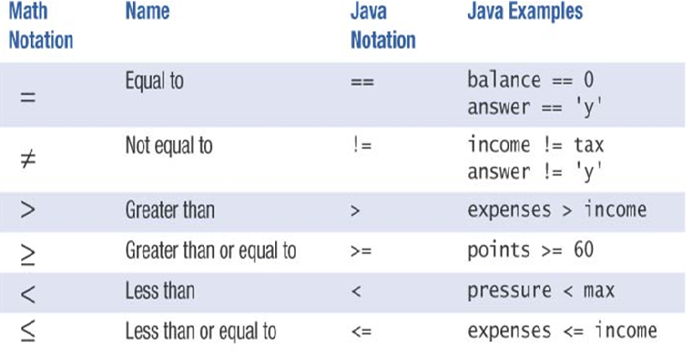
Java Comparison Operators

Slide 12
Compound Boolean Expressions
Boolean expressions can be combined using the “and” (&&) operator.
example
  if ((score > 0) && (score <= 100))
  ...
not allowed
  if (0 < score <= 100)
  ...

Slide 13
Compound Boolean Expressions
syntax
  (Sub_Expression_1) && (Sub_Expression_2)
Parentheses often are used to enhance readability.
The larger expression is true only when both of the smaller expressions are true.

Slide 14
Compound Boolean Expressions
Boolean expressions can be combined using the “or” (||) operator.
example
  if ((quantity > 5) || (cost < 10))
  ...
syntax
  (Sub_Expression_1) || (Sub_Expression_2)

Slide 15
Compound Boolean Expressions
The larger expression is true
  when either of the smaller expressions is true
  when both of the smaller expressions are true.
“or” in Java is inclusive or
  either or both to be true.
exclusive or
  one or the other, but not both to be true.

Slide 16
Negating a Boolean Expression
Boolean negation
  “not” (!) operator.
syntax
  !Boolean_Expression
Example:
  Boolean walk = false;
  System.out.println(!walk);

Slide 17
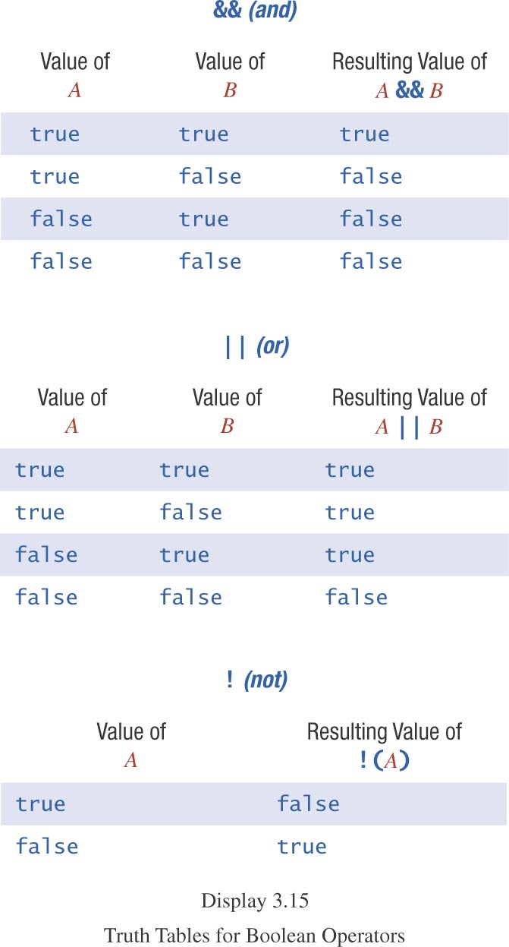
Truth Tables

Slide 18
Primary Logical Operators
Primary logical operators: and, or, not
Any logical expression can be composed
Example: exclusive or
  (a || b) && !(a && b)
Either work or play:
  (work || play) && !(work && play)
^ is exclusive-or in Java
  work ^ play
  not a logical operator in most languages

Slide 19
Using ==
== is appropriate for determining if two integers or characters have the same value.
  if (a == 3)
  where a is an integer type
== is not appropriate for determining if two floating point values are equal.
  Use < and some appropriate tolerance instead.
  if (Math.abs(b - c) < epsilon)
  b, c, and epsilon are of floating point type

Slide 20
Using ==
== is not appropriate for determining if two objects have the same value.
  if (s1 == s2)
    determines only if s1 and s2 are at the same memory location.
  If s1 and s2 refer to strings with identical sequences of characters, but stored in different memory locations
    (s1 == s2) is false.

Slide 21
Using ==, cont.
To test the equality of objects of class String, use method equals.
  s1.equals(s2)
  or
  s2.equals(s1)
  www.cs.fit.edu/~pkc/classes/cse1001/StringEqual.java
To test for equality ignoring case, use method equalsIgnoreCase.
  (“Hello”.equalsIgnoreCase(“hello”))

Slide 22
equals and equalsIgnoreCase
syntax
  String.equals(Other_String)
  String.equalsIgnoreCase(Other_String)

Slide 23
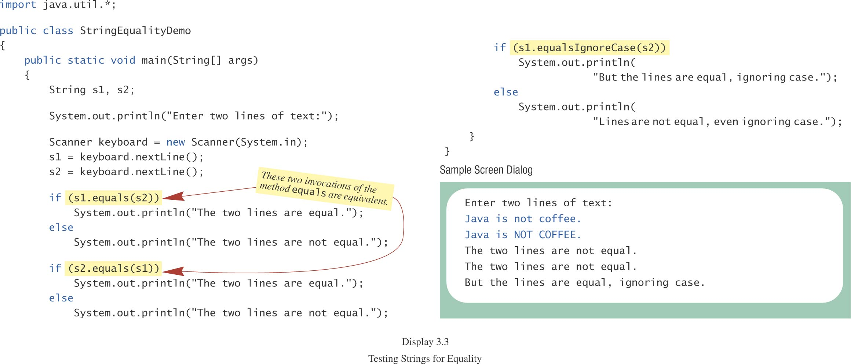
Testing Strings for Equality
class StringEqualityDemo

Slide 24
Lexicographic Order
Lexicographic order is similar to alphabetical order, but is it based on the order of the characters in the ASCII (and Unicode) character set.
  All the digits come before all the letters.
  All the uppercase letters come before all the lower case letters.

Slide 25
Lexicographic Order, cont.
Strings consisting of alphabetical characters can be compared using method compareTo and method toUpperCase or method toLowerCase.
  String s1 = “Hello”;
  String lowerS1 = s1.toLowerCase();
  String s2 = “hello”;
  if (lowerS1.compareTo(s2) == 0)
  System.out.println(“Equal!”);
  //or use s1.compareToIgnoreCase(s2)

Slide 26
Method compareTo
syntax
  String_1.compareTo(String_2)
Method compareTo returns
  a negative number if String_1 precedes String_2
  zero if the two strings are equal
  a positive number of String_2 precedes String_1
  Tip: Think of compareTo is subtraction

Slide 27
Comparing Numbers vs.
Comparing Strings
Integer and floating-point values | String objects
== != | equals( ) equalsIgnoreCase( )
> < >= <= | compareTo( ) [lexicographical ordering]

Slide 28
Nested Statements
An if-else statement can contain any sort of statement within it.
In particular, it can contain another if-else statement.
  An if-else may be nested within the “if” part.
  An if-else may be nested within the “else” part.
  An if-else may be nested within both parts.

Slide 29
Nested Statements, cont.
syntax
  if (Boolean_Expression_1)
  if (Boolean_Expression_2)
  Statement_1
  else
  Statement_2
  else
  if (Boolean_Expression_3)
  Statement_3
  else
  Statement_4

Slide 30
Nested if Example
if (temperature > 90) // int temperature
if (sunny) // boolean sunny
System.out.println(“Beach”);
else
System.out.println(“Movie”);
else
if (sunny)
System.out.println(“Tennis”);
else
System.out.println(“Volleyball”);

Slide 31
Nested Statements, cont.
Each else is paired with the nearest unmatched if.
Indentation can communicate which if goes with which else.
Braces are used to group statements.

Slide 32
Nested Statements, cont.
Different indentation
first form second form
  if (a > b) if (a > b)
  if (c > d) if (c > d)
  e = f; e = f;
  else else
  g = h; g = h;
  Same to the compiler!

Slide 33
Nested Statements, cont.
Are these different?
first form second form
  if (a > b) if (a > b)
  { if (c > d)
  if (c > d) e = f;
  e = f; else
  } g =h;
  else
  g = h;

Slide 34
Nested Statements, cont.
Proper indentation and nested if-else statements
“else” with outer “if” “else” with inner “if”
  if (a > b) if (a > b)
  { if (c > d)
  if (c > d) e = f;
  e = f; else
  } g =h;
  else
  g = h;

Slide 35
Compound Statements
When a list of statements is enclosed in braces ({}), they form a single compound statement.
syntax
  {
  Statement_1;
  Statement_2;
  …
  }

Slide 36
Compound Statements, cont.
A compound statement can be used wherever a statement can be used.
example
  if (total > 10)
  {
  sum = sum + total;
  total = 0;
  }

Slide 37
Multibranch if-else Statements
syntax
  if (Boolean_Expression_1)
  Statement_1
  else if (Boolean_Expression_2)
  Statement_2
  else if (Boolean_Expression_3)
  Statement_3
  else if …
  else
  Default_Statement

Slide 38
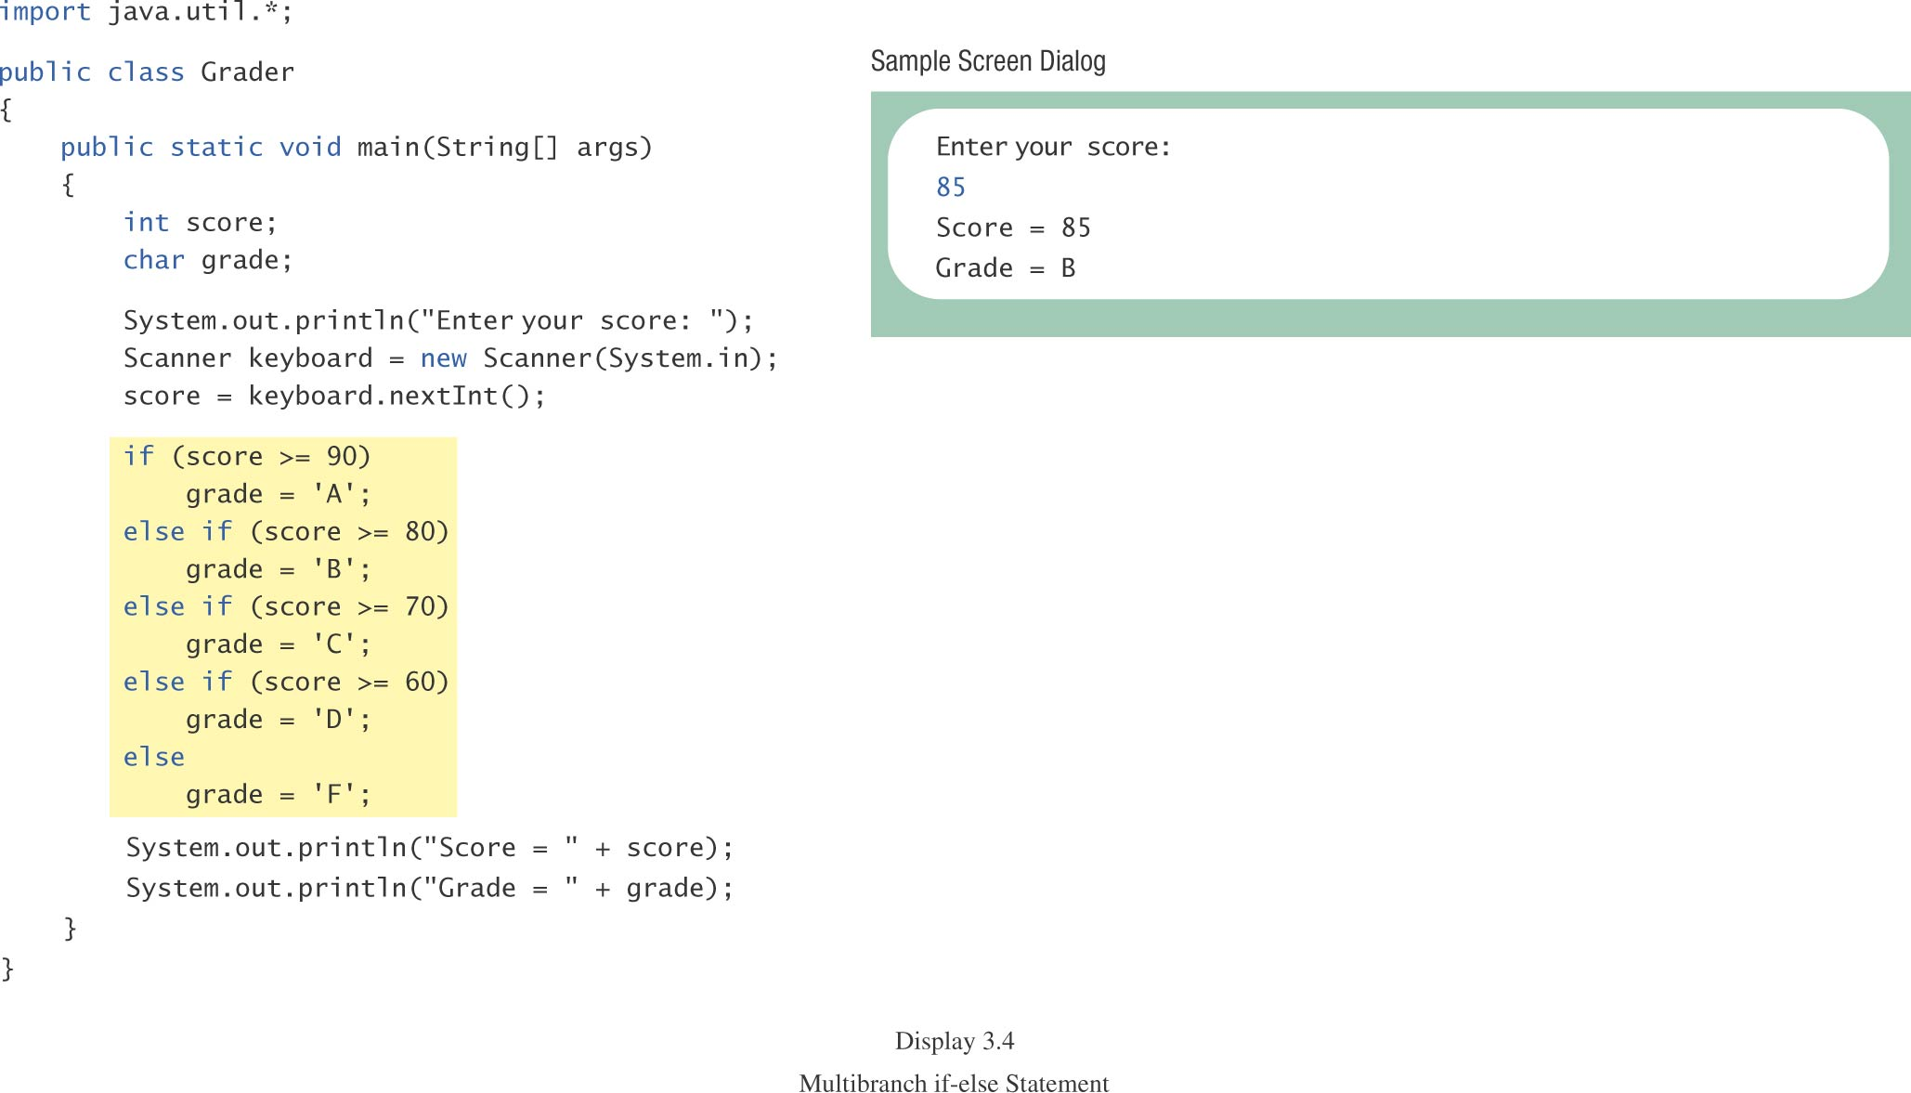
Multibranch if-else Statements, cont.
class Grader

Slide 39
Multibranch if-else Statements, cont.
equivalent logically
if (score >= 90)
grade = ‘A’;
if ((score >= 80) && (score < 90))
grade = ‘B’;
if ((score >= 70) && (score < 80))
grade = ‘C’;
if ((score >= 60) && (score < 70))
grade = ‘D’;
if (score < 60)
grade = ‘F’;

Slide 40
switch Statement
The switch statement is a multiway branch that makes a decision based on an integral (integer or character) expression.
The switch statement begins with the keyword switch followed by an integral expression in parentheses and called the controlling expression.

Slide 41
switch Statement, cont.
A list of cases follows, enclosed in braces.
Each case consists of the keyword case followed by
  a constant called the case label
  a colon
  a list of statements.
The list is searched for a case label matching the controlling expression.

Slide 42
switch Statement, cont.
The action associated with a matching case label is executed.
If no match is found, the case labeled default is executed.
  The default case is optional, but recommended, even if it simply prints a message.
Repeated case labels are not allowed.

Slide 43
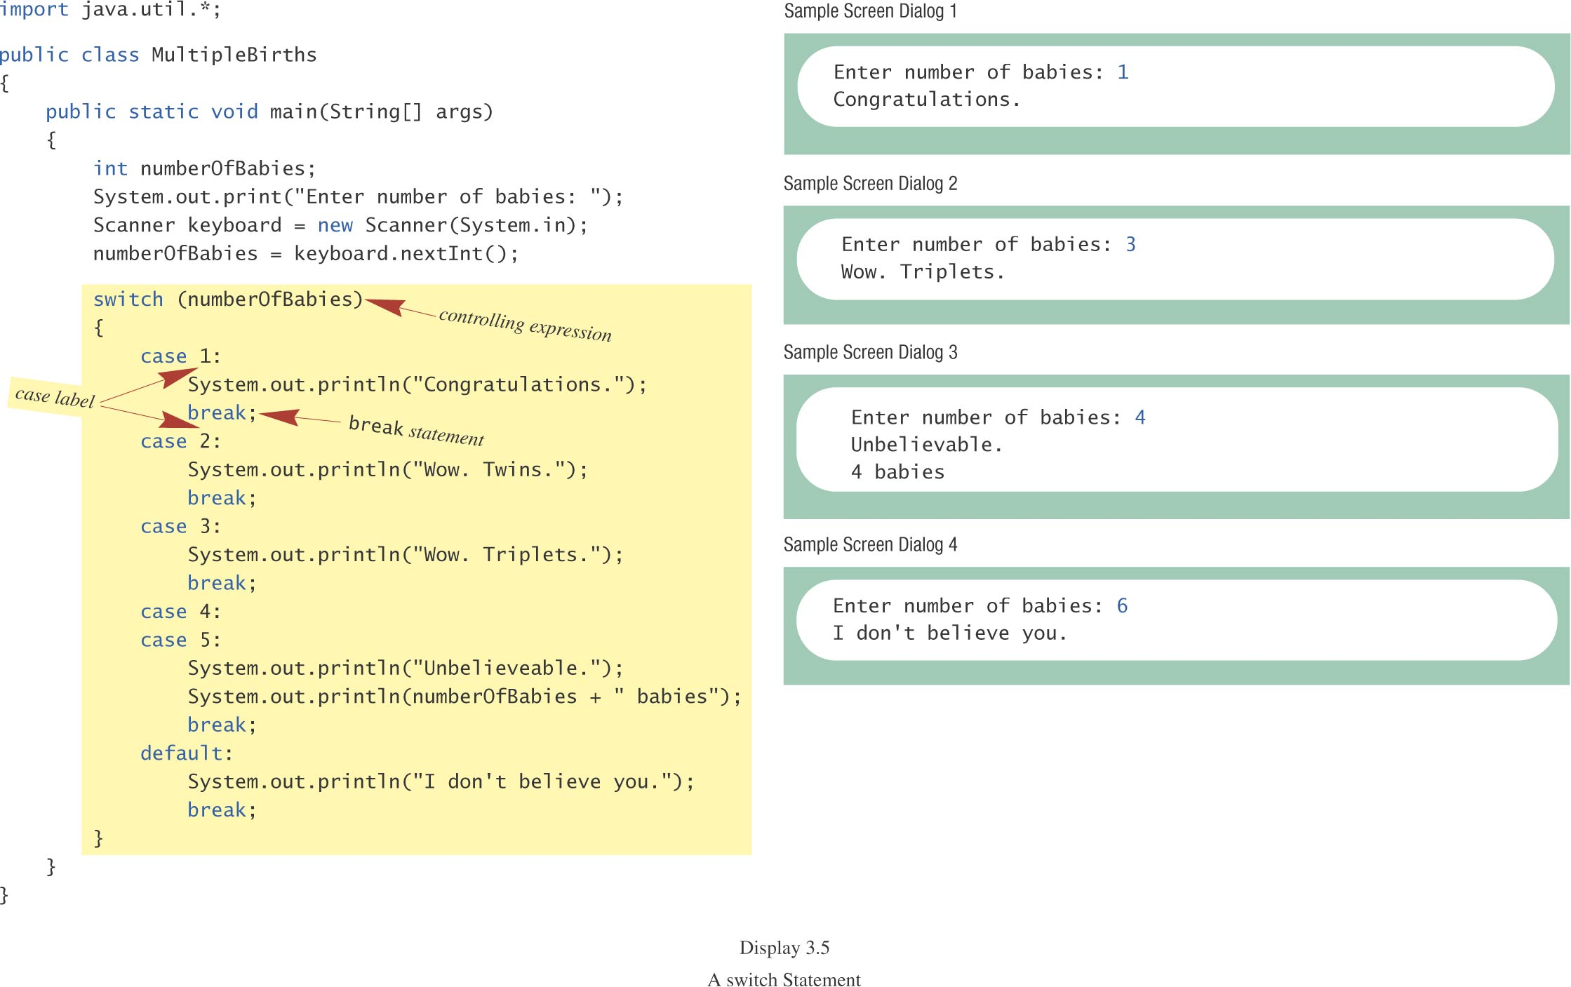
switch Statement, cont.
class MultipleBirths

Slide 44
switch Statement, cont.
The action for each case typically ends with the word break.
The optional break statement prevents the consideration of other cases.
The controlling expression can be anything that evaluates to an integral type (integer or character).

Slide 45
The switch Statement, cont.
syntax
  switch (Controlling_Expression)
  {
  case Case_Label:
  Statement(s);
  break;
  case Case_Label:
  …
  default:
  …
  }

Slide 46
Switch with char Type
char grade = 'A';
switch(grade)
{
case 'A':
case 'B':
case 'C':
case 'D':
System.out.println("Pass");
break;
case 'W':
System.out.println("Withdraw");
break;
case 'I':
System.out.println("Incomplete");
break;
default:
System.out.println("Fail");
}

Slide 47
Conditional Operator
if (n1 > n2)
  max = n1;
  else
  max = n2;
  can be written as
  max = (n1 > n2) ? n1 : n2;
The ? and : together is called the conditional operator (a ternary operator).
Note (n1 > n2) ? n1 : n2 is an expression that has a value unlike the “normal” if statement

Slide 48
Conditional Operator, cont.
The conditional operator can be useful with print statements.
  System.out.print(“You worked “ + hours + “ “ +
  ((hours > 1) ? “hours” : “hour”));

Slide 49
Summary of branching
if statement (1 or 2 branches)
Multi-branch if-else-if statement (3 or more branches)
Multi-branch switch statement
Conditional operator ? :

Slide 50
Loop Statements
A portion of a program that repeats a statement or a group of statements is called a loop.
The statement or group of statements to be repeated is called the body of the loop.
A loop could be used to compute grades for each student in a class.
There must be a means of exiting the loop.

Slide 51
Loop Structure
Control of loop: ICU
  Initialization
  Condition for termination (continuing)
  Updating the condition
Body of loop

Slide 52
Loop Statements
the while Statement
the do-while Statement
the for Statement

Slide 53
while Statement
also called a while loop
a controlling boolean expression
  True -> repeats the statements in the loop body
  False -> stops the loop
  Initially false (the very first time)
    loop body will not even execute once

Slide 54
while Statement, cont.
syntax
  while (Boolean_Expression)
  Body_Statement
  or
  while (Boolean_Expression)
  {
  First_Statement
  Second_Statement
  …
  }

Slide 55
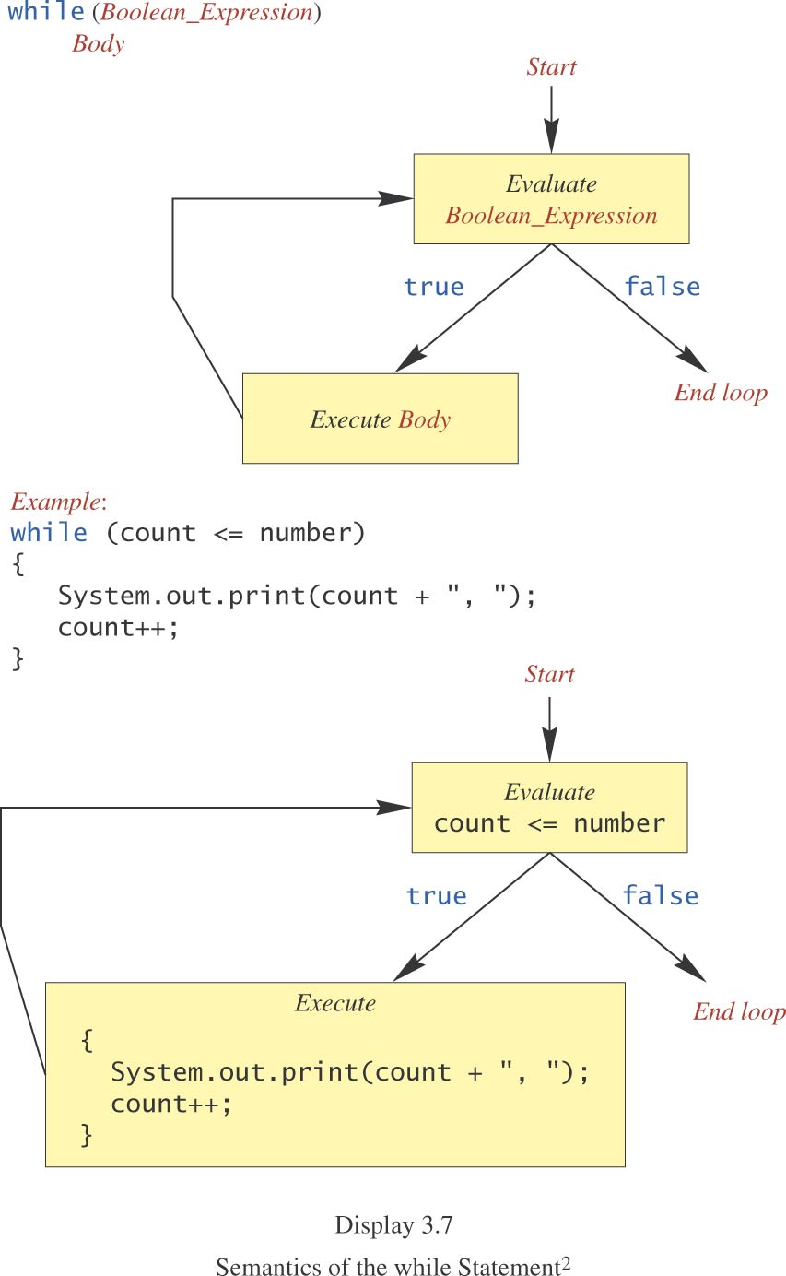
while Statement, cont.

Slide 56
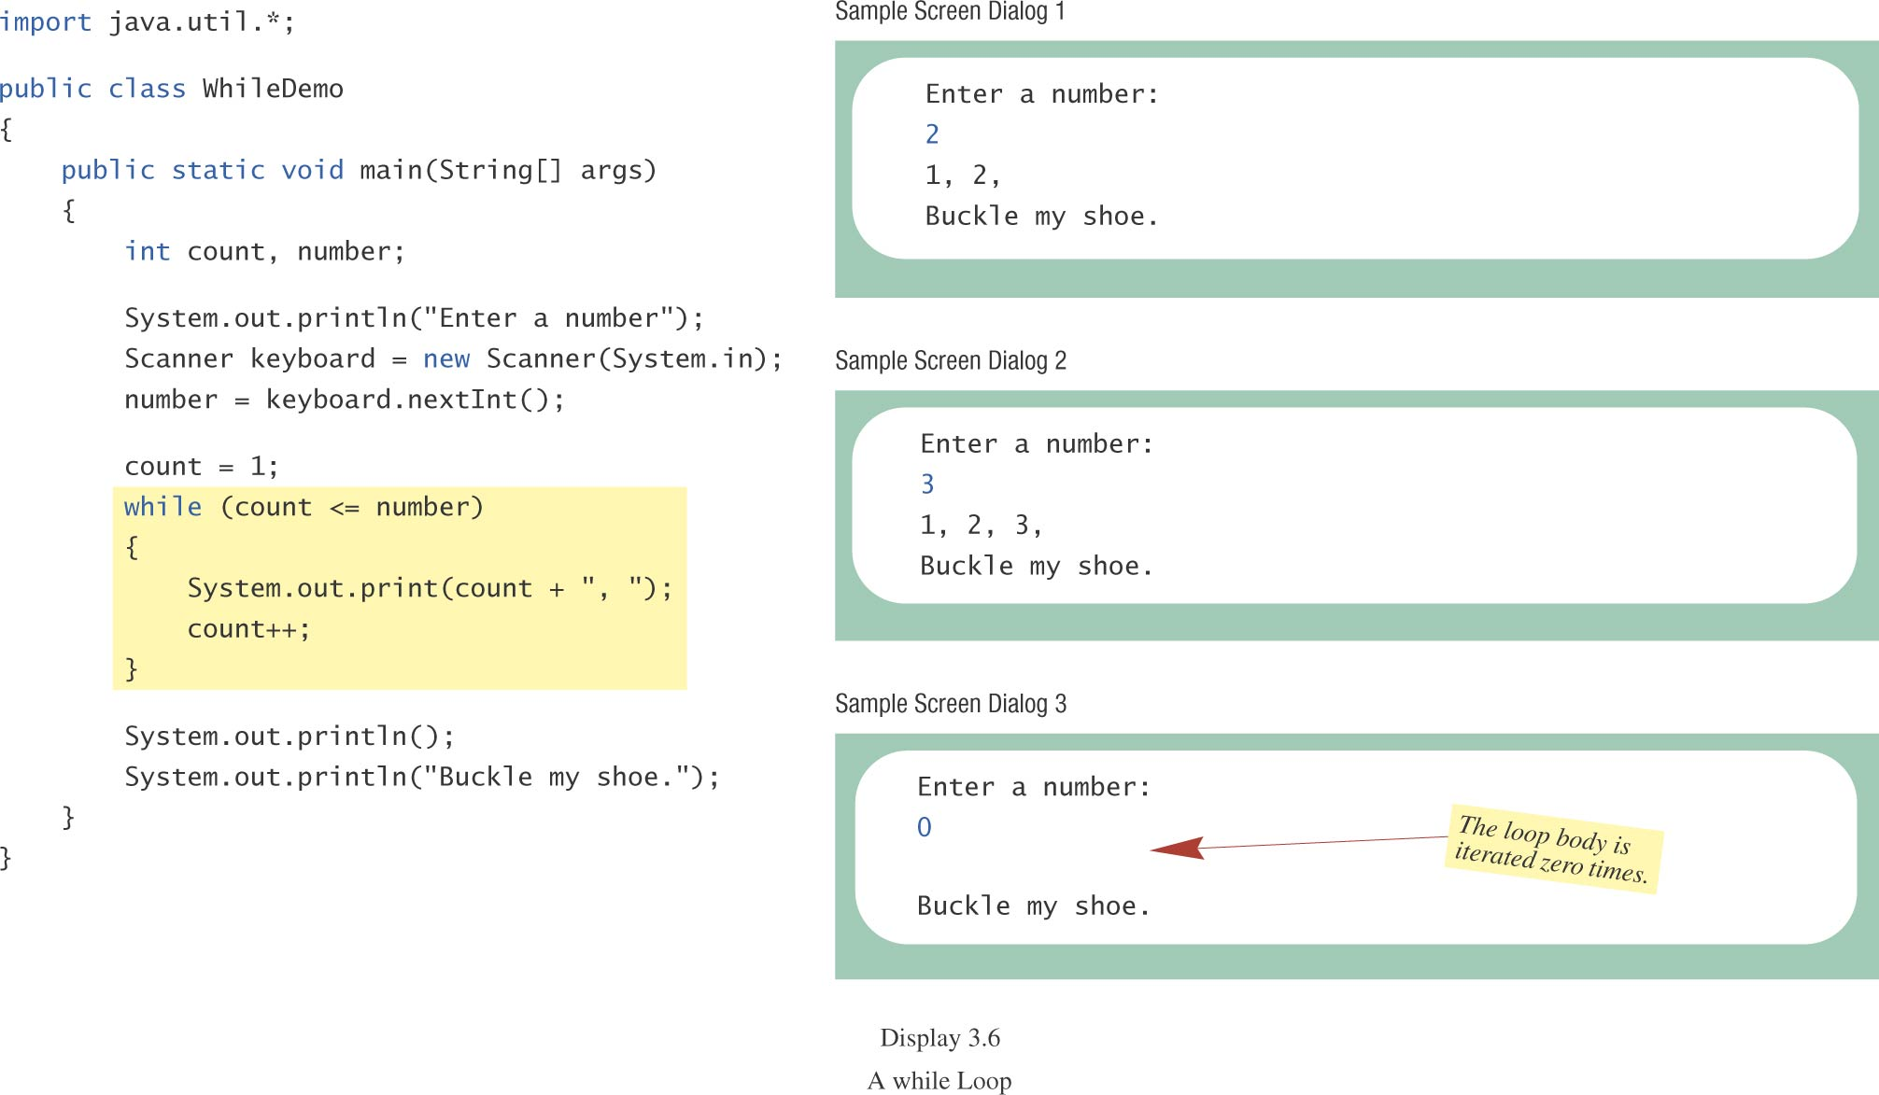
while Statement, cont.
class WhileDemo

Slide 57
do-while Statement
also called a do-while loop (repeat-until loop)
similar to a while statement
  except that the loop body is executed at least once
syntax
  do
  Body_Statement
  while (Boolean_Expression);
  don’t forget the semicolon at the end!

Slide 58
do-while Statement, cont.
First, the loop body is executed.
Then the boolean expression is checked.
  As long as it is true, the loop is executed again.
  If it is false, the loop exits.
equivalent while statement
  Statement(s)_S1
  while (Boolean_Condition)
  Statement(s)_S1

Slide 59
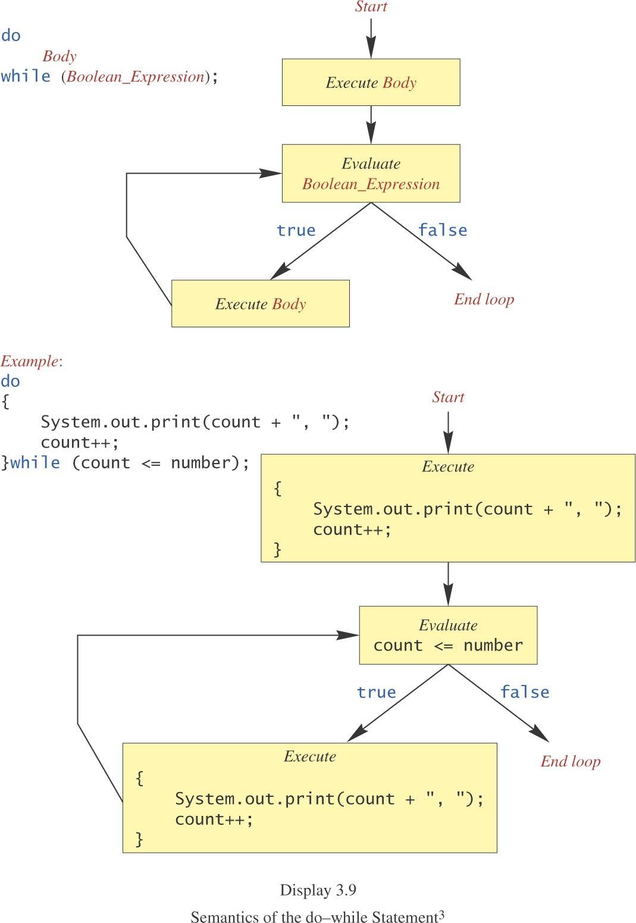
do-while Statement, cont.

Slide 60
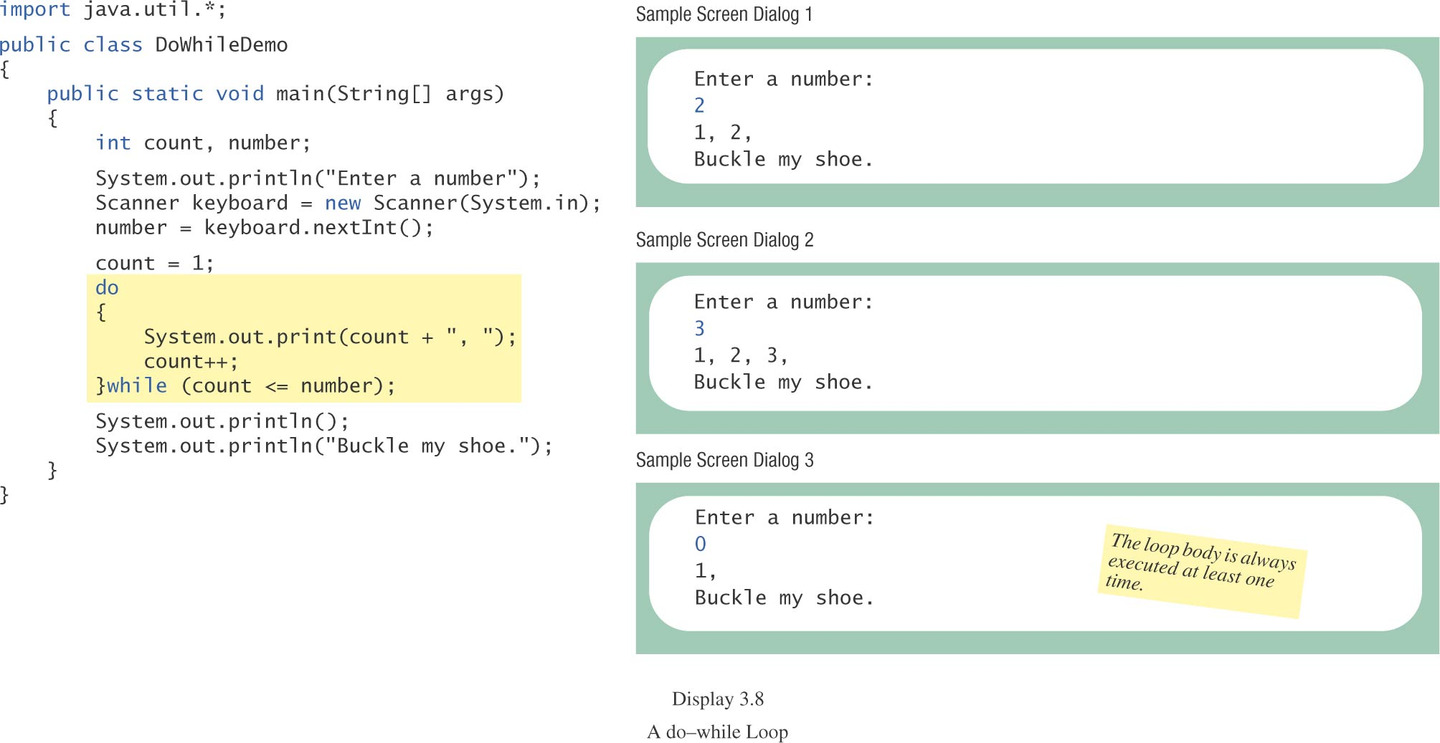
do-while Statement, cont.
class DoWhileDemo

Slide 61
Programming Example:
Bug Infestation
given
  volume of a roach: 0.0002 cubic feet
  starting roach population
  rate of increase: 95%/week
  volume of a house
find
  number of weeks to exceed the capacity of the house
  number and volume of roaches

Slide 62
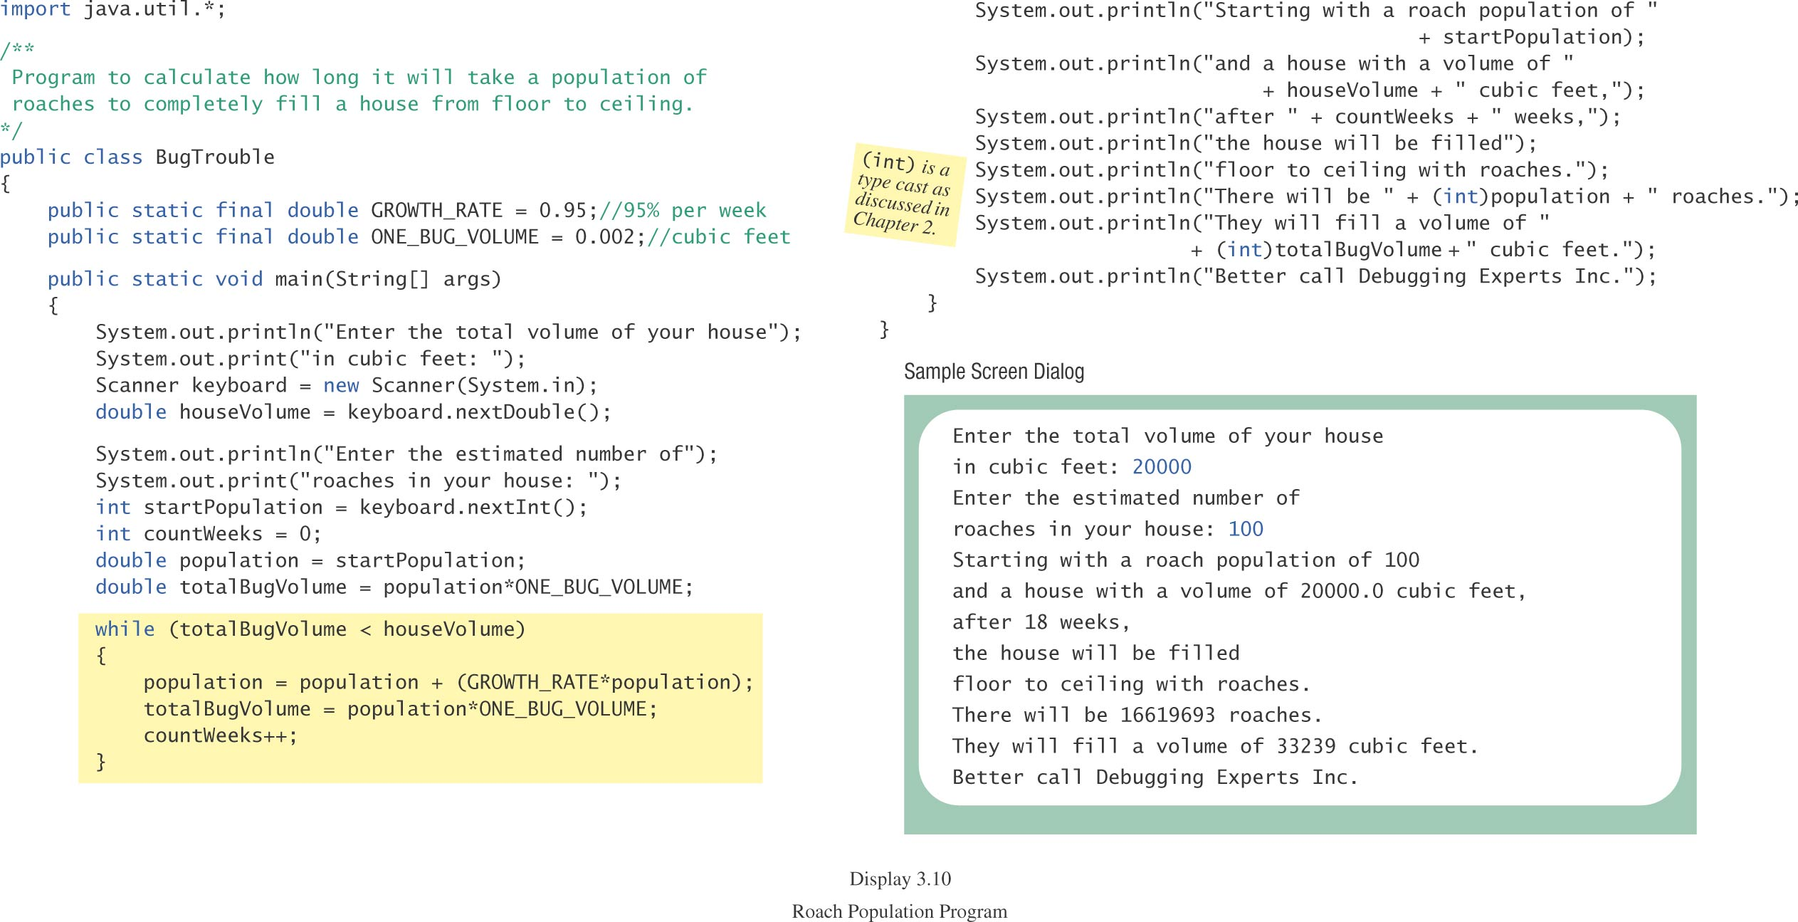
Programming Example: Bug Infestation, cont.
class BugTrouble

Slide 63
Infinite Loops
A loop which repeats without ever ending
the controlling boolean expression (condition to continue)
  never becomes false
A negative growth rate in the preceding problem causes totalBugVolume always to be less than houseVolume
  the loop never ends.

Slide 64
for Statement
A for statement executes the body of a loop a fixed number of times.
example
  for (count = 1; count < 3; count++)
  System.out.println(count);
  System.out.println(“Done”);

Slide 65
for Statement, cont.
syntax
  for (Initialization; Condition; Update)
  Body_Statement
  Body_Statement
    a simple statement or
    a compound statement in {}.
corresponding while statement
  Initialization
  while (Condition)
  Body_Statement_Including_Update

Slide 66
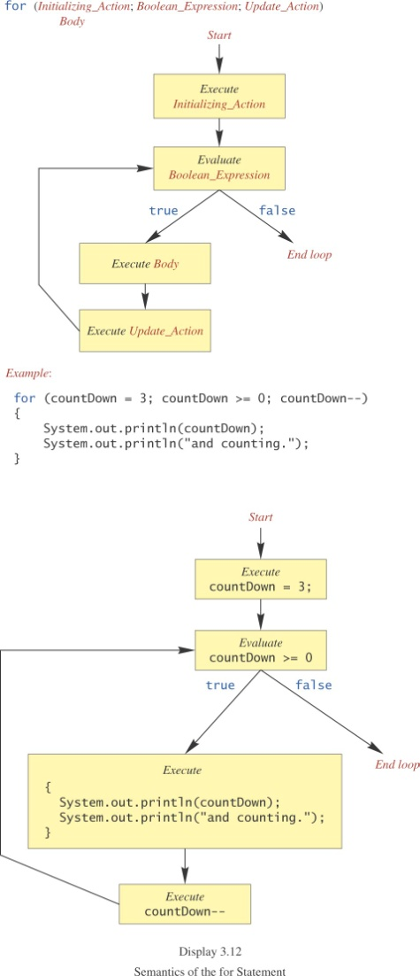
for Statement, cont.

Slide 67
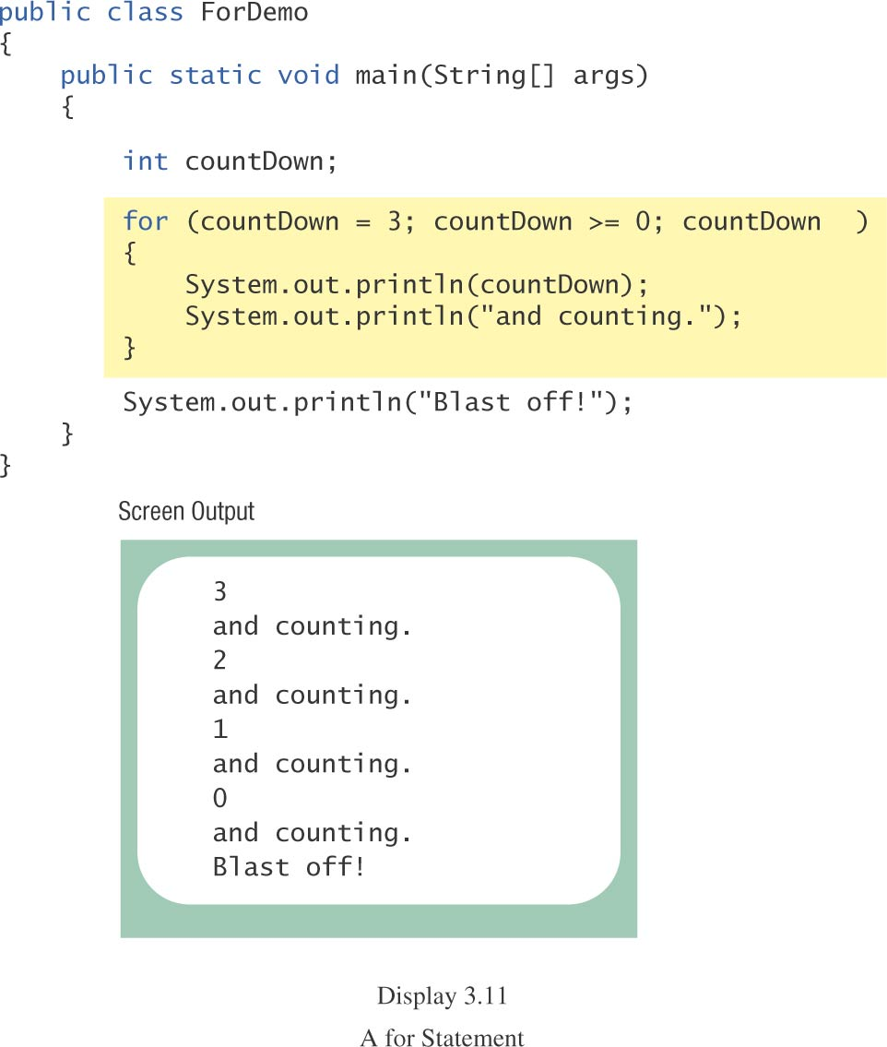
for Statement, cont.
class ForDemo

Slide 68
Multiple Initialization, etc.
example
  for (n = 1, p = 1; n < 10; n++)
  p = p * n
Only one boolean expression is allowed, but it can consist of &&s, ||s, and !s.
Multiple update actions are allowed, too.
  for (n = 1, p = 100; n < p; n++, p -= n)
rarely used

Slide 69
Choosing a Loop Statement
If you know how many times the loop will be iterated, use a for loop.
If you don’t know how many times the loop will be iterated, but
  it could be zero, use a while loop
  it will be at least once, use a do-while loop.
Generally, a while loop is a safe choice.

Slide 70
Summary of loop statements
while loop
do-while loop
for loop

Slide 71
break Statement in Loops: NOT recommended
A break statement can be used to end a loop immediately.
The break statement ends only the innermost loop that contains the break statement.
break statements make loops more difficult to understand:
  Loop could end at different places (multiple possible exit points), harder to know where.
Always try to end a loop at only one place--makes debugging easier (only one possible exit point)

Slide 72
Misuse of break Statements in loops (p. 177)
“Because of the complications they introduce, break statements in loops should be avoided.
Some authorities contend that a break statement should never be used to end a loop,
but virtually all programming authorities agree that they should be used at most sparingly.”

Slide 73
exit Method
Sometimes a situation arises that makes continuing the program pointless.
A program can be terminated normally by
  System.exit(0).
example
  if (numberOfWinners == 0)
  {
  System.out.println(“/ by 0”);
  System.exit(0);
  }

Slide 74
Programming with Loops: Outline
The Loop Body
Initializing Statements
Ending a Loop
Loop Bugs
Tracing Variables

Slide 75
Loop Body
To design the loop body, write out the actions the code must accomplish.
Then look for a repeated pattern.
  The pattern need not start with the first action.
  The repeated pattern will form the body of the loop.
  Some actions may need to be done after the pattern stops repeating.

Slide 76
Initializing Statements
Some variables need to have a value before the loop begins.
  Sometimes this is determined by what is supposed to happen after one loop iteration.
  Often variables have an initial value of zero or one, but not always.
Other variables get values only while the loop is iterating.

Slide 77
Ending a Loop
If the number of iterations is known before the loop starts, the loop is called a count-controlled loop.
  use a for loop.
Asking the user before each iteration if it is time to end the loop is called the ask-before-iterating technique.
  appropriate for a small number of iterations
  Use a while loop or a do-while loop.

Slide 78
Ending a Loop, cont.
For large input lists, a sentinel value can be used to signal the end of the list.
  The sentinel value must be different from all the other possible inputs.
  A negative number following a long list of nonnegative exam scores could be suitable.
  90
  0
  10
  -1

Slide 79
Ending a Loop, cont.
example - reading a list of scores followed by a sentinel value
  int next = keyboard.nextInt();
  while (next >= 0)
  {
  Process_The_Score
  next = keyboard.nextInt();
  }

Slide 80
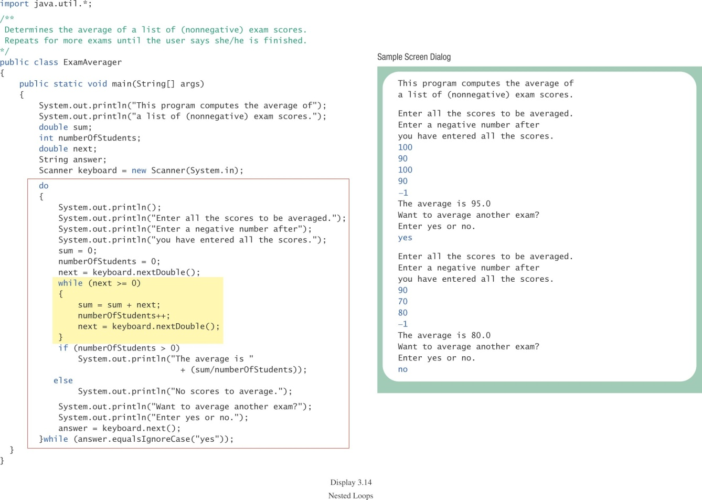
Ending a Loop, cont.
class ExamAverager

Slide 81
Nested Loops
The body of a loop can contain any kind of statements, including another loop.
In the previous example
  the average score was computed using a while loop.
  This while loop was placed inside a do-while loop so the process could be repeated for other sets of exam scores.

Slide 82
Nested Loops
The body of a loop can have any kind of statements, including another loop.
Each time the outer loop body is executed, the inner loop body will execute 5 times.
20 times total
for (line = 0; line < 4; line++)
{
for (star = 0; star < 5; star++)
System.out.print('*');
System.out.println();
}
body of outer loop
body of inner loop
*****
*****
*****
*****
Output:

Slide 83
Declaring Variables Outside Loop Bodies
Declaration of variables inside a loop body is repeated with each execution of the loop body--can be inefficient
Declaration of variables can generally be moved outside the loop body.
while (…)
{
int x;
…
}

Slide 84
Loop Bugs
common loop bugs
  unintended infinite loops
  off-by-one errors
  testing equality of floating-point numbers
subtle infinite loops
  The loop may terminate for some input values, but not for others.
  For example, you can’t get out of debt when the monthly penalty exceeds the monthly payment.

Slide 85
Off-by-One Errors
The loop body is repeated one too many times or one too few times.
examples
  < is used when <= should be used or <= is used when < should be used
  using the index of the last character of a string instead of the length of the string (or vice versa)
easy to overlook

Slide 86
Off by One
int i = 0;
while (i <= 10)
{
System.out.println(i);
i++;
}

Slide 87
Subtle Infinite Loops
Verify that the monthly payment exceeds the penalty, for example, before entering a loop to determine the number of payments needed to get out of debt.
  if (payment <= penalty)
  System.out.println(“payment is too small”);
  else
  {
  ...

Slide 88
Empty for Statement
What is printed by
  int product = 1, number;
  for (number = 1; number <= 10; number++);
  product = product * number;
  System.out.println(product);
The last semicolon in
  for (number = 1; number <= 10; number++);
produces an empty for statement.

Slide 89
Empty while Statement
  int product = 1, number = 1;
  while (number <= 10);
  {
  product = product * number;
  number++;
  }
  System.out.println(product);
The last semicolon in
  while (number <= 10);
produces an empty while loop body.

Slide 90
Testing Equality of Floating-point Numbers
== works satisfactorily for integers and characters.
== is not reliable for floating-point numbers (which are approximate quantities).
  Can cause infinite loops
  Use <= or >= rather than == or !=.
www.cs.fit.edu/~pkc/classes/cse1001/FloatEquality.java

Slide 91
Tracing Variables
Tracing variables means watching the variables change while the program is running.
  Simply insert temporary output statements in your program to print of the values of variables of interest
  or, learn to use the debugging facility that may be provided by your system.

Slide 92
Tracing Variables, cont.
float creditCardBalance = 9000.0;
while (creditCardBalance > 0)
{
… // input payment
creditCardBalance -= payment;
… // calculate penalty
creditCardBalance += penalty;
system.out.println(creditCardBalance);
}

Slide 93
Type boolean
Boolean Expressions and Variables
Truth Tables and Precedence Rules
Input and Output of Boolean Values

Slide 94
Type boolean, cont.
The type boolean is a primitive type with only two values: true and false.
Boolean variables can make programs more readable.
  if (systemsAreOK)
  instead of
  if((temperature <= 100) && (thrust >= 12000) && (cabinPressure > 30) && …)

Slide 95
Boolean Expressions and Variables
Variables, constants, and expressions of type boolean all evaluate to either true or false.
A boolean variable can be given the value of a boolean expression by using an assignment operator.
  boolean isPositive = (number > 0);
  ...
  if (isPositive) ...

Slide 96
Naming Boolean Variables
Choose names such as isPositive or systemsAreOk.
Avoid names such as numberSign or systemStatus.

Slide 97
Precedence Rules
Parentheses should be used to indicate the order of operations.
When parentheses are omitted, the order of operation is determined by precedence rules.

Slide 98
Precedence Rules, cont.
Operations with higher precedence are performed before operations with lower precedence.
Operations with equal precedence are done left-to-right (except for unary operations which are done right-to-left).

Slide 99
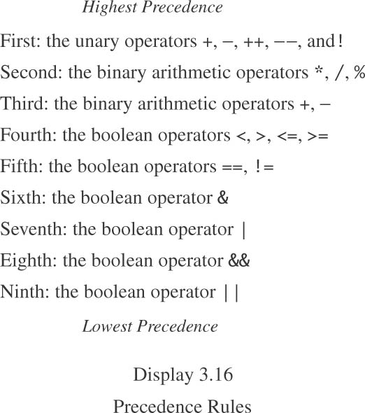
Precedence Rules, cont.
Comparison operators:
<, >, <=, >=
==, !=
Logical operators:
&
|
&&
||

Slide 100
Precedence Rules, cont.
In what order are the operations performed?
  score < min/2 - 10 || score > 90
  score < (min/2) - 10 || score > 90
  score < ((min/2) - 10) || score > 90
  (score < ((min/2) - 10)) || score > 90
  (score < ((min/2) - 10)) || (score > 90)

Slide 101
Short-circuit Evaluation
Sometimes only part of a boolean expression needs to be evaluated to determine the value of the entire expression.
  If the first operand of || is true
    entire expression is true
  If the first operand of && is false
    entire expression is false
This is called short-circuit or lazy evaluation.

Slide 102
Short-circuit Evaluation, cont.
Short-circuit evaluation is not only efficient, sometimes it is essential!
A run-time error can result, for example, from an attempt to divide by zero.
  if ((number != 0) && (sum/number > 5))
Complete evaluation can be achieved by substituting & for && or | for ||.

Slide 103
Short-circuit Evaluation
int count = 1;
…
if ( … && (++count < 10) )
{
…
}
System.out.println(count);

Slide 104
Input and Output of Boolean Values
example
  boolean boo = false;
  System.out.println(boo);
  System.out.print(“Enter a boolean value: “);
  Scanner keyboard = new Scanner (System.in);
  boo = keyboard.nextBoolean();
  System.out.println(boo);

Slide 105
Input and Output of Boolean Values, cont.
dialog
false
Enter a boolean value: true
true

Slide 106
Using a Boolean Variable to End a Loop
example
  boolean numbersLeftToRead = true;
  while (numbersLeftToRead)
  {
  next = keyboard.nextInt();
  if (next < 0)
  numbersLeftToRead = false;
  else
  Process_Next_Number
  }

Slide 107
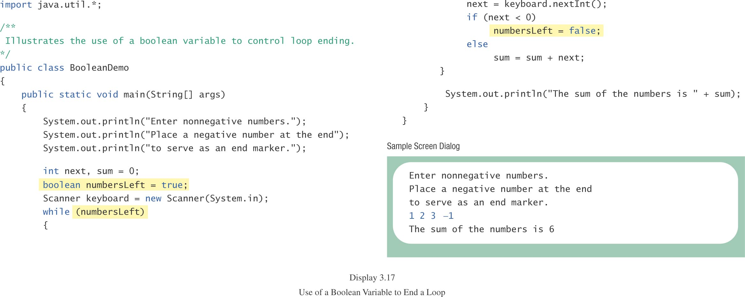
Using a Boolean Variable to End a Loop, cont
class BooleanDemo

Slide 108
Summary
You have learned about Java branching statements.
You have learned about loops.
You have learned about the type boolean.

