Slide 1
JAVA

Slide 2
History of Java
The history of java starts from Green Team.
Java team members (also known as Green Team), initiated a revolutionary task to develop a language for digital devices such as set-top boxes, televisions etc.
For the green team members, it was an advance concept at that time. But, it was suited for internet programming.
Later, Java technology was incorporated by Netscape.

Slide 3
Now a days….
Java is used in internet programming, mobile devices, games, e-business solutions etc.
Major points that describes the history of java.
James Gosling, Mike Sheridan, and Patrick Naughton initiated the Java language project in June 1991.
The small team of sun engineers called Green Team.
Originally designed for small, embedded systems in electronic appliances like set-top boxes.
Firstly, it was called "Greentalk" by James Gosling and file extension was .gt.
After that, it was called Oak and was developed as a part of the Green project.

Slide 4
Oak name for java language ???
Oak is a symbol of strength and choosen as a national tree of many countries like U.S.A., France, Germany, Romania etc.
In 1995, Oak was renamed as "Java" because it was already a trademark by Oak Technologies.

Slide 5
“JAVA” name for java language????
The team gathered to choose a new name.
The suggested words were "dynamic", "revolutionary", "Silk", "jolt", "DNA" etc.
They wanted something that reflected the essence of the technology: revolutionary, dynamic, lively, cool, unique, and easy to spell and fun to say.
According to James Gosling "Java was one of the top choices along with Silk".
Since java was so unique, most of the team members preferred java.

Slide 6
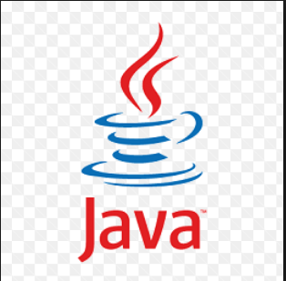
JAVA !!!
Java is an island of Indonesia where first coffee was produced (called java coffee).
Notice that Java is just a name not an acronym.
Originally developed by James Gosling at Sun Microsystems (which is now a subsidiary of Oracle Corporation) and released in 1995.
In 1995, Time magazine called Java one of the Ten Best Products of 1995.
JDK 1.0 released in(January 23, 1996).

Slide 7
Java Version History
There are many java versions that has been released. Current stable release of Java is Java SE 8.
JDK Alpha and Beta (1995)
JDK 1.0 (23rd Jan, 1996)
JDK 1.1 (19th Feb, 1997)
J2SE 1.2 (8th Dec, 1998)
J2SE 1.3 (8th May, 2000)
J2SE 1.4 (6th Feb, 2002)
J2SE 5.0 (30th Sep, 2004)
Java SE 6 (11th Dec, 2006)
Java SE 7 (28th July, 2011)
Java SE 8 (18th March, 2014)

Slide 8
JDK Editions
Java Standard Edition (J2SE)
  J2SE can be used to develop client-side standalone applications or applets.
Java Enterprise Edition (J2EE)
  J2EE can be used to develop server-side applications such as Java servlets and Java ServerPages.
Java Micro Edition (J2ME).
  J2ME can be used to develop applications for mobile devices such as cell phones.

Slide 9
Comparison between Java and C
Java | C
It follows an object-oriented paradigm or a data oriented paradigm. The problem is broken down into objects. | It follows a procedure oriented paradigm. The problem is broken down into functions
It is an interpreted language. The program gets first transformed to an intermediary code called bytecode. | It is a compiled language. The program gets compiled to a machine level code.
Java does not have preprocessors | C requires preprocessors like #define #include etc.
Java uses the bottom up approach | C uses the top-down approach.
Java does not require explicit handling of pointers | C requires explicit handling of pointers
 | Contd..

Slide 10
Java | C
Java does memory management automatically by use of garbage collector. | In C, memory management is done by the user manually using library calls like 'malloc' and 'free'
Java provides support for method overloading | C doesnt support overloading at all.
In Java, if an error occurs, an exception is thrown and can be handled by the user. | In C, an error is an error.
Java does not support data types 'struct' and 'union' | C provides support for data types 'struct' and 'union'

Slide 11
Features of Java
  Simple
  Object-Oriented
  Platform Independent
  Secured
  Robust
  Architecture Neutral
  Portable
  High Performance
  Distributed
  Multi-threaded

Slide 12
Simple
According to Sun, Java language is simple because:
syntax is based on C++ (easier for programmers to learn it after C++).
removed many confusing and/or rarely-used features e.g., explicit pointers, operator overloading etc.
No need to remove unreferenced objects because there is Automatic Garbage Collection in java.

Slide 13
Object-oriented
Object-oriented means we organize our software as a combination of different types of objects that incorporates both data and behaviour.
Object-oriented programming(OOPs) is a methodology that simplify software development and maintenance by providing some rules.
Basic concepts of OOPs are:
Object
Class
Inheritance
Polymorphism
Abstraction
Encapsulation

Slide 14
Platform Independent
A platform is the hardware or software environment in which a program runs.
There are two types of platforms software-based and hardware-based.
Java provides software-based platform.
The Java platform differs from most other platforms in the sense that it's a software-based platform that runs on top of other hardware-based platforms.
It has two components:
Runtime Environment
API(Application Programming Interface)

Slide 15
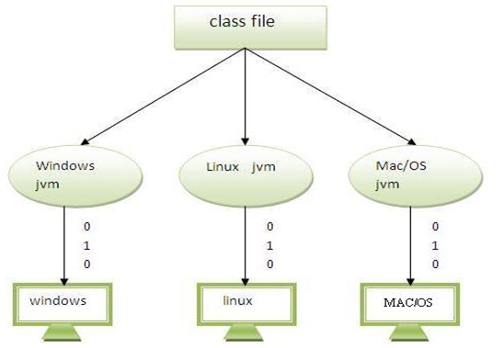
Java code can be run on multiple platforms e.g.Windows, Linux, Sun Solaris, Mac/OS etc.
Java code is compiled by the compiler and converted into bytecode. This bytecode is a platform independent code because it can be run on multiple platforms i.e. Write Once and Run Anywhere(WORA).

Slide 16
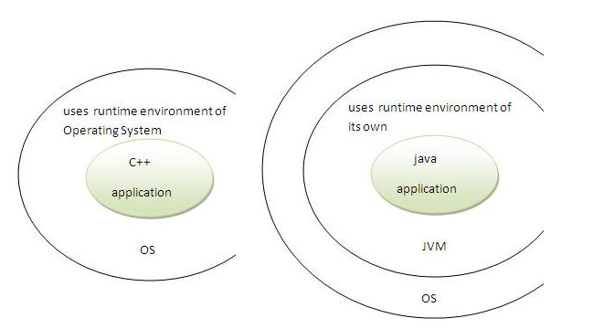
Secured
Java is secured because:
No explicit pointer
Programs run inside virtual machine sandbox.

Slide 17
Classloader- adds security by separating the package for the classes of the local file system from those that are imported from network sources.
Bytecode Verifier- checks the code fragments for illegal code that can violate access right to objects.
Security Manager- determines what resources a class can access such as reading and writing to the local disk.
These security are provided by java language. Some security can also be provided by application developer through SSL, JAAS, cryptography etc.

Slide 18
Robust
Robust simply means strong.
Java uses strong memory management.
There are lack of pointers that avoids security problem.
There is automatic garbage collection in java.
There is exception handling and type checking mechanism in java.
All these points makes java robust.

Slide 19
Architecture-neutral
There is no implementation dependent features e.g. size of primitive types is set.
Portable
We may carry the java bytecode to any platform.
High-performance
Java is faster than traditional interpretation since byte code is "close" to native code still somewhat slower than a compiled language (e.g., C++)

Slide 20
Distributed
We can create distributed applications in java. RMI and EJB are used for creating distributed applications.
We may access files by calling the methods from any machine on the internet.
Multi-threaded
A thread is like a separate program, executing concurrently.
We can write Java programs that deal with many tasks at once by defining multiple threads.
The main advantage of multi-threading is that it shares the same memory.
Threads are important for multi-media, Web applications etc.

Slide 21
Java Development Kit (JDK)
The Java Development Kit (JDK) is actually a combination of Java compilation tools and API implementation for a particular version of the Java Platform. It also typically includes a Java runtime (JRE), so that you can run the programs you compile. The JDK comprises the following development tools
java: Serves as a Java interpreter used to run Java applets and applications by reading and interpreting bytecode files
javac: Serves as a Java compiler used to translate Java source code files.
javadoc: Creates HTML documentation for Java source code files
javap: Serves as a Java disassemble used to convert bytecode files into a Java program description
jdb: Serves as a Java debugger used to find errors in Java programs
appletviewer: Facilitates to run Java applets
jar: Serves as archive used to package related class libraries into a single executable JAR file. This tool also helps to manage the JAR files
javah: Serves as the C header and stub generator, which is used to write native methods.

Slide 22
How to Download Java
Latest version of Java can be downloaded from Java Website.
Java Installation
Once java is downloaded, it can be installed like any other software (.exe) in your Windows system.

Slide 23
Setting up the Environment Variables
After installing Java there are some environment variables that need to be set.
CLASSPATH : This environment variable points the location of JDK home directory. It also contains the address of the folder from where the jars get loaded by the ClassLoader
JAVA_HOME : This environment variable will point the location of Java home directory.

Slide 24
Set environment variable in different platforms
Windows XP
To set up environment variables in Windows XP right click on the “My Computer” icon and select Properties.
In the Property window select the “ADVANCED” tab and click on “ENVIRONMENT VARIABLES” .
A window will appear were you can enter a new environment variable under System Variables by clicking on the New button.

Slide 25
Windows Vista / 7
To set up environment variables in Windows Vista / 7 right click on the “Computer” and select Properties.
In the Property window select the “ADVANCED SYSTEM SETTINGS” and then select the “ADVANCED” tab and click “ENVIRONMENT VARIABLES”.
A window will appear were you can enter a new environment variable under User/System Variables by clicking on the New button.

Slide 26
How to Check if Java is Installed
To check if your java is installed properly open Command Prompt .
To open command prompt write “CMD” in run command and hit enter.
In the command prompt window write “java -version“.
If your java is installed properly and all environment variables are configured correctly it will show the version of Java installed .
Information reflected on the command prompt will be like
C:UsersJbt>java -version
java version "1.6.0_25"
Java(TM) SE Runtime Environment (build 1.6.0_25-b06)
Java HotSpot(TM) Client VM (build 20.0-b11, mixed mode, sharing)

Slide 27
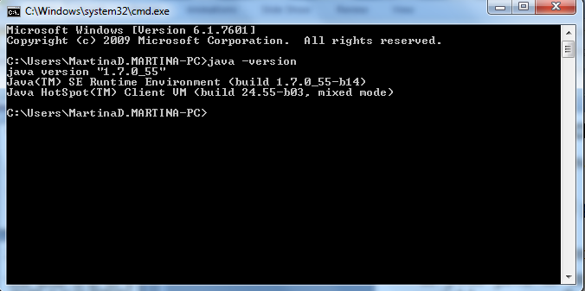

Slide 28
JAVA

Slide 29
Why Java ?
Portable
Easy to learn
[ Designed to be used on the Internet ]

Slide 30
JVM
JVM stands for
Java Virtual Machine
Unlike other languages, Java “executables” are executed on a CPU that does not exist.

Slide 31
Platform Dependent
myprog.c
gcc
myprog.exe
C source code
machine code
OS/Hardware
Platform Independent
javac
myprog.class
myprog.java
bytecode
Java source code
JVM
OS/Hardware

Slide 32
A Simple Java Program
//This program prints Welcome to Java!
public class Welcome {
public static void main(String[] args) {
System.out.println("Welcome to Java!");
}
}

Slide 33

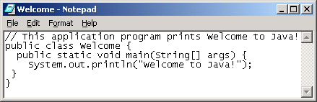
Creating and Editing Using NotePad
To use NotePad, type
  notepad Welcome.java
from the DOS prompt.

Slide 34

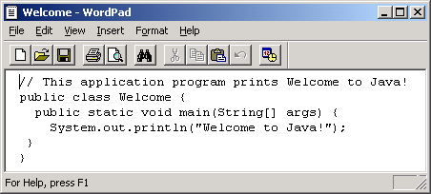
Creating and Editing Using WordPad
To use WordPad, type
  write Welcome.java
from the DOS prompt.

Slide 35
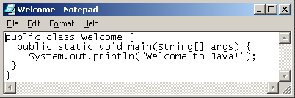
Creating, Compiling, and Running Programs

Slide 36
Compiling Java Source Code
Java was designed to run object programs on any platform. With Java, you write the program once, and compile the source program into a special type of object code, known as bytecode.
The bytecode can then run on any computer with a Java Virtual Machine, as shown below.
Java Virtual Machine is a software that interprets Java bytecode.

Slide 37
Compiling and Running Java from the Command Window
Compile
  javac Welcome.java
Run
  java Welcome

Slide 38
Anatomy of a Java Program
Comments
Reserved words
Modifiers
Statements
Blocks
Classes
Methods
The main method

Slide 39
Comments
Three types of comments in Java.
Line comment: A line comment is preceded by two slashes (//) in a line.
Paragraph comment: A paragraph comment is enclosed between /* and */ in one or multiple lines.
javadoc comment: javadoc comments begin with /** and end with */.
They are used for documenting classes, data, and methods.
They can be extracted into an HTML file using JDK's javadoc command.

Slide 40
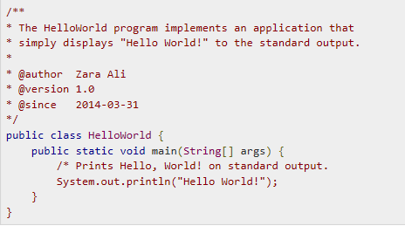
javadoc comment example

Slide 41
Reserved Words
Reserved words or keywords are words that have a specific meaning to the compiler and cannot be used for other purposes in the program.
For example, when the compiler sees the word class, it understands that the word after class is the name for the class.
Other reserved words are public, static, and void.

Slide 42
Modifiers
Java uses certain reserved words called modifiers that specify the properties of the data, methods, and classes and how they can be used.
Examples of modifiers are public and static.
Other modifiers are private, final, abstract, and protected.
A public datum, method, or class can be accessed by other programs.
A private datum or method cannot be accessed by other programs.

Slide 43
Statements
A statement represents an action or a sequence of actions.
The statement
System.out.println("Welcome to Java!");
in the program is a statement to display the greeting "Welcome to Java!“
Every statement in Java ends with a semicolon (;).

Slide 44
Blocks
A pair of braces in a program forms a block that groups components of a program.

Slide 45
Classes
The class is the essential Java construct.
A class is a template or blueprint for objects.
To program in Java, you must understand classes and be able to write and use them.

Slide 46
Methods
What is System.out.println?
It is a method: a collection of statements that performs a sequence of operations to display a message on the console.
It can be used even without fully understanding the details of how it works.
It is used by invoking a statement with a string argument.
The string argument is enclosed within parentheses. In this case, the argument is "Welcome to Java!"
You can call the same println method with a different argument to print a different message.

Slide 47
main Method
The main method provides the control of program flow. The Java interpreter executes the application by invoking the main method.
The main method looks like this:
public static void main(String [] args) {
// Statements;
}

Slide 48
Hello World
Hello.java
class Hello {
public static void main(String[]args) {
System.out.println(“Hello World !!!”); }
}
C:\javac Hello.java
C:\java Hello
( compilation creates Hello.class )
(Execution on the local JVM)

Slide 49
Our First Java Program
Open any editor and write the below code.
public class MyFirstJavaProgram
{
public static void main(String [] args) {
System.out.println("Hello World!");
}}
Once done save the file with the name “MyFirstJavaProgram.java“.

Slide 50
Open notepad and add the code as above.
Save the file as: MyFirstJavaProgram.java.
Open a command prompt window and go to the directory where you saved the class. Assume it's C:\.
Type ' javac MyFirstJavaProgram.java ' and press enter to compile your code.
If there are no errors in your code, the command prompt will take you to the next line (Assumption : The path variable is set).
Now, type ' java MyFirstJavaProgram ' to run your program.

Slide 51
Case Sensitivity - Java is case sensitive, which means identifier Hello and hello would have different meaning in Java.
Class Names - For all class names the first letter should be in Upper Case.
If several words are used to form a name of the class, each inner word's first letter should be in Upper Case.
Example class MyFirstJavaClass

Slide 52
Method Names - All method names should start with a Lower Case letter.
If several words are used to form the name of the method, then each inner word's first letter should be in Upper Case.
Example public void myMethodName()

Slide 53
Program File Name
Name of the program file should exactly match the class name.
When saving the file, you should save it using the class name (Remember Java is case sensitive) and append '.java' to the end of the name
If the file name and the class name do not match your program will not compile.
Example : Assume 'MyFirstJavaProgram' is the class name. Then the file should be saved as 'MyFirstJavaProgram.java'
public static void main(String args[]) - Java program processing starts from the main() method which is a mandatory part of every Java program

Slide 54
If the java file is compiled properly the compiler will create a class file for the java source file.
It will be saved in the same location as the source file or maybe some other location depending on its package declaration.
Since there is no package declared in the given code so the .class file will be created in the same folder location.

Slide 55
Java Identifiers:
All Java components require names. Names used for classes, variables and methods are called identifiers.
In Java, there are several points to remember about identifiers. They are as follows:
All identifiers should begin with a letter (A to Z or a to z), currency character ($) or an underscore (_).
After the first character identifiers can have any combination of characters.
A key word cannot be used as an identifier.
Most importantly identifiers are case sensitive.
Examples of legal identifiers: age, $salary, _value, __1_value
Examples of illegal identifiers: 123abc, -salary

Slide 56
Java Modifiers:
Like other languages, it is possible to modify classes, methods, etc., by using modifiers. There are two categories of modifiers:
Access Modifiers: default, public , protected, private
Non-access Modifiers: final, abstract, strictfp

Slide 57
Java Variables:
We would see following type of variables in Java:
Local Variables
Class Variables (Static Variables)
Instance Variables (Non-static variables)
Syntax:
data type variable [ = value][, variable [= value] ...] ;
Eg:
int a, b, c; // Declares three ints, a, b, and c.
int a = 10, b = 10; // Example of initialization
byte B = 22; // initializes a byte type variable B.
double pi = 3.14159; // declares and assigns a value of PI.
char a = 'a'; // the char variable a is initialized with value

Slide 58
Local variables
Local variables are declared in methods, constructors, or blocks.
Local variables are created when the method, constructor or block is entered and the variable will be destroyed once it exits the method, constructor or block.
Access modifiers cannot be used for local variables.
Local variables are visible only within the declared method, constructor or block.
Local variables are implemented at stack level internally.
There is no default value for local variables so local variables should be declared and an initial value should be assigned before the first use.

Slide 59
Example
public class Test
{
public void pupAge()
{ int age = 0;
age = age + 7;
System.out.println("Puppy age is : " + age);
}
public static void main(String args[])
{
Test test = new Test();
test.pupAge(); }
}
This would produce the following result:
Puppy age is: 7

Slide 60
Instance variables
Instance variables are declared in a class, but outside a method, constructor or any block.
When a space is allocated for an object in the heap, a slot for each instance variable value is created.
Instance variables are created when an object is created with the use of the keyword 'new' and destroyed when the object is destroyed.
Instance variables hold values that must be referenced by more than one method, constructor or block, or essential parts of an object's state that must be present throughout the class.
Instance variables can be declared in class level before or after use.

Slide 61
Instance variable
Access modifiers can be given for instance variables.
The instance variables are visible for all methods, constructors and block in the class. Normally, it is recommended to make these variables private (access level). However visibility for subclasses can be given for these variables with the use of access modifiers.
Instance variables have default values. For numbers the default value is 0, for Booleans it is false and for object references it is null. Values can be assigned during the declaration or within the constructor.
Instance variables can be accessed directly by calling the variable name inside the class. However within static methods and different class ( when instance variables are given accessibility) should be called using the fully qualified name . ObjectReference.VariableName.

Slide 62
Example
import java.io.*;
public class Employee
{
// this instance variable is visible for any child class.
public String name;
// salary variable is visible in Employee class only.
private double salary;
// The name variable is assigned in the constructor.
public Employee (String empName)
{
name = empName;
}
// The salary variable is assigned a value.
public void setSalary(double empSal)
{
salary = empSal;
}
// This method prints the employee details.
public void printEmp()
{ System.out.println("name : " + name );
System.out.println("salary :" + salary);
}
public static void main(String args[])
{
Employee empOne = new Employee("Ransika");
empOne.setSalary(1000);
empOne.printEmp();
}
}
output
name : Ransika
salary :1000.0

Slide 63
Class/static variables:
Class variables also known as static variables are declared with the static keyword in a class, but outside a method, constructor or a block.
There would only be one copy of each class variable per class, regardless of how many objects are created from it.
Static variables are rarely used other than being declared as constants. Constants are variables that are declared as public/private, final and static. Constant variables never change from their initial value.
Static variables are stored in static memory. It is rare to use static variables other than declared final and used as either public or private constants.
Static variables are created when the program starts and destroyed when the program stops.

Slide 64
Class/static variables:
Visibility is similar to instance variables. However, most static variables are declared public since they must be available for users of the class.
Default values are same as instance variables. For numbers, the default value is 0; for Booleans, it is false; and for object references, it is null. Values can be assigned during the declaration or within the constructor. Additionally values can be assigned in special static initializer blocks.
Static variables can be accessed by calling with the class name ClassName.VariableName.
When declaring class variables as public static final, then variables names (constants) are all in upper case. If the static variables are not public and final the naming syntax is the same as instance and local variables.

Slide 65
Example
import java.io.*;
public class Employee
{
// salary variable is a private static variable
private static double salary;
// DEPARTMENT is a constant public static final String
DEPARTMENT = "Development ";
public static void main(String args[])
{
salary = 1000;
System.out.println(DEPARTMENT + "average salary:" + salary); } }
Output:
Development average salary:1000

Slide 66
Data Types
For all data, assign a name (identifier) and a data type
Data type tells compiler:
  How much memory to allocate
  Format in which to store data
  Types of operations you will perform on data
Compiler monitors use of data
  Java is a "strongly typed" language
Java "primitive data types"
  byte, short, int, long, float, double, char, boolean

Slide 67
Strongly typed Language
Java is a strongly typed programming language because every variable must be declared with a data type.
A variable cannot start off life without knowing the range of values it can hold, and once it is declared, the data type of the variable cannot change.
Examples:
boolean hasDataType;
The following declaration is allowed because the variable has "hasDataType" is declared to be a boolean data type:
For the rest of its life, hasDataType can only ever have a value of true or false.

Slide 68
Declaring Variables
Variables hold one value at a time, but that value can change
Syntax:
dataType identifier;
or
dataType identifier1, identifier2, …;
Naming convention for variable names:
  first letter is lowercase
  embedded words begin with uppercase letter

Slide 69
Names of variables should be meaningful and reflect the data they will store
  This makes the logic of the program clearer
Don't skimp on characters, but avoid extremely long names
Avoid names similar to Java keywords

Slide 70
Integer Types - Whole Numbers
Type Size Minimum Value Maximum Value
in Bytes
byte 1 -128 127
short 2 -32,768 32,767
int 4 -2, 147, 483, 648 2, 147, 483, 647
long 8 -9,223,372,036,854,775,808 9,223,372,036,854,775,807
Example declarations:
int testGrade;
int numPlayers, highScore, diceRoll;
short xCoordinate, yCoordinate;
byte ageInYears;
long cityPopulation;

Slide 71
Floating-Point Data Types
Numbers with fractional parts
Type Size Minimum Value Maximum Value
in Bytes
float 4 1.4E-45 3.4028235E38
double 8 4.9E-324 1.7976931348623157E308
Example declarations:
float salesTax;
double interestRate;
double paycheck, sumSalaries;

Slide 72
char Data Type
One Unicode character (16 bits - 2 bytes)
Type Size Minimum Value Maximum Value
in Bytes
char 2 character character
encoded as 0 encoded as FFFF
Example declarations:
char finalGrade;
char newline, tab, doubleQuotes;

Slide 73
boolean Data Type
Two values only:
  true
  false
Used for decision making or as "flag" variables
Example declarations:
  boolean isEmpty;
  boolean passed, failed;

Slide 74
Assigning Values to Variables
Assignment operator =
  Value on the right of the operator is assigned to the variable on the left
  Value on the right can be a literal (text representing a specific value), another variable, or an expression
Syntax: (LHS=RHS)
  dataType variableName = initialValue;
  Or
  dataType variable1 = initialValue1,
  variable2 = initialValue2, …;

Slide 75
Literals
int, short, byte
Optional initial sign (+ or -) followed by digits 0 – 9 in any combination.
long
Optional initial sign (+ or -) followed by digits 0–9 in any combination, terminated with an L or l.
Note:Use the capital L because the lowercase l can be confused with the number 1.

Slide 76
Floating-Point Literals
float
Optional initial sign (+ or -) followed by a floating-point number in fixed or scientific format, terminated by an F or f.
double
Optional initial sign (+ or -) followed by a floating-point number in fixed or scientific format.

Slide 77
Commas, dollar signs, and percent signs (%) cannot be used in integer or floating-point literals

Slide 78
char and boolean Literals
char
  Any printable character enclosed in single quotes
  A decimal value from 0 – 65535
  '\m' , where \m is an escape sequence.
  For example, '\n' represents a newline, and '\t' represents a tab character.
boolean
true or false

Slide 79
Assignment Operator
Syntax:
target = expression;
expression: operators and operands that evaluate to a single value
--value is then assigned to target
--target must be a variable (or constant)
--value must be compatible with target's data type

Slide 80
Examples:
int numPlayers = 10; // numPlayers holds 10
numPlayers = 8; // numPlayers now holds 8
int legalAge = 18;
int voterAge = legalAge;
The next statement is illegal
int height = weight * 2; // weight is not defined
int weight = 20;
and generates the following compiler error:
illegal forward reference

Slide 81
Assigning the Values of Other Variables
Syntax:
dataType variable2 = variable1;
Rules:
  1. variable1 needs to be defined before this statement appears in the source code
2. variable1 and variable2 need to be compatible data types; in other words, the precision of variable1 must be lower than or equal to that of variable2.

Slide 82
Compatible Data Types
Any type in right column can be assigned to type in left column:
Data Type Compatible Data Types
byte byte
short byte, short
int byte, short, int, char
long byte, short, int, long, char
float float, byte, short, int, long, char
double float, double, byte, short, int, long, char
boolean boolean
char char

Slide 83
Sample Assignments
float salesTax = .05f; Valid
double taxRate = salesTax;
This is invalid because the float data type is lower in precision than the double data type:
double taxRate = .05; Invalid
float salesTax = taxRate;

Slide 84
String Literals
String is actually a class, not a basic data type;
String variables are objects
String literal: text contained within double quotes.
Example of String literals:
"Hello"
"Hello world"
"The value of x is "

Slide 85
String Concatenation Operator (+)
Combines String literals with other data types for printing
Example:
String s1= "Hello";
String s2= "there";
String greeting = s1 + ' ' + s2;
System.out.println( greeting );
Output is:
Hello there

Slide 86
Common Error Trap
String literals must start and end on the same line. This statement:
System.out.println( "Never pass a water fountain
without taking a drink" );
!!! generates these compiler errors:
unclosed string literal
')' expected
Break long Strings into shorter Strings and use the concatenation operator:
System.out.println( "Never pass a water fountain"
+ " without taking a drink" );

Slide 87
Escape Sequences
To include a special character in a String, use an escape sequence
Character Escape Sequence
Newline \n
Tab \t
Double quotes \"
Single quote \'
Backslash \\
Backspace \b
Carriage return \r
Form feed \f

Slide 88
Declare a variable only once
These statements:
double twoCents;
double twoCents = .02;
!!! generate this compiler error:
twoCents is already defined

Slide 89
Once a variable is declared, its data type cannot be changed.
These statements:
double cashInHand;
int cashInHand;
!!!! generate this compiler error:
cashInHand is already defined

Slide 90
Constants
Value cannot change during program execution
Syntax:
final dataType constantIdentifier =
assignedValue;
Note: assigning a value when the constant is declared is optional.
But a value must be assigned before the constant is used.

Slide 91
Use all capital letters for constants and separate words with an underscore:
Example:
final double TAX_RATE = .05;
Declare constants at the top of the program so their values can easily be seen
Declare as a constant any data that should not change during program execution

Slide 92
Different Primitive Data Types
Java supports the below mentioned primitive data types.
byte
short
int
long
float
double
char
boolean

Slide 93
Primitive types
int 4 bytes
short 2 bytes
long 8 bytes
byte 1 byte
float 4 bytes
double 8 bytes
char Unicode encoding (2 bytes)
boolean {true,false}
Behaviors is exactly as in C++
Note:
Primitive type always begin with lower-case

Slide 94
Primitive types - cont.
Constants
37 integer
37.2 float
42F float
0754 integer (octal)
0xfe integer (hexadecimal)

Slide 95
Import the Scanner class
You can either choose to import the java.util.Scanner class or the entire java.util package.
To import a class or a package, add one of the following lines to the very beginning of your code:
import java.util.Scanner; // This will import just the Scanner class.
import java.util.*; // This will import the entire java.util package

Slide 96
Initialize a new Scanner object by passing the System.in input stream to the constructor.
System.in is the standard input stream that is already open and ready to supply input data. Typically this stream corresponds to keyboard input.
Scanner userInputScanner = new Scanner(System.in);
OR
DataInputStream= new DataInputStream(System.in);

Slide 97
You can now read in different kinds of input data that the user enters.
The Scanner class supports getting primitives such as int, byte, short, long in addition to getting strings.
Here are some methods that are available through the Scanner class:
Read a byte - nextByte()
Read a short - nextShort()
Read an int - nextInt()
Read a long - nextLong()
Read a float - nextFloat()
Read a double - nextDouble()
Read a boolean - nextBoolean()
Read a complete line - nextLine()
Read a word - next()

Slide 98
Examples

Slide 99
Arithmetic Operators
Operator | Operation
+ | addition
- | subtraction
* | multiplication
/ | division
% | modulus (remainder after division)

Slide 100
Operator Precedence
Operator | Order of evaluation | Operation
( ) | left - right | parenthesis for explicit grouping
* / % | left - right | multiplication, division, modulus
+ - | left - right | addition, subtraction
= | right - left | assignment

Slide 101
Example
You have 2 quarters(25), 3 dimes(10), and 2 nickels(5).
How many pennies are these coins worth?
int pennies = 2 * 25 + 3 * 10 + 2 * 5;
= 50 + 30 + 10
= 90

Slide 102
Another Example
Translate x into Java:
2y
// incorrect!
double result = x / 2 * y;
=> x * y
2
// correct
double result = x / ( 2 * y );

Slide 103
Integer Division & Modulus
When dividing two integers:
  the quotient is an integer
  the remainder is truncated (discarded)
To get the remainder, use the modulus operator (%) with the same operands

Slide 104
Division by Zero
Integer division by 0:
Example: int result = 4 / 0;
No compiler error, but at run time, JVM generates ArithmeticException and program stops executing
Floating-point division by 0:
  If dividend is not 0, the result is Infinity
  If dividend and divisor are both 0, the result is NaN (not a number)

Slide 105
Mixed-Type Arithmetic
When performing calculations with operands of different data types:
  Lower-precision operands are promoted to higher-precision data types, then the operation is performed
  Promotion is effective only for expression evaluation; not a permanent change
  Called "implicit type casting"
Bottom line: any expression involving a floating-point operand will have a floating-point result.

Slide 106
Rules of Promotion
Applies the first of these rules that fits:
If either operand is a double, the other operand is converted to a double.
If either operand is a float, the other operand is converted to a float.
If either operand is a long, the other operand is converted to a long.
If either operand is an int, the other operand is promoted to an int
If neither operand is a double, float, long, or an int, both operands are promoted to int.

Slide 107
Type Casting
Assigning a value of one type to a variable of another type is known as Type Casting.
Example :
int x = 10;
byte y = (byte)x;
In Java, type casting is classified into two types,
Widening Casting(Implicit)
Narrowing Casting(Explicitly done)

Slide 108
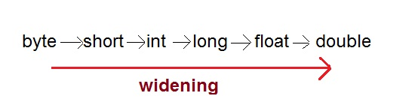
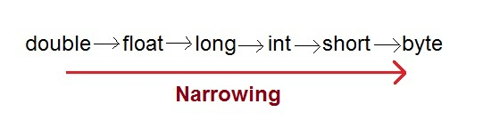
Widening Casting(Implicit)
Narrowing Casting(Explicitly done)

Slide 109
public class TestImplicit
{ public static void main(String[] args)
{
int i = 100;
long l = i; //no explicit type casting required
float f = l; //no explicit type casting required
System.out.println("Int value "+i);
System.out.println("Long value "+l);
System.out.println("Float value "+f);
}}
Output :
Int value 100
Long value 100
Float value 100.0

Slide 110
public class TestExplicit
{
public static void main(String[] args)
{
double d = 100.04;
long l = (long)d; //explicit type casting required
int i = (int)l; //explicit type casting required
System.out.println("Double value "+d);
System.out.println("Long value "+l);
System.out.println("Int value "+i);
} }
Output :
Double value 100.04
Long value 100
Int value 100

Slide 111
Shortcut Operators
++ increment by 1 -- decrement by 1
Example:
count++; // count = count + 1;
count--; // count = count - 1;
Postfix version (var++, var--): use value of var in expression, then increment or decrement.
Prefix version (++var, --var): increment or decrement var, then use value in expression

Slide 112
More Shortcut Operators
Operator | Example | Equivalent
+= | a += 3; | a = a + 3;
-= | a -= 10; | a = a - 10;
*= | a *= 4; | a = a * 4;
/= | a /= 7; | a = a / 7;
%= | a %= 10; | a = a % 10;

Slide 113
Examples bitwise operators
Operator | Example | Equivalent
&= | x&=y; | x=x&y;
|= | x|=y; | x=x|y;
^= | x^=y; | x=x^y;
>>= | x>>=y; | result=x>>y;

Slide 114
Common Error Trap
No spaces are allowed between the arithmetic operator and the equals sign
Note that the correct sequence is +=, not =+
Example: add 2 to a
// incorrect
a =+ 2; // a = +2; assigns 2 to a
// correct
a += 2; // a = a + 2;

Slide 115
Operator Precedence
Operator | Order of evaluation | Operation
( ) | left - right | parenthesis for explicit grouping
++ -- | right - left | preincrement, predecrement
++ -- | right - left | postincrement, postdecrement
* / % | left - right | multiplication, division, modulus
+ - | left - right | addition or String concatenation, subtraction
= += -= *= /= %= | right - left | assignment

Slide 116
Types of Java Statement
Control Statement
Assignment Statement
Control Statements
Conditional execution
Looping
Flow Control Statement
Types of Conditional Execution
  If Statement
  If – Else statement
  If- Else-if statement
  Switch Statement

Slide 117
If Statement
If statement in java encloses some code which is executed only if a condition is true.
If statement only takes a boolean expression as its condition.

Slide 118
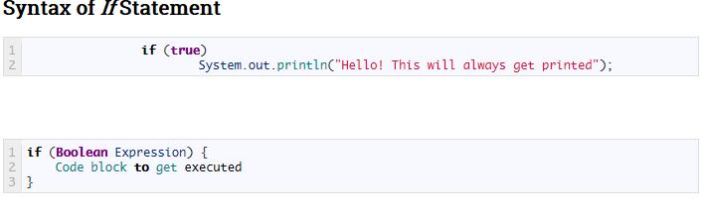

Slide 119
If Else Statement
If Else statement consists of one if condition and and one else part.
It encloses some code which is executed only if the if condition is true, if its false then the else part of the code will be executed.
If else statement takes boolean expression as its condition.
Note*: Unlike other languages, Java does not accept numbers as conditional operators.
It only considers boolean expressions as conditions which returns TRUE / FALSE.
E.g if(1==1) is accepted as it is boolean expression and will return true.
if(x=1) statement is not allowed in java.

Slide 120
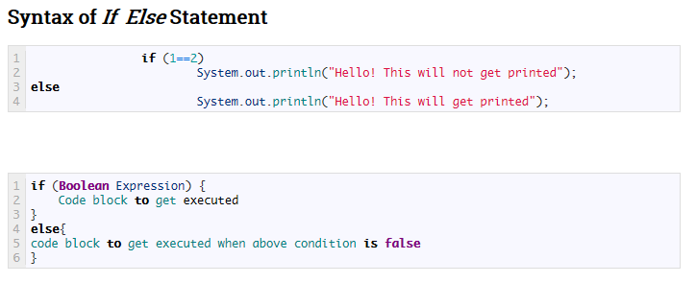

Slide 121
If Else If Statement
If Else If statement consists of multiple if conditions and and an else part.
If the if condition is true then the enclosed code will be executed.
But if the if condition is false then it will check for the next if condition.
If the next if condition is true then the enclosed code will be executed otherwise the else part of the code will be executed.
If Else If statements takes boolean expression as its condition .
Note*: Unlike other language Java doesn’t accept numbers as conditional Operator.
Only thing that can be accepted as condition is boolean expression which returns TRUE / FALSE.
E.g If(x=1) is not allowed while if(1==1) is accepted as it is boolean expression and will return true.

Slide 122
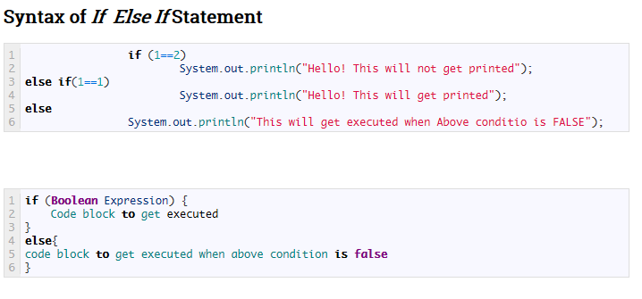

Slide 123
Types of Looping Statement
For Loop
While Loop
Do – While Loop
Types of Flow Control Statement
Return Statement
Continue Statement
Break Statement

Slide 124
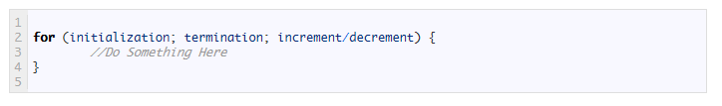
For Loop
For(for) loop is used when you want to iterate over a range of value.
Scenario : When you want to print a string for 4 times.
Syntax of for loop

Slide 125
initialization : used to initialize the loop. This part will be executed once only.
termination : This loop will continue unless this part has value false.
increment : This expression will be invoked after each iteration can be used to increment or decrements the value.

Slide 126

While loop statements in Java
WHILE statement is useful when you want to execute something till a particular condition is true.
Scenario of WHILE loop
Ask user to provide input and wait till user provide the input.
Syntax of WHILE loop

Slide 127
Here while statement will evaluate the expression and check if it is true or not.
If true then execute the statement within loop. Once completed execution in loop again check the expression.
Perform this activity unless value of expression is not TRUE.

Slide 128
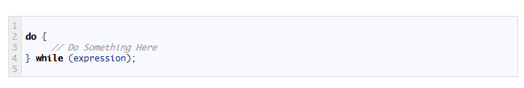
Do While loop in Java
Do – While loop is same as While loop except in this case loop is confirmed to execute once
Means in any case statements in Do-While block will execute atleast once.
Syntax of Do-While Loop

Slide 129
switch Statement
The switch statement is a multiway branch that makes a decision based on an integral (integer or character) expression.
The switch statement begins with the keyword switch followed by an integral expression in parentheses and called the controlling expression.

Slide 130
switch Statement
A list of cases follows, enclosed in braces.
Each case consists of the keyword case followed by
  a constant called the case label
  a colon
  a list of statements.
The list is searched for a case label matching the controlling expression.

Slide 131
switch Statement, cont.
The action associated with a matching case label is executed.
If no match is found, the case labeled default is executed.
  The default case is optional, but recommended, even if it simply prints a message.
Repeated case labels are not allowed.

Slide 132
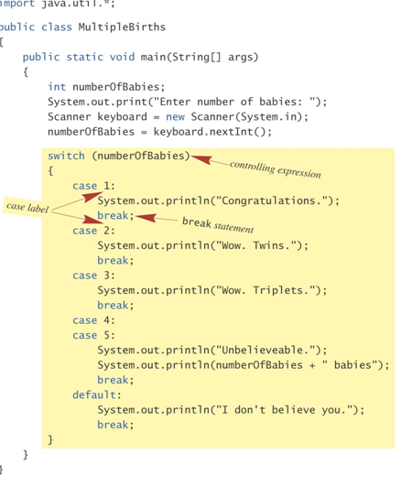
switch Statement

Slide 133
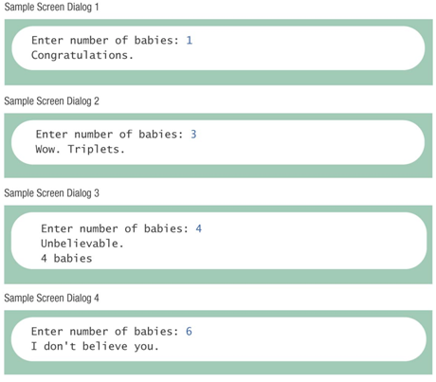

Slide 134
switch Statement, cont.
The action for each case typically ends with the word break.
The optional break statement prevents the consideration of other cases.
The controlling expression can be anything that evaluates to an integral type (integer or character).

Slide 135
The switch Statement, cont.
syntax
  switch (Controlling_Expression)
  {
  case Case_Label:
  Statement(s);
  break;
  case Case_Label:
  …
  default:
  …
  }

Slide 136
Switch with char Type
char grade = 'A';
switch(grade)
{
case 'A':
case 'B':
case 'C':
case 'D':
System.out.println("Pass");
break;
case 'W':
System.out.println("Withdraw");
break;
case 'I':
System.out.println("Incomplete");
break;
default:
System.out.println("Fail");
}

Slide 137
Conditional Operator
if (n1 > n2)
  max = n1;
  else
  max = n2;
  can be written as
  max = (n1 > n2) ? n1 : n2;
The ? and : together is called the conditional operator (a ternary operator).
Note (n1 > n2) ? n1 : n2 is an expression that has a value unlike the “normal” if statement

Slide 138
Conditional Operator
The conditional operator can be useful with print statements.
System.out.print(“You worked “ + hours + “ “ +
  ((hours > 1) ? “hours” : “hour”));

Slide 139
Types of Flow Control Statement
Return Statement
Continue Statement
Break Statement

Slide 140
When we consider a Java program it can be defined as a collection of objects that communicate via invoking each other's methods. Let us now briefly look into what do class, object, methods and instance variables mean.
Object - Objects have states and behaviors. Example: A dog has states - color, name, breed as well as behaviors -wagging, barking, eating. An object is an instance of a class.
Class - A class can be defined as a template/ blue print that describes the behaviors/states that object of its type support.
Methods - A method is basically a behavior. A class can contain many methods. It is in methods where the logics are written, data is manipulated and all the actions are executed.
Instance Variables - Each object has its unique set of instance variables. An object's state is created by the values assigned to these instance variables.

